Slide 1
NORA Interdisciplinary Seminar Series
Presents
“Fatal Incidents Among Landscaping and Tree Care Workers: Insights from NIOSH and State-based FACE Reports”
Greg Kearney, DrPH, MPH
March 7, 2024 | 12:00pm to 1:00pm ET
Notes:
[make sure to start recording and auto transcription]
Welcome to the NORA Interdisciplinary Seminar Series hosted by the North Carolina Occupational Safety and Health Education and Research Center, or NC OSHERC for short, and the Gillings School of Global Public Health.
[introduce yourself]. We are happy to have all of you here with us today for this presentation by Greg Kearney titled “Fatal Incidents Among Landscaping and Tree Care Workers: Insights from NIOSH and State-based FACE Reports.”
Before we start, I have a few opening comments:
The presentation slides, evaluation survey, and recording will be available on the NC OSHERC website. We will put the link to the website in the chat, and I suggest you bookmark it for future reference. https://sph.unc.edu/osherc/outreach-and-continuing-education/ Once they are uploaded, the slides, recording, and survey link for this presentation will be located about halfway down the webpage under “NORA seminar series.”
It is important to note that only those who are formally registered for each seminar will receive follow-up emails, which is why everyone needs to register for each seminar, even if you cannot attend on the day of. Please also bookmark the website link that we will put in the chat and check back on the website for updates.
Please be sure to complete the short evaluation survey that you will receive via email after the seminar ends. It should only take 30 seconds of your time. We will also post the evaluation survey link in the chat at the end of the seminar. We are interested in ways to improve the seminar series so please complete the survey. All NIOSH funded trainees are required to complete the evaluation survey for attendance credit. Importantly, we require that everyone who wishes to claim attendance credit for the seminar, including trainees and professional certification credits, must complete the survey within 2 weeks of the seminar to be awarded completion credit.

Slide 2
Providing High-quality Education and Research Training in Occupational Health and Safety Sciences to Protect and Promote Worker Health
Physical Location – University of North Carolina at Chapel Hill (UNC-CH), Gillings School of Global Public Health
3 Universities – UNC-CH, Duke University, North Carolina State University
NIOSH Funded Education and Research Center since 1976
Notes:
The mission of NC OSHERC is to provide High-quality Education and Research Training in Occupational Health and Safety Sciences to Protect and Promote Worker Health.
We are physically located at the University of North Carolina Gillings School of Global Public Health and are made up of various occupational safety and health academic programs at UNC Chapel Hill, Duke University, and North Carolina State University. We also provide a variety of continuing education courses and other services for occupational safety and health professionals.
NC OSHERC is a NIOSH-funded Education and Research Center since 1976.

Slide 3
If you need a certificate for CE or CM points:
WITHIN 2 WEEKS OF THE LIVE SEMINAR:
Submit a completed online evaluation and be sure to provide your full name (first and last) in the survey.
AND Email NCOSHERC@unc.edu to request a certificate.
A certificate of attendance will be emailed to you by a member of NC OSHERC staff.
See the ABIH website for the CM credit criteria.
http//www.abih.org
Notes:
If you need a certificate for CE or CM points, make sure you complete and submit the online evaluation within 2 weeks of the live seminar and provide your full name in the survey. Then email us at NCOSHERC@unc.edu to request a certificate and a member of the NC OSHERC staff will email your certificate to you. Certificates are not automatically provided after you submit the survey, so it is very important that you also email us after completing the survey to specifically request a certificate. After the 2 week window, you will no longer be eligible for completion credit.
ABIH = American Board for Industrial Hygiene

Slide 4
Contact Information
Mailing Address:
NC OSHERC
University of North Carolina at Chapel Hill
1700 Martin Luther King Jr., Blvd., CB #7502
Chapel Hill, NC 27599-7502
Questions:
NCOSHERC@unc.edu
919-843-9612
Notes:
Please note our contact information for your future reference.

Slide 5
Stay tuned for the 2nd Spring 2024 NORA Seminar!​​
Spring 2024
TBD
TBD
Zoom
Notes:
We are currently confirming the details of the second Spring 2024 NORA seminar. We will advertise the information and registration link as soon as we have confirmed everything with the speaker.

Slide 6
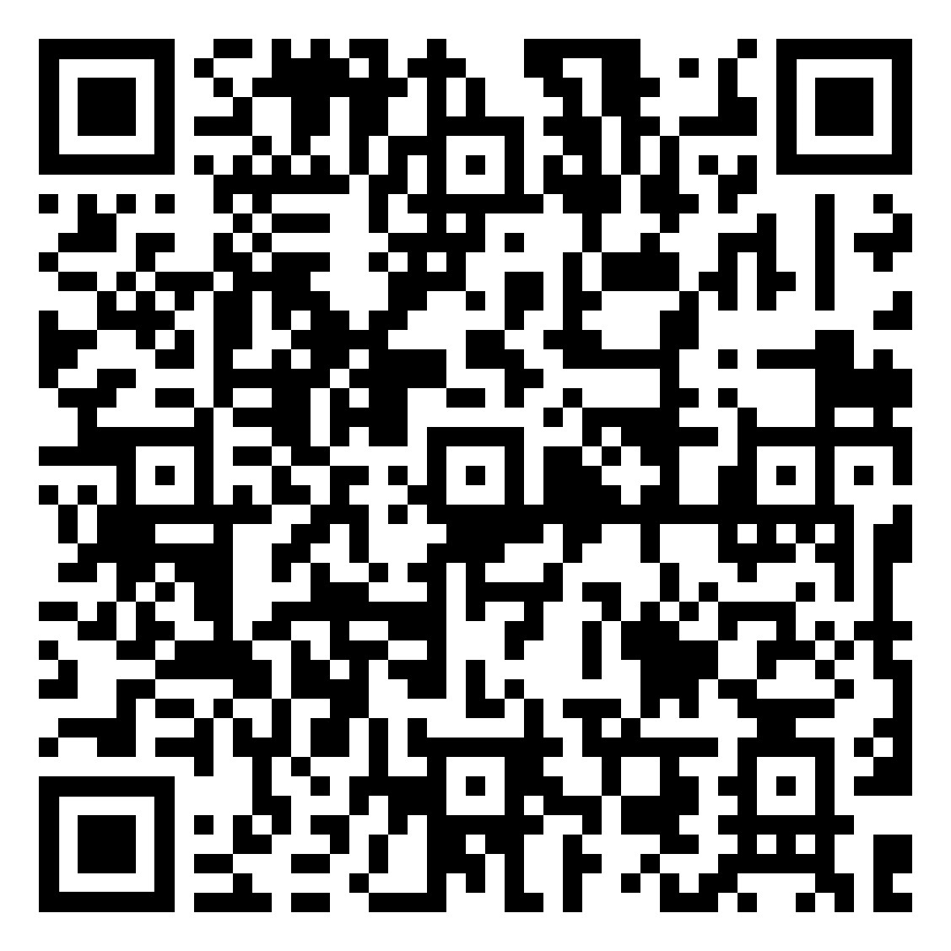
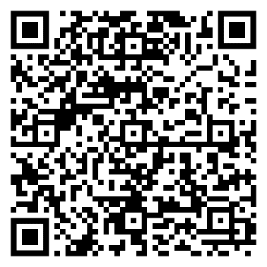
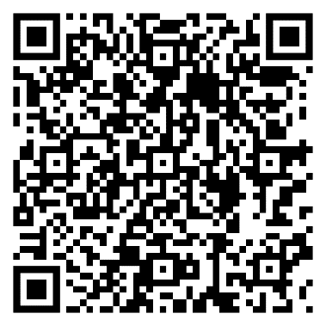
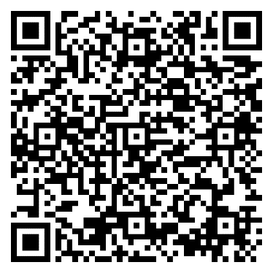
Upcoming 2024 Spring Institute CE Courses
100% In-person in Chapel Hill
Anyone can register!
May 13-15, 2024 May 15-17, 2024
Respiratory Protection Fundamentals
Biosafety
Industrial Hygiene Sampling
Industrial Toxicology
Notes:
We have our 2024 Spring Institute coming up, May 13-17 in Chapel Hill! We will be offering 4 continuing education courses as part of the Institute. All courses will be 100% in-person at the Rizzo Center, and all are open to everyone from anywhere. Attendees can take up to 2 courses if they take one course from the left box and one course from the right box. Our NIOSH trainees are eligible for free registration. You can scan the QR codes here to learn more about them and to register. The registration links can also be found on our website that we shared in the chat as well. Please feel free to reach out to us if you have any questions about our courses.

Slide 7
To learn more about NC OSHERC
Email us!
Connect with us!
https://www.linkedin.com/company/nc-osherc
https://www.facebook.com/NCOSHERC/
https://twitter.com/ncosherc
johnstaley@unc.edu
or
Emily.McAden@unc.edu
Check out our website!
https://go.unc.edu/NCOSHERC
Notes:
For more information about NC OSHERC, you can go to our website at go.unc.edu/NCOSHERC or connect with us on LinkedIn, Facebook, or Twitter. You can also email either the NC OSHERC deputy director John Staley at johnstaley@unc.edu or the Outreach and CE Program Manager Emily McAden at Emily.McAden@unc.edu.
If you have questions or comments, please type them in the chat or raise your hand.
With that, I’d like to welcome Dr. Greg Kearney. Dr. Kearney is a full professor and founding director of the Doctor of Public Health Environmental and Occupational Health Program within the Department of Public Health at the Brody School of Medicine, East Carolina University. Dr. Kearney earned his DrPH in Environmental Health Sciences from the University of Alabama at Birmingham and holds a Master of Public Health from the University of South Florida.
Dr. Kearney's public health expertise has been honed through significant roles, including more than two decades tenure with the State of Florida Department of Health and subsequently with the Centers for Disease Control and Prevention, National Center for Environmental Health in Atlanta. In 2011, Dr. Kearney returned to his roots in eastern North Carolina, where he engages in teaching and occupational health research at ECU, and serves as an active member on the NIOSH, NORA Services Sector Council.
During this seminar, Dr. Kearney will present “Fatal Incidents Among Landscaping and Tree Care Workers: Insights from NIOSH and State-based FACE Reports.” I’ll turn it over to you at this point to introduce yourself and get started!

