Slide 1
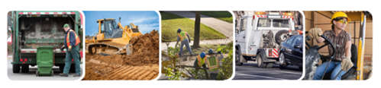
NC Occupational Safety and Health Education and Research Center
Fatal Incidents Among Landscaping and Tree Care Workers:
Insights from NIOSH and State-based FACE Reports
Presenter:
Greg Kearney, DrPH, MPH
Professor and Director
DrPH, Environmental and Occupational Health Program
Brody School of Medicine, Department of Public Health
East Carolina University
March 7, 2024

Slide 2


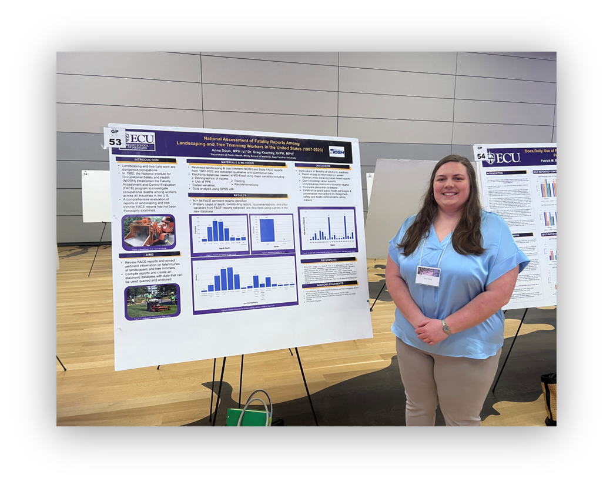
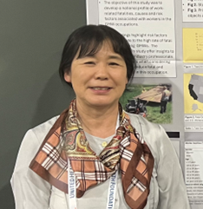
Acknowledgments
Lauren Menger-Ogle, PhD
NIOSH/CDC - Division of Science Integration
Nancy Romano, MS, CSHM
NIOSH/CDC - FACE Program, Director
Satomi Imai, PhD
ECU/BSOM, Department of Public Health
Anna Doub, MPH (c)
ECU/BSOM, Department of Public Health

Slide 3
Objective:
AVOID
TEGO Syndrome
Their Eyes Glaze Over

Slide 4
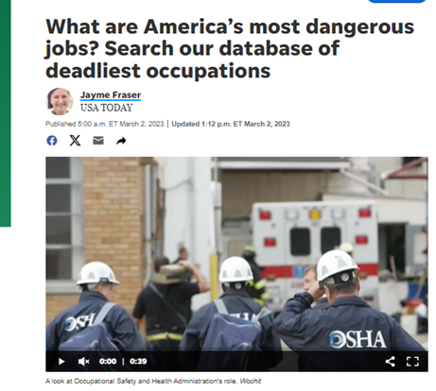
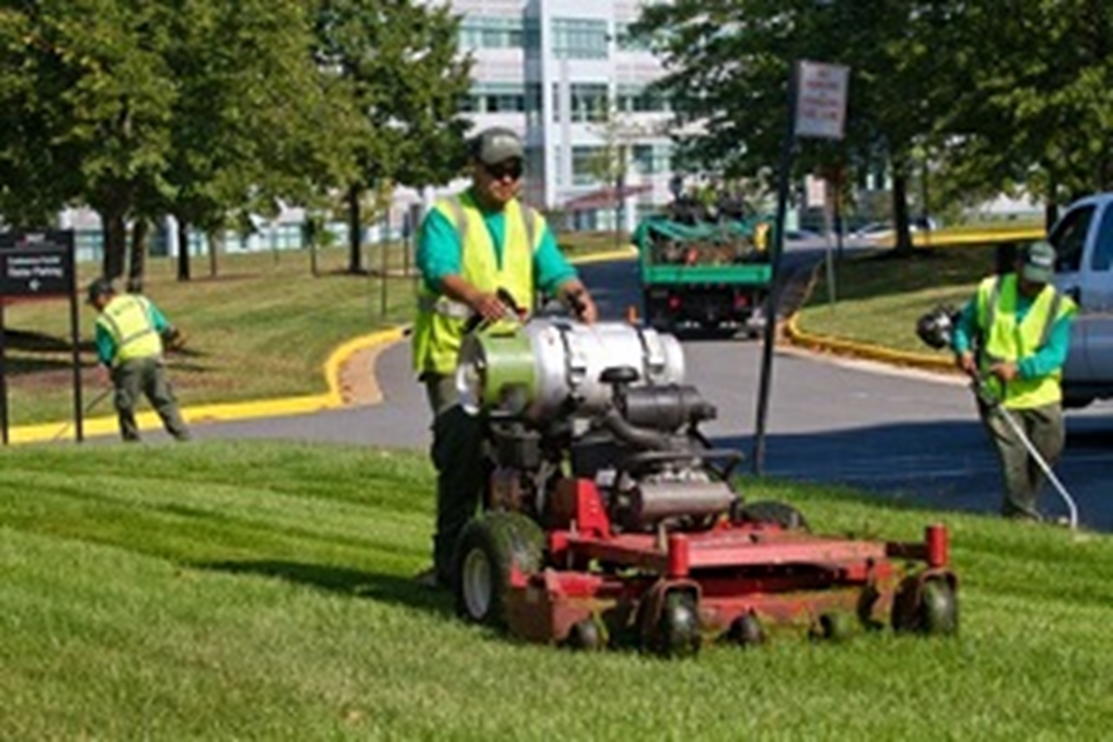
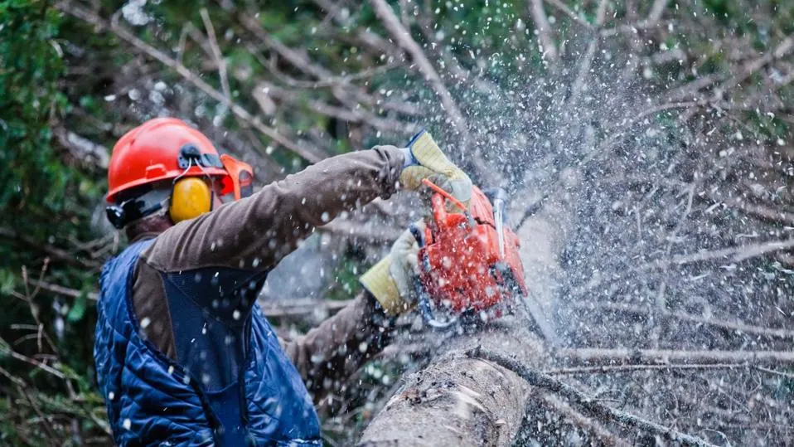
“Most Dangerous Jobs in America”
#10 Grounds maintenance workers
Fatal injury rate: 17.4 per 100k
Fatal injuries per year: 217
Common causes of fatal injury: Transportation incidents
Mean annual salary: $30,330
5 times more likely to have a fatal injury than the average worker
https://www.princegeorgecountyva.gov/news_detail_T6_R1402.php
Notes:
Among the lowest wages on this list are those of grounds maintenance workers, who, despite their low pay, are actually five times more likely to experience a fatal injury than the average worker. Groundskeepers and similar workers often work with heavy industrial machinery and are responsible for wide swaths of land. Transportation to and from various locations is the cause of the greatest number of these workers’ deaths on the job.

Slide 5
Quiz
Which of the occupations listed below would you consider to be “grounds maintenance”?
Landscaping
Tree trimming and pruning
Pesticide handlers, sprayers, applicators
All the above
None of the above

Slide 6

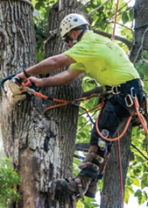

Grounds maintenance workers install and maintain landscapes, prune trees or shrubs, and do other tasks to ensure that vegetation is attractive, orderly, and safe.
- BLS, 2021
Standard Occupation Classification (SOC)
  Building and Grounds Cleaning and Maintenance Occupations (37-0000)
  Grounds Maintenance Workers (37-3010)
    Landscaping and Groundskeeping Workers (37-3011)
    Pesticide handlers (37-3012)
    Tree Trimmers and Pruners (37-3013)
    Grounds Maintenance Workers, All Other (37-3019)
Why is the SOC important?
  Classifying ensures consistent and accurate information on employment, wage and projections characteristics.
  Researcher – SOC categories can be evaluated for injury, illnesses and fatalities – BLS, Census of Fatal Occupational Injuries (CFOI)
Bureau of Labor Statistics, U.S. Department of Labor, Occupational Outlook Handbook, Grounds Maintenance Workers,
at https://www.bls.gov/ooh/building-and-grounds-cleaning/grounds-maintenance-workers.htm (visited September 07, 2023
Notes:
The North American Industry Classification System is used to classify industries and the 2000 Standard Occupational Classification (SOC) system is used to classify occupations.
These classifications are designed to reflect the current occupational composition in the U.S. and help inform the federal government where there are employment gaps, trends, wage information.
From a research standpoint

Slide 7

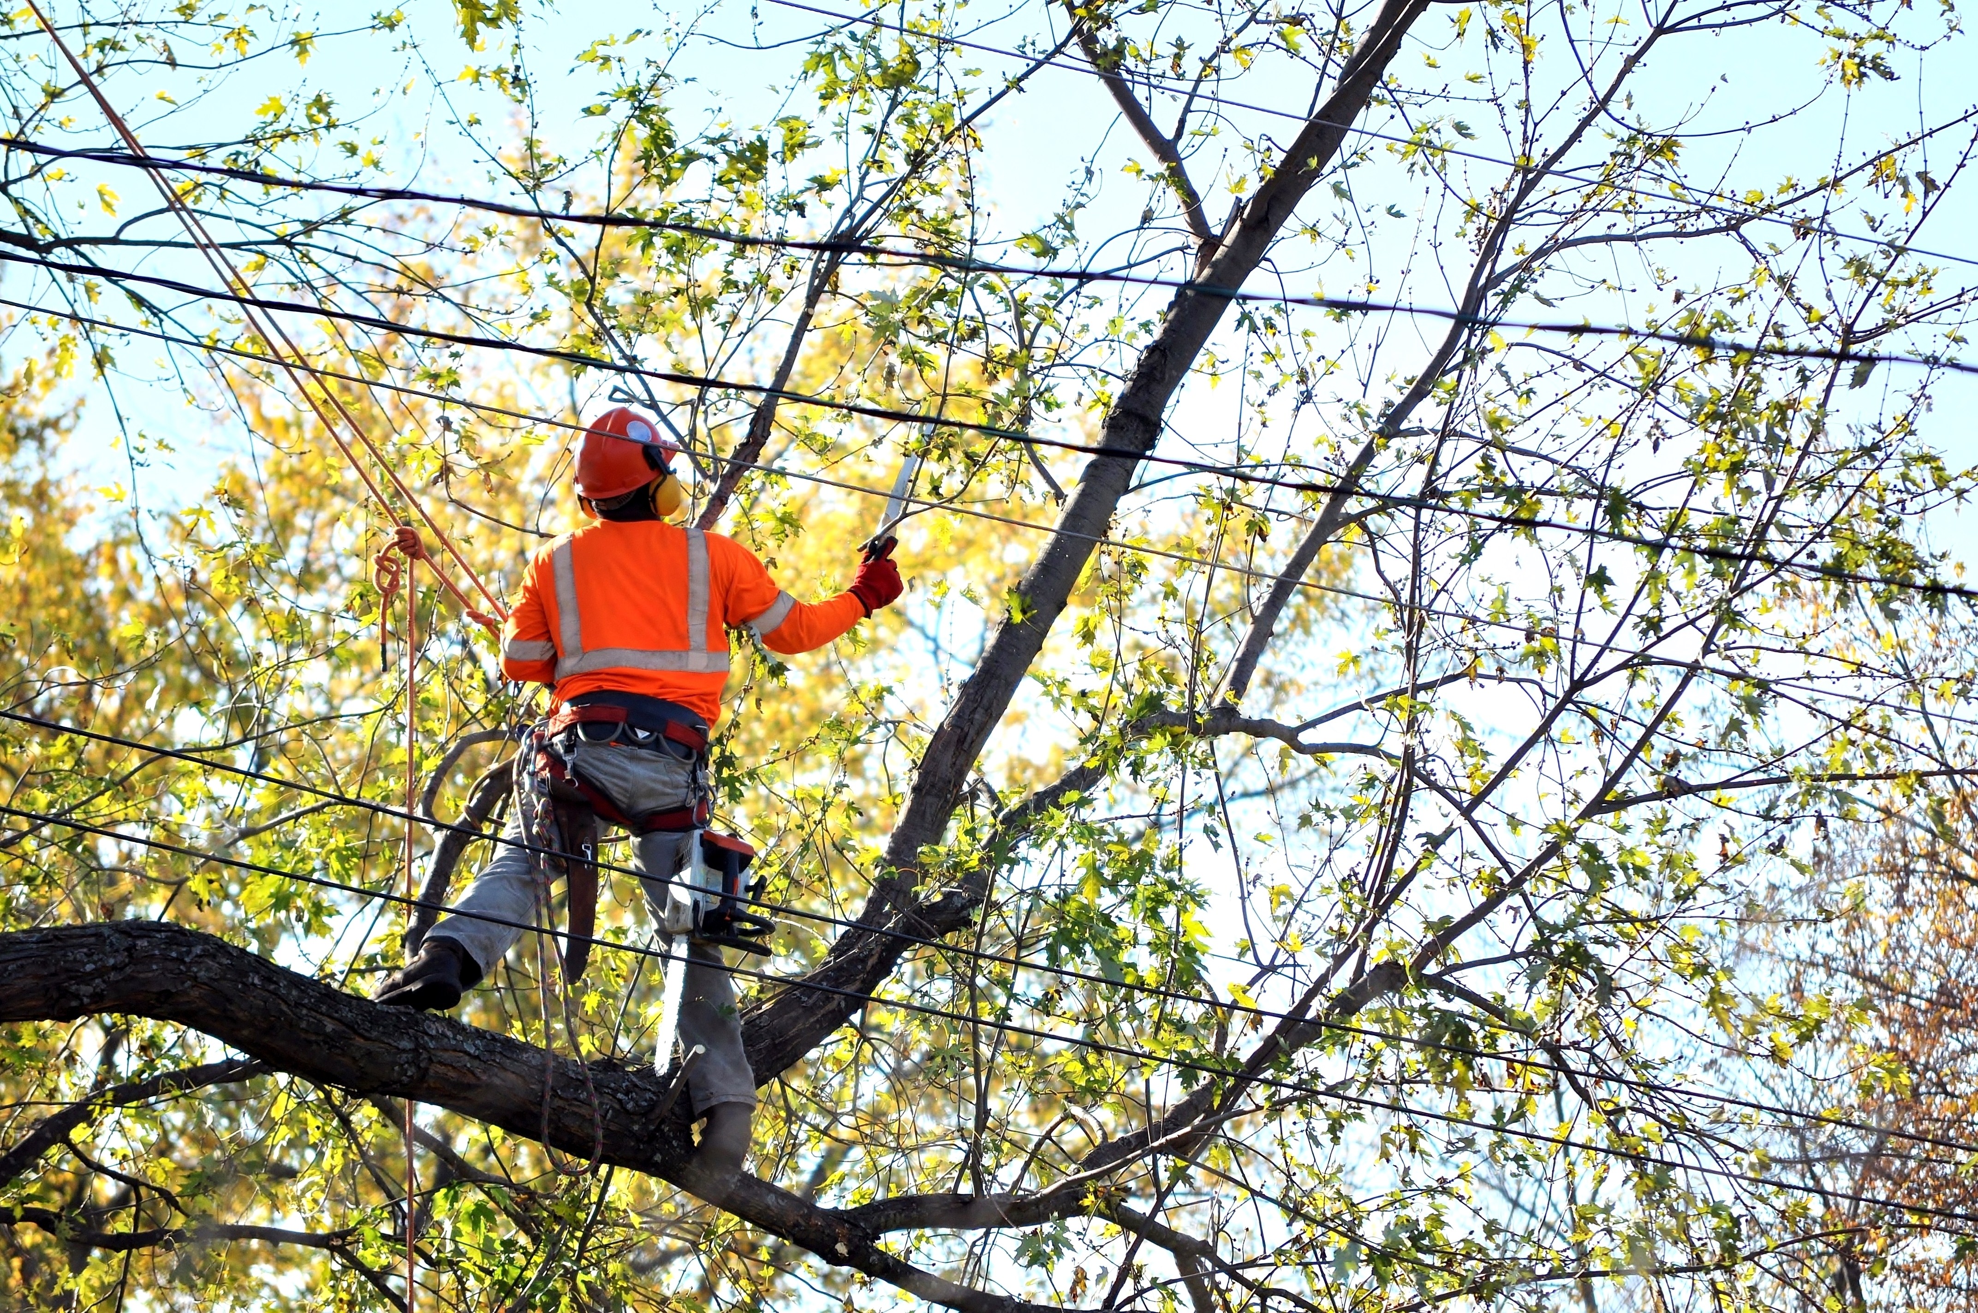
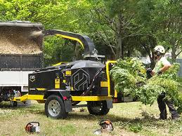
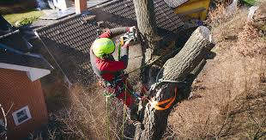
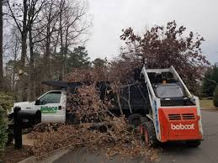
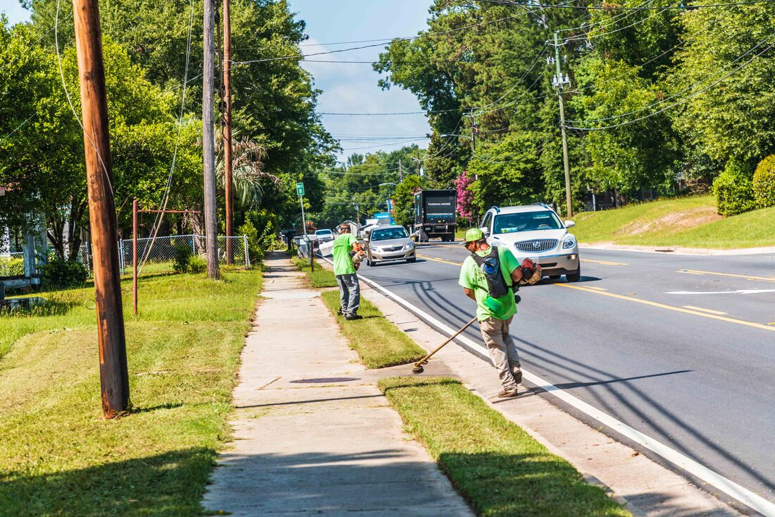
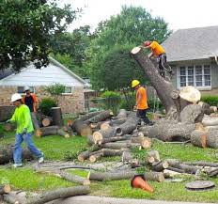
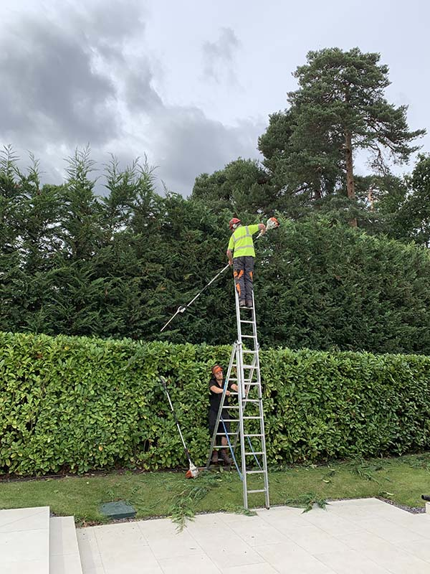
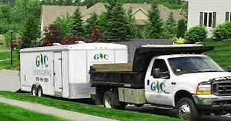
Dangerous and Often Blurred

Slide 8
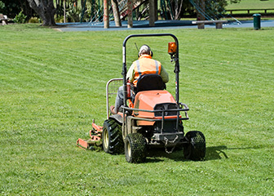
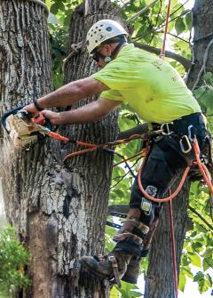
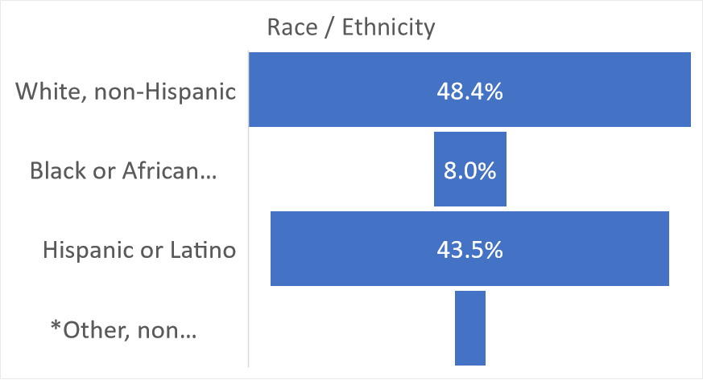
Workforce Demographics - U.S.
Landscaping and groundskeeping workers | 1,176,100
Tree trimmers and pruners | 66,000
Pesticide handlers, sprayers, applicators, vegetation | 23,200
Grounds maintenance workers, all other | 16,300
Bureau of Labor Statistics, U.S. Department of Labor, Occupational Outlook Handbook, Grounds Maintenance Workers, at https://www.bls.gov/ooh/building-and-grounds-cleaning/grounds-maintenance-workers.htm (visited September 07, 2023).
US Census Bureau / BLS, Current Population Survey, 2021 – Includes only occupations listed above, SOC 37-3010
Notes:
According to the BLS, in 2021 approximately 1.3 million GMWs, however that number is highly likely to be under represented because it only takes into account FTE, so in these numbers do include seasonal, temporary, part-time workers, or day laborers.

Slide 9

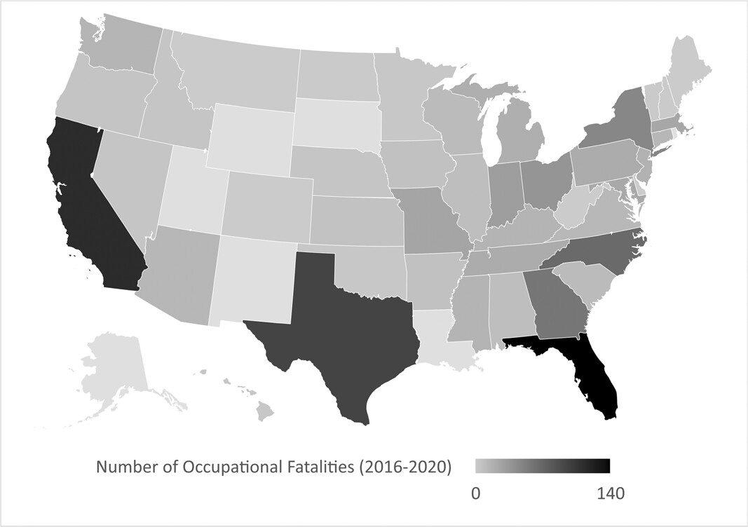
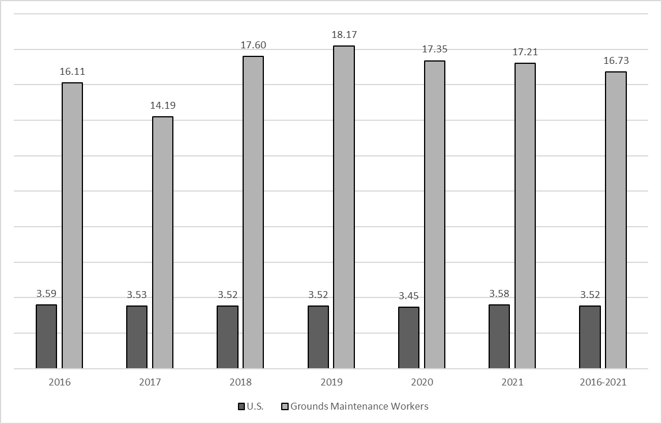
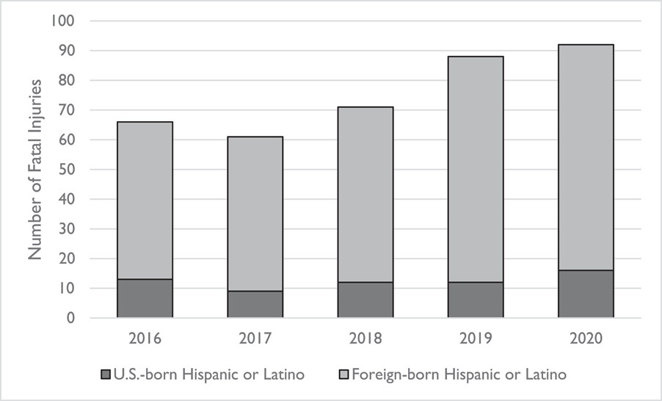
Kearney GD, Imai S. Occupational fatalities among Grounds Maintenance Workers in the United States (2016-2020).
Am J Ind Med. 2023 Jun 11.
Figure 1. Number of Fatal Occupational Injuries Among Grounds Maintenance Workers, by State, U.S. (2016-2020)ª
Figure 2. Fatal Occupational Injury Rate Among Grounds Maintenance Workers and U.S. Workers, U.S. (2016-2020)ª
Figure 3. Number of Fatal Occupational Injuries Among U.S. and Foreign-born Grounds Maintenance Workers of Hispanic or Latino Ethnicity, U.S. (2016-2020)^{a,b}
ª Source: BLS, Census of Fatal Occupational Injuries. ª Persons identified as Hispanic or Latino may be of any race. Cases reported with unknown ethnicity were included in counts of non-Hispanic workers

Slide 10


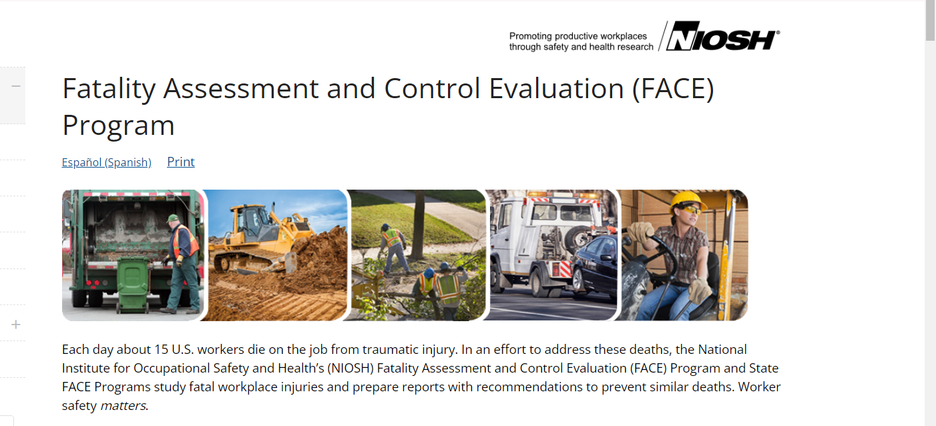
NIOSH and FACE Program
OSHA Act of 1970
CDC / NIOSH
  Practice-based research
NIOSH FACE Program (est. 1982)
Goal: Prevention of occupational fatalities
Investigate selected fatalities
Identify hazards
Develop prevention recommendations
Share with employers, industry, workers
In 1989, State-based FACE Programs began, using the NIOSH FACE Program model
https://www.cdc.gov/niosh/face/
Notes:
The OSH Act was signed by President Richard Nixon on December 29, 1970. In addition to creating OSHA, the act established the independent Occupational Safety and Health Review Commission to review enforcement priorities, actions and cases and the National Institute for Occupational Safety and Health (NIOSH), an independent research institute.
NIOSH FACE began in 1982

Slide 11
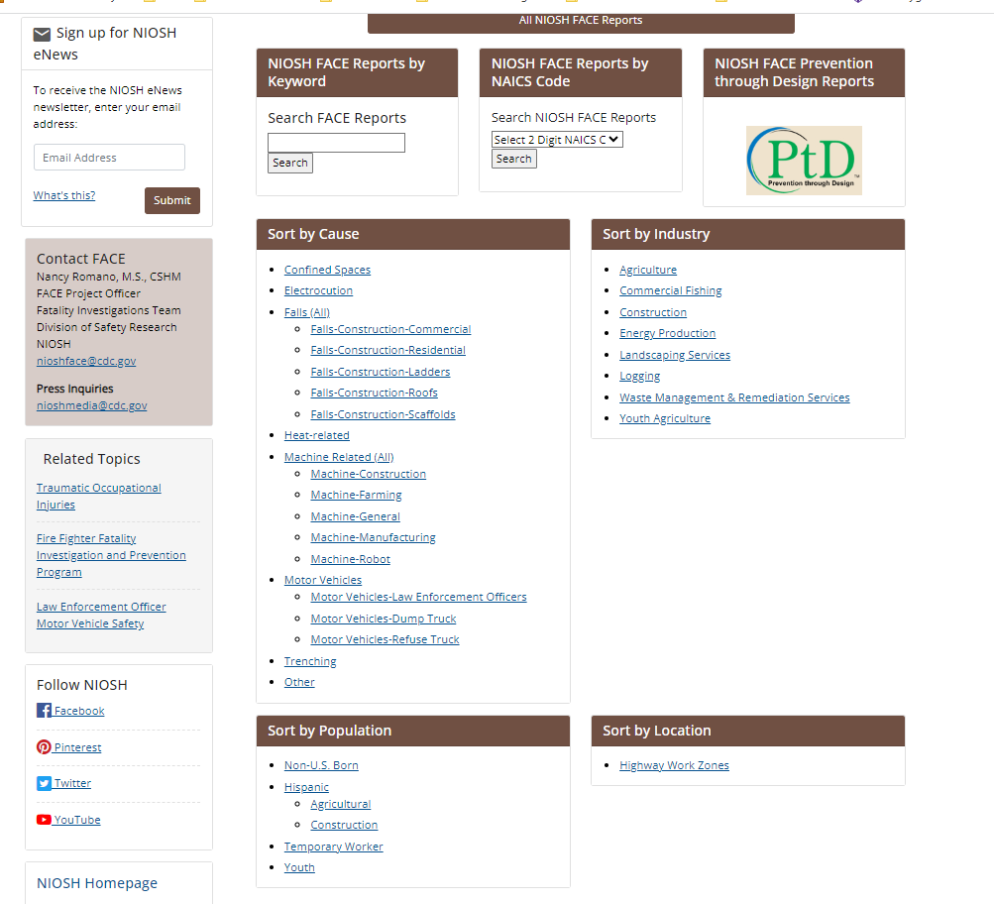
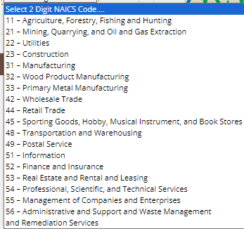
https://www.cdc.gov/niosh/face/

Slide 12
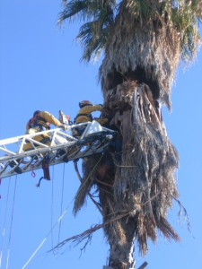
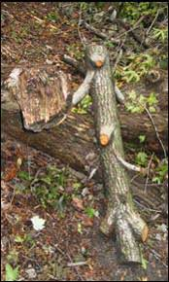
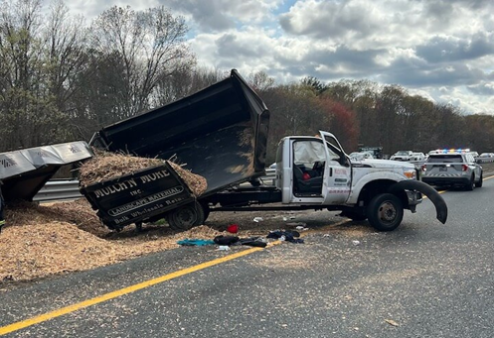
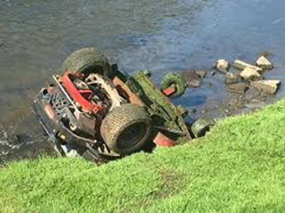
Event or Exposure Categories*
Transportation Incidents
Falls, Slips and Trips
Exposure to Harmful Substances or Environments
Contact with Objects and Equipment
Groundman Killed by Falling Tree Section at Tree Removal Operation
*Occupational Injury and Illness Classification System
(includes only categories associated with fatal injuries identified from FACE reports)

Slide 13
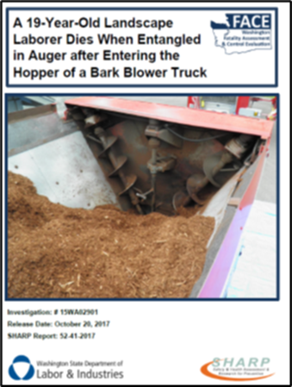
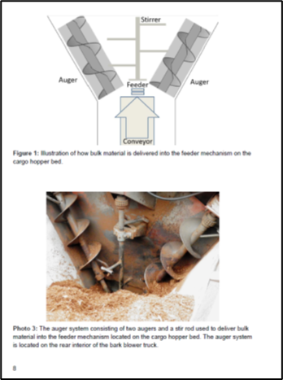
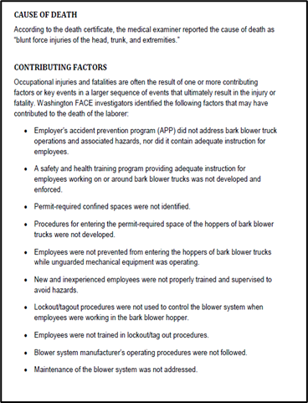
FACE REPORTS: CONTENT
Descriptive Title
Photos and Diagram
Cause of Death and Contributing Factors
Safety and Prevention Recommendations

Slide 14
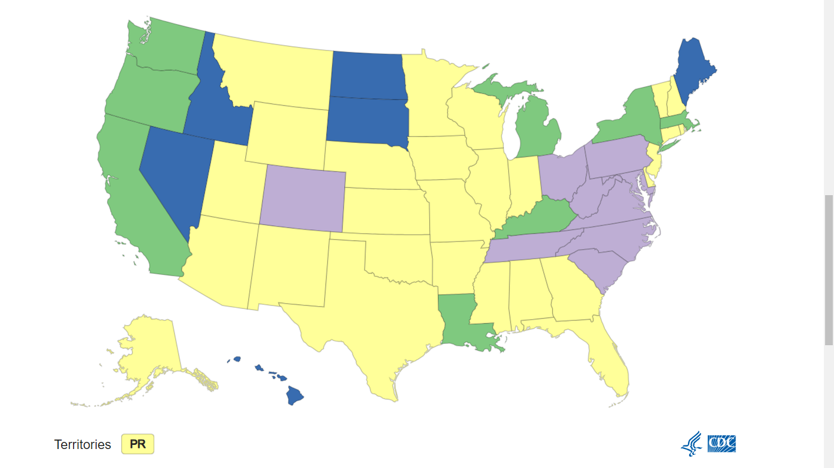
How are FACE Investigations Conducted?
Step 1: Investigators evaluate the location where the death occurred to examine the worksite and collect facts about what happened before, during, and after the incident.
Step 2: Investigators talk with company officials, witnesses, and workers to learn about the work environment and victim.
Step 3: The investigators analyze the collected information, then prepare a report. Reports are anonymous and do not name the workers, witnesses, or others involved in the incident.
Step 4: The report is given to the company where the victim was employed and posted to the NIOSH website so others can use it for prevention strategies, training, and education purposes.
Fig. FACE Investigations have been conducted across 46 States including Commonwealth of Puerto Rico
Notes:
ACE investigators are safety professionals, engineers, or industrial hygienists with training and experience in identifying workplace hazards and developing recommendations to reduce the risk of injury and death. FACE investigators do not enforce compliance with State or Federal job safety and health standards, nor do they place blame or determine the fault for a workplace fatality. Investigators will not ask family members for an interview as part of their investigation but will share information and findings upon request. They will not include names of employers, victims, and/or witnesses in written investigative reports or in the FACE database.

Slide 15
GOAL and OBJECTIVES
Goal:
To gain insight and increase understanding of events, contributing factors and circumstances involving worker fatalities in the landscaping services industry
Objectives:
To review 93 FACE case reports involving landscaping and tree care investigations
Transform qualitative information from FACE reports into quantified data for analysis
Develop a descriptive summary of findings hazards and conditions associated with fatal incidents

Slide 16
METHODS
Case study Approach:
NIOSH and State-based FACE Program reports (n=93)
Framework (database):
  The Construction FACE Database - Codifying the NIOSH FACE Reports*
Selected Variables:
  Decedent Demographic and Employer Characteristics; Safety Recommendations
Occ Injury and Illness Classification System (OIICS, v. 2.01):
Nature (physical characteristic of injury/illness)
Part of Body (directly affected)
Source of Injury (object, substance, bodily motion)
Event/Exposure (manner occurred)
Analysis
  Excel and SPSS v28 for coding and descriptive analysis
  NVivo for Content Analysis – primary themes for safety recommendations
(Dong et., al, 2017)
*The Center for Construction Research and Training (CPWR); https://www.cpwr.com/research/data-center/construction-face-database/
Dong et al., Codifying the NIOSH FACE Reports,
Notes:
Nature: he nature of injury or illness identifies the principal physical characteristic(s) of the work-related injury or illness.Name the injury or illness indicated on the source document. Example: for strained back, choose Sprains, strains, tears.
Part of Body: The part of body affected identifies the part of the body directly affected by the previously identified nature of injury or illness. Head, Neck, Trunk

Slide 17
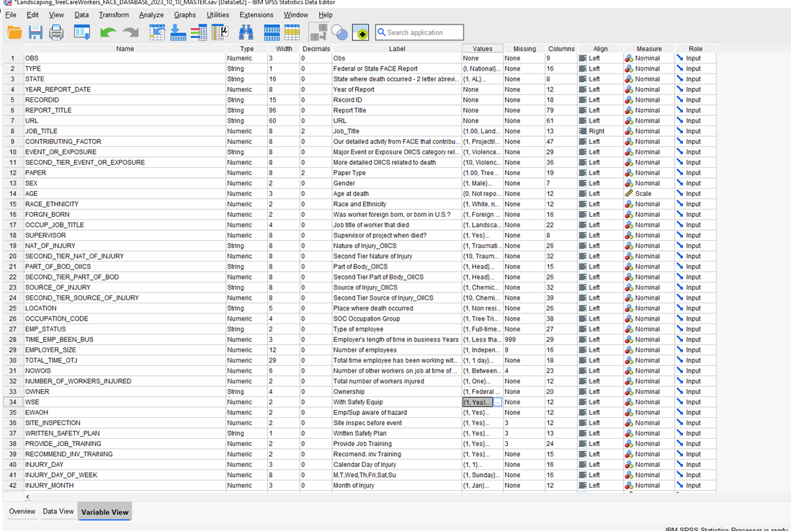

METHODS
Database Schema

Slide 18
RESULTS
NIOSH and State FACE Reports Involving Landscaping Service Worker Fatalities, by Year
NIOSH = 14
State = 79
*Please note that these are abbreviated preliminary findings, and should not be distributed
1987-2023 (n=93)

Slide 19
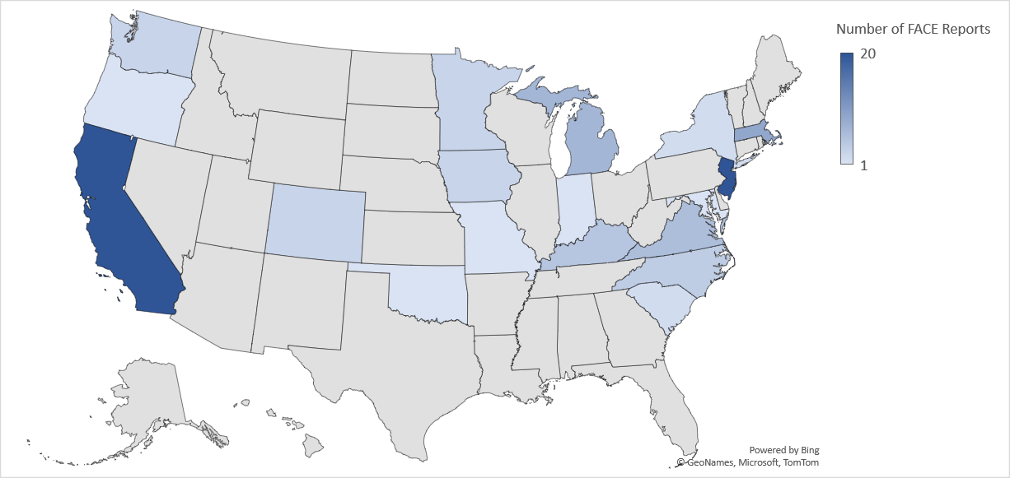
RESULTS
NIOSH and State FACE Reports, Landscaping Service Worker Fatalities, by State
Number of NIOSH and State-Based FACE Reports | No. of FACE Reports
California | 20
New Jersey | 20
Massachusetts | 9
Michigan | 7
Virginia | 6
Kentucky | 5
North Carolina | 4
Colorado | 3
Iowa | 3
Minnesota | 3
Washington | 3
New York | 2
South Carolina | 2
Indiana | 1
Maryland | 1
Missouri | 1
Oklahoma | 1
Oregon | 1
*Puerto Rico | 1
21
21
1987-2023 (n=93)

Slide 20
RESULTS
NIOSH and State FACE Reports, Report/Data Completeness
*Please note that these are abbreviated preliminary findings, and should not be distributed
1987-2023 (n=93)

Slide 21
RESULTS
FACE Reports: Decedent’s Demographic, Work and Employer Characteristics
Decedent
Employer
Mean Age = 35 years
  Youngest - 16
  Oldest - 73
  Almost half between 35-54 years
Male – 98%
Hispanic or Latino - 31%
Foreign-born - 25%
Job Classification
  Tree Care – 61%
  Landscaping - 33%
  Other – 6%
  Working fulltime – 60%
Private Ownership – 98%
Employer Size –
  Between 2-9 workers - 29%
Length of Time in Business
  Less than 1 year – 4%
  More than 10 years – 44%
Written Safety Plan (yes) – 41%
Provided Job Training (yes) – 56%
Employer Aware of Hazard (yes) – 50%
*Please note that these are abbreviated preliminary findings, and should not be distributed
Notes:
From those Reports reporting

Slide 22
RESULTS
Major Event or Exposure Category
*Please note that these are abbreviated preliminary findings, and should not be distributed
Notes:
Fatal Incident categories from our interpretation of OIICS – Nancy is working with NIOSH folks in her shop to confirm some our OIICS interpretation

Slide 23
RESULTS
Source of Fatal Injury
*Please note that these are abbreviated preliminary findings, and should not be distributed
FACE Reports (1987-2023)
Notes:
This is plain language pulled out of reports (not necessarily OIICS coding, but pretty close)

Slide 24
RESULTS
FACE Reports: Fatal Incidents and Job Tenure with Employer
Note: Cumulative percent; 28 or 30.1% of reports did not specify time spent on job with employer.
*Please note that these are abbreviated preliminary findings, and should not be distributed
(1987-2023)

Slide 25
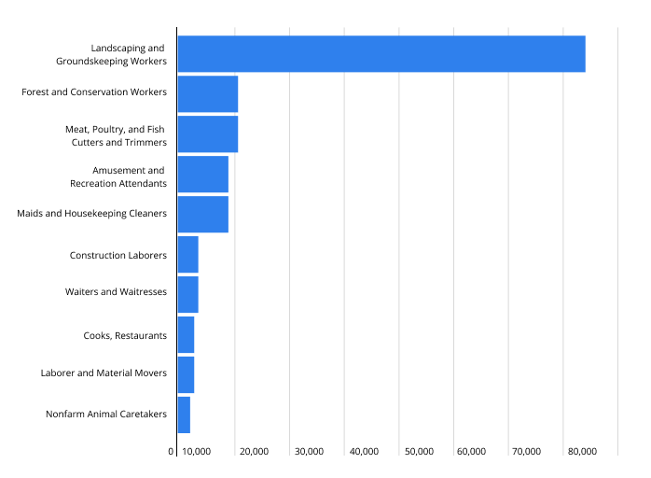
Discussion
Web of Interrelated Factors
Workers - New, Hispanic or Latino
Job Tenure < 1 year
Small business < employees
Written plans and training
Top 10 Occupations - H-2B Temporary Non-Ag Program FY 2020
Intervention Strategies
Recognizing differences between occupations
Focus on new and diverse workers
Assisting small businesses with safety resources and training
Safety certification for both occupations
Source: U.S. Department of Labor
Note: H2A Temp Ag Workers in FY 2020 was estimated at 275,000

Slide 26

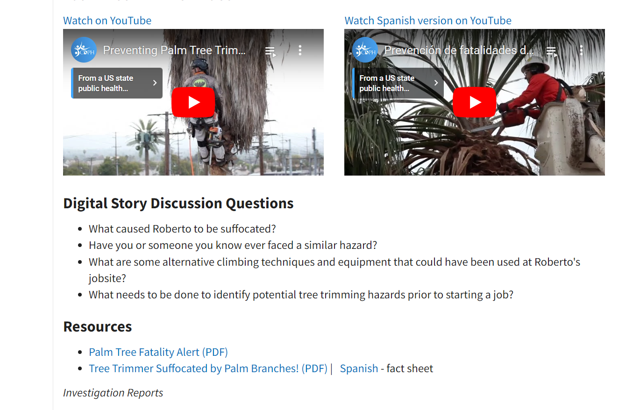
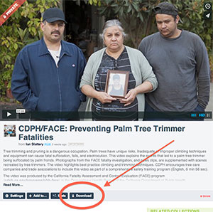
Intervention Strategies:
California FACE Program
Tree Trimmer Fatalities by Palm Fronds
Fact Sheets
Industry Alerts
Digital Stories
Download Palm Video
Download Spanish Palm Video
California FACE Program Contact: Bob Harrison, MD
https://www.cdph.ca.gov/Programs/CCDPHP/DEODC/OHB/FACE/Pages/PalmAction.aspx
Notes:
Shout out to Bob Harrison and CA FACE Program – good example of increasing awareness to creating ongoing prevention campaigns and supplemental trainings
Digital stories are best used as educational triggers that can kick off a worker training session and facilitate discussion. See below for video discussion questions, fact sheets, the corresponding FACE investigation report (12CA011), and video download instructions.

Slide 27
References
USA Today, What are America’s most dangerous jobs? Jayme Fraser, March 2, 2023. https://www.usatoday.com/story/money/2023/03/02/most-dangerous-jobs-america-database/11264064002/
Harrison, B (2012). A tree trimmer dies from asphyxia when compressed by palm fronds. California FACE Program. Retrieved March 12, 2023. https://blogs.cdc.gov/niosh-science-blog/2015/08/24/tree-trimming/
Eggerth DE, Keller BM, Cunningham TR, Flynn MA. Evaluation of toolbox safety training in construction: The impact of narratives. Am J Ind Med. 2018;61(12):997-1004. doi:10.1002/ajim.22919
Dong XS, Largay JA, Wang X, Cain CT, Romano N. The construction FACE database - Codifying the NIOSH FACE reports. J Safety Res. 2017;62:217-225. doi:10.1016/j.jsr.2017.06.017
Kearney GD, Imai S. Occupational fatalities among grounds maintenance workers in the United States (2016-2020). Am J Ind Med. 2023 Jun 11. doi: 10.1002/ajim.23507. Epub ahead of print. PMID: 37302115.
Kearney GD, Balanay JA, Mannarino AJ. Safety behavior and work safety climate among landscaping and groundskeeping workers in North Carolina: A pilot study. Work. 2017;56(1):45-53. doi: 10.3233/WOR-162475. PMID: 28128785.
Kearney GD, Balanay J, Mannarino A. Effectiveness of a Multifaceted Occupational Noise and Hearing Loss Intervention Among Landscaping and Groundskeeping Workers. National Journal of Environmental Health. 2017. 80. 8-15.
Balanay JA, Kearney GD, Mannarino AJ. Noise exposure assessment among groundskeepers in a university setting: A pilot study. J Occup Environ Hyg. 2016;13(3):193-202. doi: 10.1080/15459624.2015.1091967. PMID: 26554597.
Balanay JA, Kearney GD, Mannarino AJ. Assessment of Occupational Noise Exposure among Groundskeepers in North Carolina Public Universities. Environ Health Insights. 2016 Jun 13;10:83-92. doi: 10.4137/EHI.S39682. PMID: 27330303; PMCID: PMC4909058.
Kearney GD, Xu X, Hight A, Arcury TA. Case study. Behavior and perception of using safety gear among commercial landscapers: a pilot study. J Occup Environ Hyg. 2013;10(7):D79-85. doi: 10.1080/15459624.2013.794381. PMID: 23706148

Slide 28
Quiz
Which response below best describes your experience during this presentation?
I did not experience TEGO during this presentation
I did experience TEGO during this presentation
None of the above
What is TEGO, again?

Slide 29
Thank you for your attention!
Questions?

Slide 30
Contact Information
Greg Kearney, DrPH, MPH
Professor and Program Director
Environmental and Occupational Health Program
Brody School of Medicine, Department of Public Health
East Carolina University
KearneyG@ecu.edu
(252) 744-4039

