Slide 1
Racist Epidemiology and Abolitional Possibility: The case of aluminum worker health
April 8, 2022
Libby McClure

Slide 2
Overview
About me
Definitions
Aluminum worker case study
Quantitative aim 1
Quantitative aim 2
Critical assessment of epidemiology
Abolitional possibility

Slide 3
My research background
Environmental justice
Occupational epidemiology
Applied public health

Slide 4
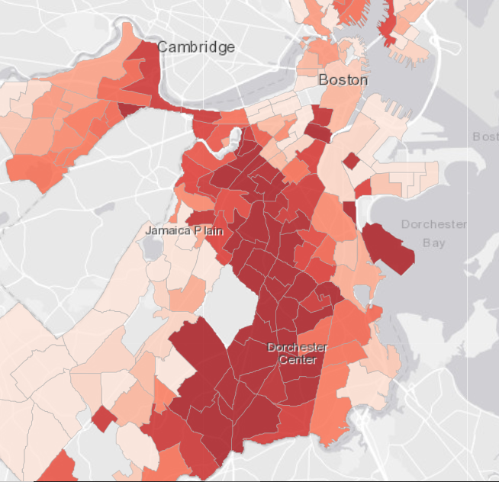
My research background
Environmental justice

Slide 5
My research background
Applied public health

Slide 6
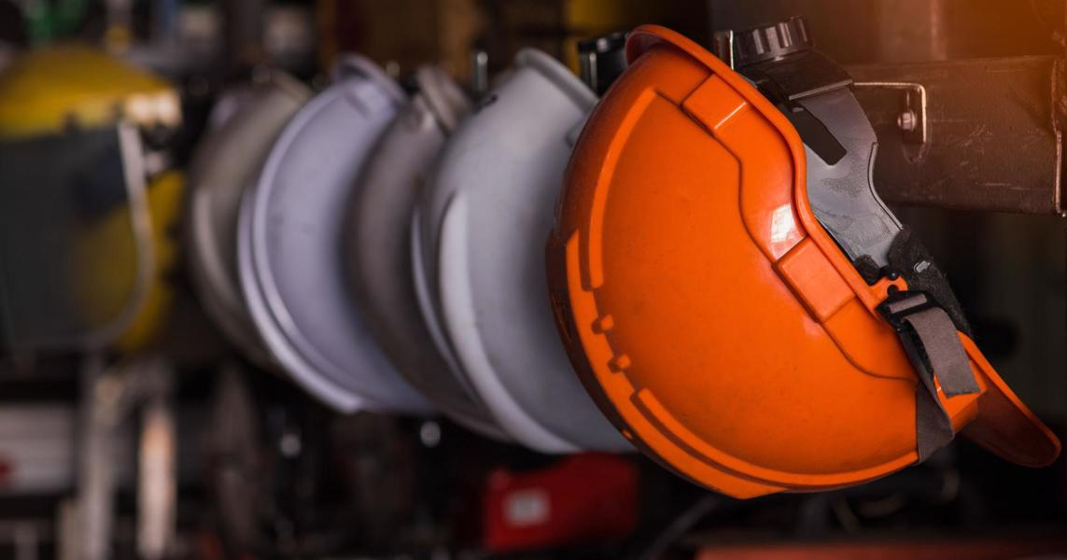
My research background
Occupational epidemiology

Slide 7
My research background
Environmental justice
Occupational epidemiology
Applied public health

Slide 8
Definitions

Slide 9
Epidemiology’s origins
Industrial & political revolutions
Interdisciplinary – awareness of political economies
Focused on equity

Slide 10
What do I mean by racist epidemiology?
Dominant social science methods shaped by white culture
Leads social science research to perpetuate racism
Characteristics of white supremacy culture appear in occupational epidemiology

Slide 11
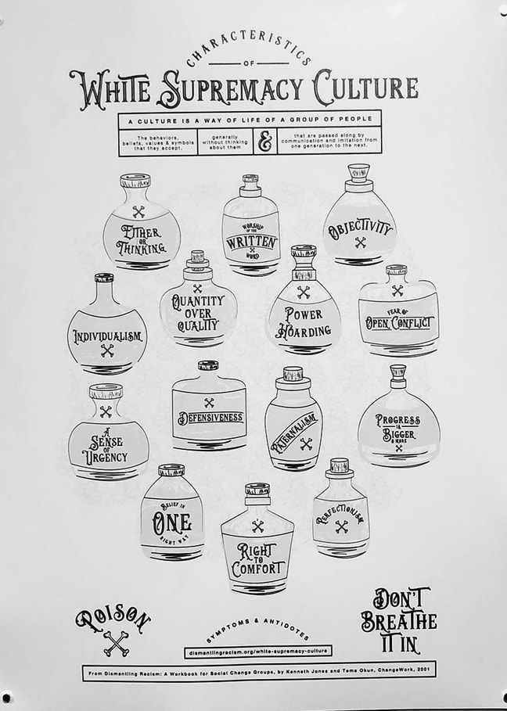
Characteristics of White Supremacy Culture
https://www.whitesupremacyculture.info/characteristics.html

Slide 12
Racial Capitalism:
Race is a central, necessary construct for structuring social and labor hierarchies in capitalist economies
Robinson CJ. Black Marxism: the Making of the Black Radical Tradition. Chapel Hill, NC: University of North Carolina Press; 2000.
Pulido L. Geographies of race and ethnicity II: environmental racism, racial capitalism and state-sanctioned violence. Prog Hum Geogr. 2017;41(4):524–533.

Slide 13
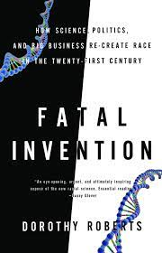
Racial Capitalism within Health Research:
Focus on individual conditions and behaviors ignores structural factors driving disparities
Roberts DE. Fatal Invention: How Science, Politics, and Big Business Re-create Race in the Twenty-first Century. New York, NY: New Press; 2011.
Krieger N, Chen JT, Waterman PD, et al. The inverse hazard law: blood pressure, sexual harassment, racial discrimination, workplace abuse and occupational exposures in US low-income black, white and Latino workers. Soc Sci Med. 2008;67(12):1970–1981.

Slide 14
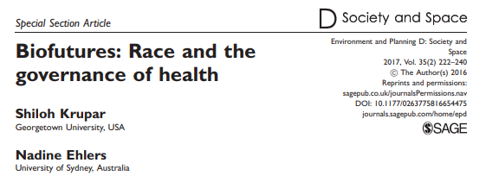
Abolitional possibility
How can occupational epidemiology avoid recreating Blackness as the problem while still addressing structural racism?

Slide 15
Aluminum worker case study

Slide 16
Study site – Badin, North Carolina

Slide 17
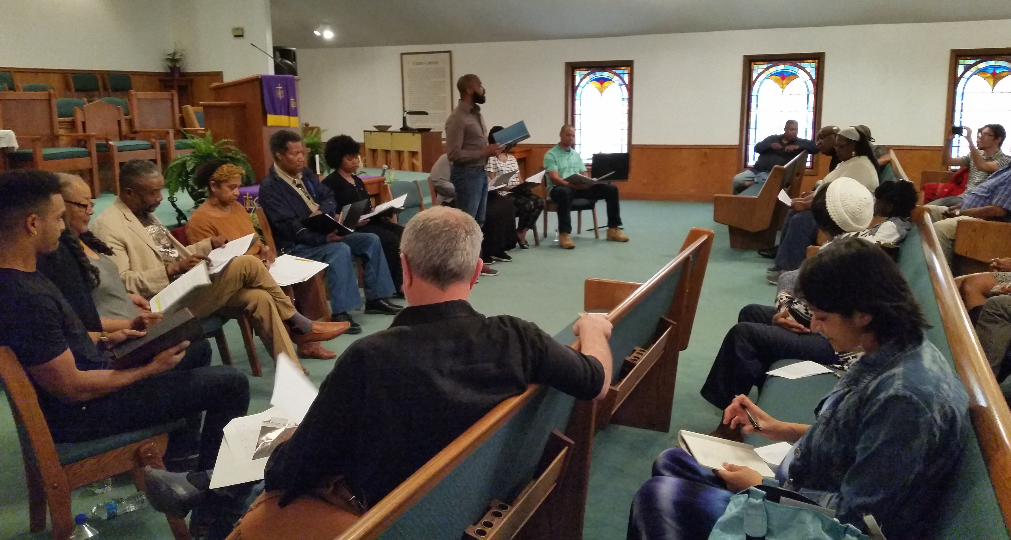
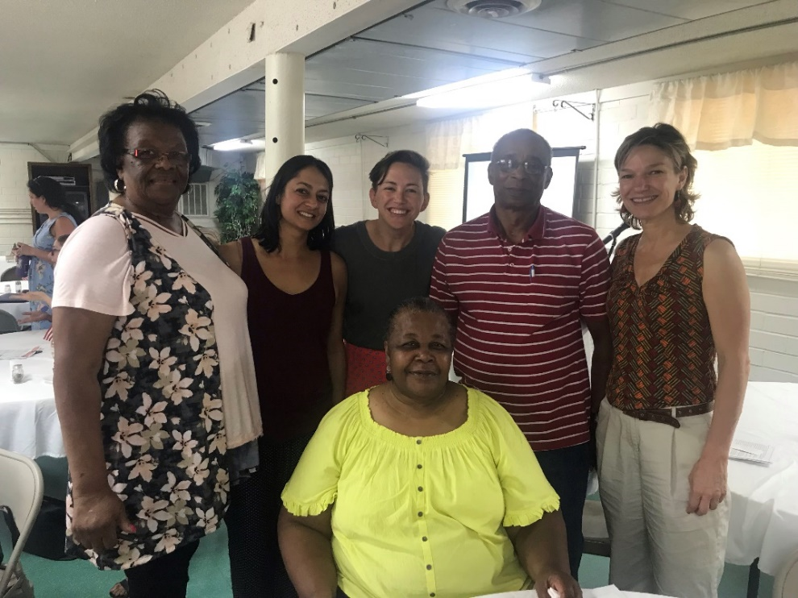
Collaborative research
Concerned Citizens of West Badin Community
North Carolina Environmental Justice Network

Slide 18
“
I’m one of the ones Alcoa told one time, that they would spend millions of dollars to keep from giving me a dime… Somebody now will hopefully understand that Alcoa wasn’t who we thought they were. That we went through a lot of heartache, a lot of suffering, a lot of segregation, to even be a part of Alcoa.
We didn’t discuss it with nobody. I have lived with shame because I didn't speak out sooner... The old folks would say 'Don't go running off at the mouth, you'll get the plant closed,' and they depended on it… I didn’t want to trouble my family with my illness.
But what if they have been affected and I didn’t say nothing, how will they even know?
”

Slide 19
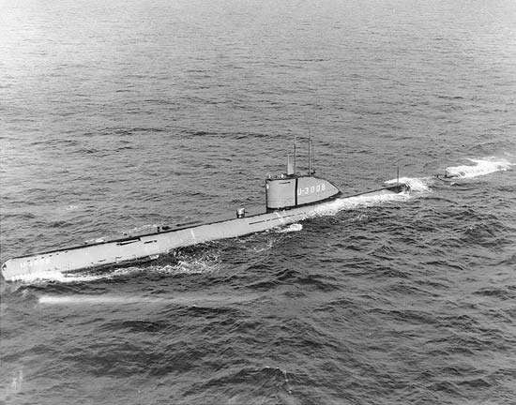
History of aluminum production in the United States
US was the world’s largest aluminum producer for decades
Three-stage process from bauxite ore: mining, refining, smelting
All require vast energy inputs and produce toxic outputs

Slide 20
Existing health literature on aluminum smelting – Exposures
Alumina dust | Hydrogen chloride
Aluminum metal dust | Hydrogen fluoride
Aluminum fluoride | Polycyclic aromatic hydrocarbons
Ammonia | Magnesium dust/fume
Asbestos | Mercury
Beryllium dust | Nickel
Cadmium dust | Fluorides
Carbon monoxide | Lead
Chlorine gas | Ozone
Chromium | Phosgene
Coal tar pitch volatiles | Silica
Coke dust | Silica dust
Copper dust | Sulfur dioxide
Extreme heat | Trace elements (e.g. chromium, nickel)
Fibrous sodium aluminum tetrafluoride particles | Vanadium
High static magnetic fields | Welding fumes

Slide 21
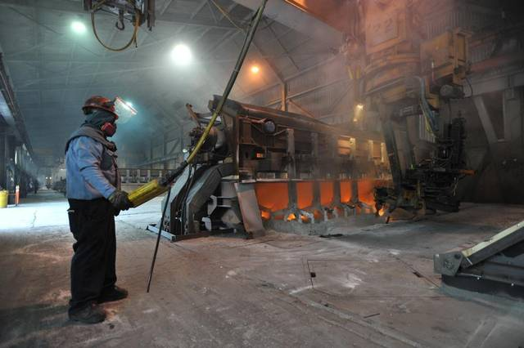
Existing health literature on aluminum smelting – Outcomes
IARC Group 1
Bladder cancer (most documented)
Lung cancer
Central nervous system cancer
Respiratory disease
Injury
All cause mortality

Slide 22
Quantitative aim 1
Describe differences in job assignment and work exposures by race and gender

Slide 23
“
Any inferior job at the plant was done by Black workers. I was in the second set of females in 1976. In the pot room, it was liquid fire, and I mean it ran like water.
The white men would drop their pants, loosen screws on my equipment. When we saw the danger, we caused static, but those men would say ‘you women shouldn’t be here anyway.’
”

Slide 24
Badin Facility Workers
 | N=1,234 n (%)
Sex Female Male | 156 (13) 1,077 (87)
Race Black White | 316 (26) 917 (74)
Elizabeth S. McClure, Whitney R. Robinson, Pavithra Vasudevan, Mark R. Cullen, Steven Marshall, Elizabeth Noth, David Richardson. Disparities in Job Characteristics by Race and Sex in a Southern Aluminum Smelting Facility. To be submitted to American Journal of Industrial Medicine. (Embargoed)

Slide 25
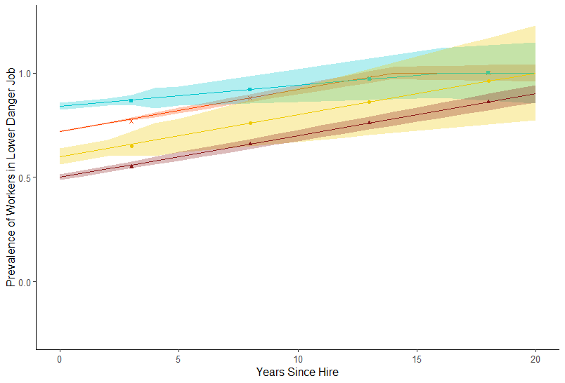
Danger
20 Years Since Hire
■ White Female 1.00 (0.77, 1.26)
+ White Male 1.00 (0.99, 1.01)
● Black Female 1.00 (0.62, 1.37)
▲ Black Male 0.90 (0.86, 0.95)
At Hire
■ White Female 0.84 (0.82,0.87)
+ White Male 0.72 (0.71, 0.73)
● Black Female 0.60 (0.56, 0.64)
▲ Black Male 0.50 (0.49, 0.51)

Slide 26
Danger
■ White Female
+ White Male
● Black Female
▲ Black Male
Black males were least likely to be hired into low danger jobs and remained less likely after 20 years tenure.

Slide 27
Quantitative aim 2
Characterize mortality among USW members at the Badin Alcoa facility relative to reference populations

Slide 28
“
You told my story… I’m a product of some of the sickness that you’re still talking about. Because I got asbestos in my lungs. And I’m sure there’s a whole lot of other guys in here who’s got all sorts of complications. So we didn’t escape it, we just lived through some of it.
I remember when I got in the 25 year club, they told me that I had put my name on the cemetery, that I had joined the death group. I laughed about it and thought it was all funny. But as I lived, it was so true….
”

Slide 29
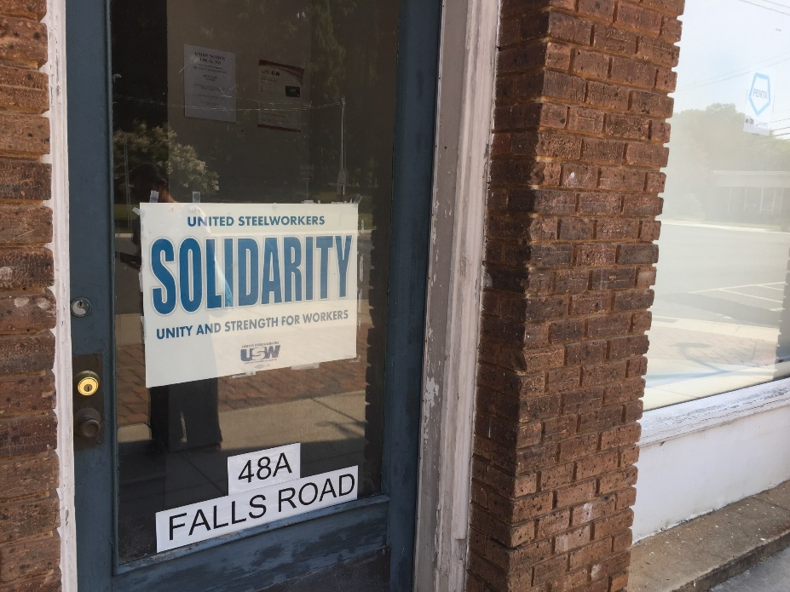
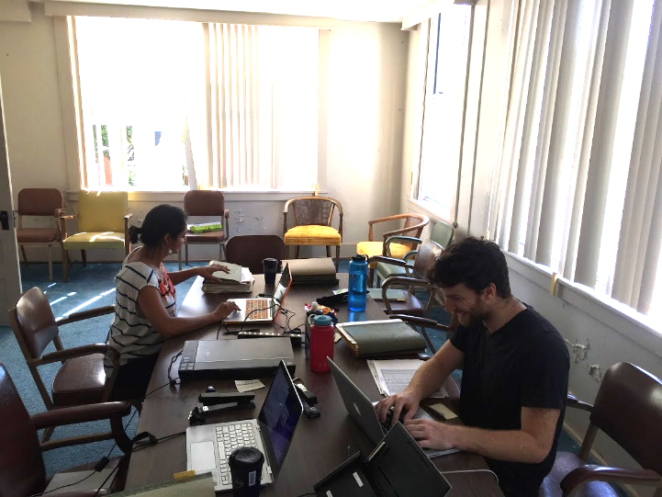
Data collection – USW

Slide 30
Standardized Mortality Ratios
Cause of death | Observed Deaths | aSMR (95% CI)
All-cancer | 86 | 1.55 (1.10, 2.21)
Bladder/urinary cancers | 4 | 3.47 (1.25, 9.62)
Mesothelioma | 3 | 17.33 (5.40, 55.59)
Respiratory cancers | 24 | 1.24 (0.77, 1.99)
Respiratory diseases | 17 | 1.05 (0.61, 1.82)
Elizabeth S. McClure, Pavithra Vasudevan, Nathan DeBono, Whitney R. Robinson, Stephen W. Marshall, David Richardson. Cancer and noncancer mortality among aluminum smelting workers in Badin, North Carolina. American Journal of Industrial Medicine 2020; 63 (9): 755-765. PMID: 32649003.

Slide 31
Standardized Rate Ratios
 | Pot Room
Cause of death | Never Referent [deaths] | Ever SRR (95% CI) [deaths]
All-cause | 1.0 [158] | 2.83 (0.88, 9.10) [89]
All-cancer | 1.0 [51] | 1.48 (0.92, 2.39) [35]
Bladder/urinary cancers | 1.0 [3] | 1.58 (0.15, 15.28) [1]
Mesothelioma | 1.0 [2] | 3.36 (0.21, 53.78) [1]
Respiratory cancers | 1.0 [11] | 2.99 (1.23, 7.26) [13]
Respiratory disease | 1.0 [15] | 0.33 (0.07, 1.71) [2]

Slide 32
Main Study Findings
Elizabeth S. McClure, Whitney R. Robinson, Pavithra Vasudevan, Mark R. Cullen, Steven Marshall, Elizabeth Noth, David Richardson. Disparities in Job Characteristics by Race and Sex in a Southern Aluminum Smelting Facility. To be submitted to American Journal of Industrial Medicine. (Embargoed)
Black workers were most likely to be hired into undesirable jobs and least likely to transition out of them
Elizabeth S. McClure, Pavithra Vasudevan, Nathan DeBono, Whitney R. Robinson, Stephen W. Marshall, David Richardson. Cancer and noncancer mortality among aluminum smelting workers in Badin, North Carolina. American Journal of Industrial Medicine 2020; 63 (9): 755-765. PMID: 32649003.
There has been excess cancer mortality among USW, hourly Badin workers, especially pot room workers
Elizabeth S. McClure, Pavithra Vasudevan, Zinzi Bailey, Snehal Patel, Whitney R Robinson. Racial Capitalism Within Public Health—How Occupational Settings Drive COVID-19 Disparities. American Journal of Epidemiology Nov 2020; 189 (11): 1244–1253. PMID: 32619007. PMCID: PMC7337680.
Race-based clinical metrics result in Black workers being under compensated for injuries and illnesses related to work exposures

Slide 33
Critical assessment of epidemiology

Slide 34
Characteristics of white supremacy culture
One Right Way
Definition: The belief there is one right way to do things. Connected to the belief in an objective "perfect" that is both attainable and desirable for everyone. Connected to the belief that I am qualified to know what the perfect right way is for myself and others.
How it shows up: the belief there is one right way to do things and once people are introduced to the right way, they will see the light and adopt it

Slide 35
Characteristics of white supremacy culture
Urgency
Definition: Applying the urgency of racial and social justice to our every day lives in ways that perpetuate power imbalance and disregard for our need to breathe and pause and reflect.
How it shows up: Sacrifices and erases the potential of other modes of knowing and wisdom that require more time (embodied, intuitive, spiritual)

Slide 36
Characteristics of white supremacy culture
Either/Or
Definition: Reduces the complexity of life and the nuance of our relationships with each other and all living things into either/or, yes or no, right or wrong in ways that reinforce urgency, one right way perfectionist thinking, and abuse of power.
How it shows up:
Positioning or presenting options or issues as either/or — good/bad, right/wrong, with us/against us
Trying to simplify complex things, for example believing that poverty is simply the result of lack of education

Slide 37
Characteristics of white supremacy culture
Right to Comfort
Definition: The internalization that I or we have a right to comfort, which means we cannot tolerate conflict, particularly open conflict.
How it shows up:
The belief that those with power have a right to emotional and psychological comfort (another aspect of valuing ‘logic’ over emotion)
Scapegoating those who cause discomfort, for example, targeting and isolating those who name racism rather than addressing the actual racism that is being named

Slide 38
Characteristics of white supremacy culture
Progress is More/Quantity over Quality
Definition: The assumption that the goal is always more and bigger with an emphasis on what we can "objectively" measure as more valuable than the quality of our relationships to all living beings.
How it shows up: A narrow focus on numbers (financial, people, geography, power) without an ability to value processes (relationships), including cost to the human and natural environment

Slide 39
Characteristics of white supremacy culture in aluminum smelting literature
Characteristic | How it shows up in literature on aluminum smelting
One Right Way | Focus on statistical biases, applications of methodological advances; Company controls what is studied, data collected, published, measured
Urgency | Latency periods, terminating surveillance
Either/Or Thinking | Statistical significance
Right to Comfort | Outcomes chosen; Celebrating company-initiated protective measures; Little strong evidence of harmful effects when we know human lives are at stake
Progress is More/Quantity Over Quality | Focus on financial feasibility of protective measures, workers’ value = productivity; No acknowledgement of financial interest, presented as objective studies, no results communicated to workers

Slide 40
Limitations of existing occupational epidemiology on aluminum smelting
Narrow focus on company-initiated interventions (e.g. hearing protection) and methodological advances
Does not assess determinants of race and gender disparities in exposure/health
Does not reflect worker experience described by former workers in West Badin

Slide 41
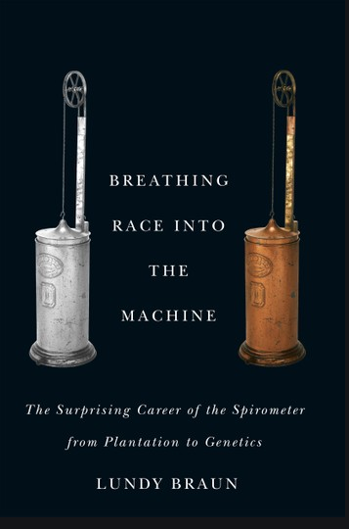
Race-based clinical metrics

Slide 42
Abolitional possibility

Slide 43
Community survey – an abolitional approach?

Slide 44
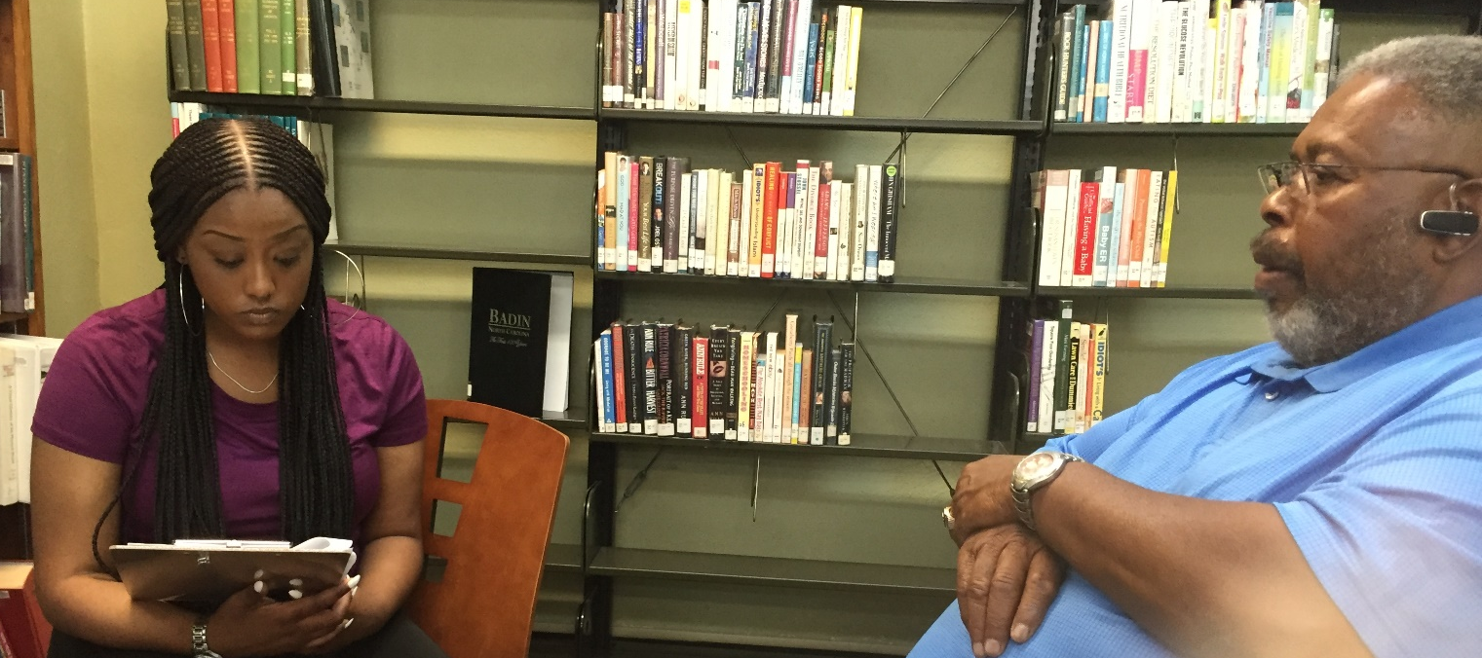
Community survey – methods
Initiated by worker concerns
Collaborative question development
Mutual participation in training

Slide 45
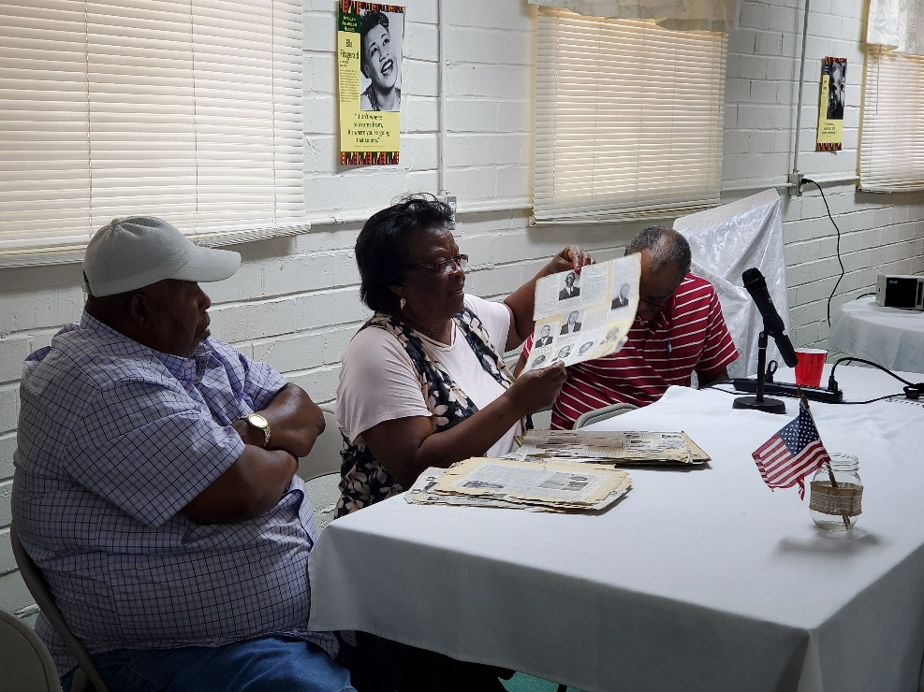
Supporting organizing

Slide 46
Conclusions
By applying insights and lessons from community organizing, we can unpack how public health literature perpetuates white supremacy
Research example: occupational epidemiology documenting racial capitalism within an aluminum smelting plant

Slide 47
Acknowledgements
Research Collaborators:
Macy Hinson
Valerie Tyson
Richard Leak
Naeema Muhammad
Pavithra Vasudevan
Whitney Robinson
David Richardson
Steve Marshall
Zinzi Bailey
Snehal Patel
Funding/Data Sources:
Environmental Epidemiology Training Grant (T32 ES007018)
Carolina Population Center Training Grant (T32 HD007168)
North Carolina Occupational Safety and Health Education and Research Center Pilot Project Grant
Carolina Center for Public Service Community Engagement Fellowship
United Steel Workers, Local 303

Slide 48
Thank you! Questions? emcclure@unc.edu

Slide 49
Appendix

Slide 50
Data Sources
Data Source | SPIROLA (lung function) | NHANES (hearing)
Population | Workers who identified as Non-Hispanic Black or Non-Hispanic white | Respondents aged 20–65 years who reported “ever having job exposure to loud noise” and identified as Non-Hispanic Black or Non-Hispanic white
Dataset Years | 1999 | 2005-2006

Slide 51
Lung function
Observed: Race-corrected equations (current standard)
Expected: counterfactual scenario, elimination of race “correction” for lung function
Hearing loss
Observed: No race correction (current standard)
Expected: counterfactual scenario, addition of white decrement “correction”

Slide 56
Key finding
Lung function: Race-correction → Black workers are under compensated, Race-based metrics are used in practice
Hearing loss: Race-correction → white workers would be under compensated, Race-based metrics are not used in practice

Slide 57
Survey tool

Slide 58
Survey tool

Slide 59
Survey tool

