Slide 1
COVID-19 UPDATE: OMICRON UPDATE
David J. Weber, MD, MPH, FIDSA, FSHEA, FRSM (London)
Sanders Distinguished Professor of Medicine, Pediatrics and Epidemiology
Associate Chief Medical Officer
Medical Director, Hospital Epidemiology
Disclosures: Consultancy; Pfizer, Merck, Sanofi, PDI, Germitec, UVinnovators
All drugs/vaccines issues discussed consistent with FDA approvals or authorizations

Slide 2
COVID-19: RECENT SUMMARY
Increasing cases due to Omicron
Hospitalizations largely limited to unvaccinated and immunocompromised
Omicron
Dominant variant; highly transmissible; escape from most mABs; escape for “natural immunity” and vaccine (“fully vaccinated”)
Advances in therapy – active against Omicron (therapy for mild-moderate illness) - limited supply for all but remdesivir
Paxlovid: FDA authorized, substantial drug interactions, CYP3A4 inhibitor; ~88% effective to prevent hospitalizations, oral
Sotrovimab: FDA authorized, IV infusion
Remdesivir: FDA approved but “off label”, IV infusion each day for 3 days
Molnupiravir: FDA authorized, limited effectiveness (~30% to prevent hospitalization), oral
Advances in preventive therapy (IM)
Evusheld (tixagevimab co-packaged with cilgavimab and administered together)

Slide 3
Risk Factors for Severe COVID-19 Outcomes Among Persons Aged ≥18 Years Who Completed a Primary COVID-19 Vaccination Series; 465 Care Facilities, US, December 2020–October 2021 (MMWR 2022;71:19)
Among 1,228,664 persons who completed primary vaccination during December 2020–October 2021, severe COVID-19–associated outcomes (0.015%) or death (0.0033%) were rare. Risk factors for severe outcomes included age ≥65 years, immuno-suppressed, and six other underlying conditions. All persons with severe outcomes had at least one risk factor; 78% of persons who died had at least four.

Slide 4
IMPACT OF COVID-19 ON DEATHS BY AGE GROUP, US
https://www.healthsystemtracker.org/brief/covid19-and-other-leading-causes-of-death-in-the-us/

Slide 5
IMPACT OF COVID-19 ON LIFE EXPECTANCY, UK and US
Average life expectancy for males fell 2.1 years in 2020—before COVID-19 vaccines became widely available—from 76.3 years in 2019 to 74.2 years in 2020. For females, the average decrease was 1.5 years, from 81.4 years in 2019 to 79.9 years in 2020. The age-adjusted death rate increased by nearly 17%, from 715.2 deaths per 100 000 standard population in 2019 to 835.4 in 2020. However, the increases in death rates for non-Hispanic Black and Hispanic populations were far greater, increasing by nearly 43% among Hispanic males and more than 32% among Hispanic females (compared with approximately 13% for non-Hispanic White males and 12% for non-Hispanic White females) and by 28% among non-Hispanic Black males and nearly 25% among non-Hispanic Black females.
Stephenson J. JAMA 4 Jan. 2022
Andrasfay T, Goldman N. PNAS 2021;118:No. 5 e2014746118
Abuto JM, et al. BMJ 2021;75:735-740

Slide 6
FREQUENCY AND SYMPTOMS OF LONG-COVID-19
Goal: Assess long-COVID-19 in large EMR database
Methods: Retrospective cohort study using EMR data from 81 million patients, 273,618 COVID-19 survivors; incidence within 6 months and 3-6 months after diagnosis
Results: Among COVID-19 survivors (mean [SD] age: 46.3 [19.8], 55.6% female), 57.00% had one or more long-COVID feature recorded during the whole 6-month period (i.e., including the acute phase), and 36.55% between 3 and 6 months.
1 in 3 patients had one or more features of long-COVID recorded between 3 and 6 months after a diagnosis of COVID-19. This was significantly higher than after influenza.
2 in 5 of the patients who had long-COVID features in the 3- to 6-month period, had no record of any such feature in the previous 3 months.
The risk of long-COVID features was higher in patients who had more severe COVID-19 illness, and slightly higher among females and young adults. White and non-white patients were equally affected.
Schmidt C. Nature Biotechnology 2021;39:908-913
Taquet M, et al. PLOS Medicine 2021;28 September

Slide 7
UNC-CH LONG COVID-19 CLINIC
Data supplied by Dr. Jonh Baratta

Slide 8
The Impact of Coronavirus on Households Across America, Robert Wood Johnson Foundation, SEPTEMBER 2020
At least half of households in the four largest U.S. cities—New York City (53%), Los Angeles (56%), Chicago (50%), and Houston (63%)—report serious financial problems including depleted savings, and trouble paying bills or affording medical care.
Many of these experiences are concentrated among Black and Latino households; households with annual incomes below $100,000; and households experiencing job or wage losses since the start of the outbreak.
At least four in ten Latino, Black, and Native American households report using up all or most of their household savings during this time.
One in five households in the United States (20%) report household members unable to get medical care for serious problems. A majority unable to get care when needed (57%) report negative health consequences as a result.
More than 1 in 3 households that include anyone with a disability report facing serious financial problems, many experiencing difficulty affording utilities and food.
More than one in three (36%) households with children face serious problems keeping their children’s education going, and among working households, nearly one in five (18%) report serious problems getting childcare when adults need to work.
About one in three households with children (34%) either do not have a high-speed internet connection at home or report serious problems with their connection while doing schoolwork or their jobs during the pandemic.
https://www.rwjf.org/en/library/research/2020/09/the-impact-of-coronavirus-on-households-across-america.html

Slide 9
COVID-19 VARIANTS
Variants are of concerns if they impact:
Transmissibility (intrinsic)
Performance of diagnostics
Immunity (immune evasion): Vaccination, prior infection, monoclonal antibodies/convalescent plasma
Effectiveness of treatments
Severity of illness
Omicron (~30 mutations in spike protein; variant derived from early variants)
Detected in South Africa in late November (but isolates from early November have been detected)
Dominant variant worldwide and US
Increased infectivity: Inherent, escape from “natural immunity”, escape from vaccines (including fully vaccinated)
Detected by most current diagnostic tests
Escape by in vitro testing from most mABs
Lower virulence
Prevention: 1) Encourage or require vaccine be “up to date”, 2) Universal pandemic precautions (masks, eye protection, N95s for COVID care/AGPs), 3) Avoid presenteeism

Slide 10
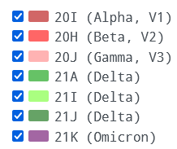
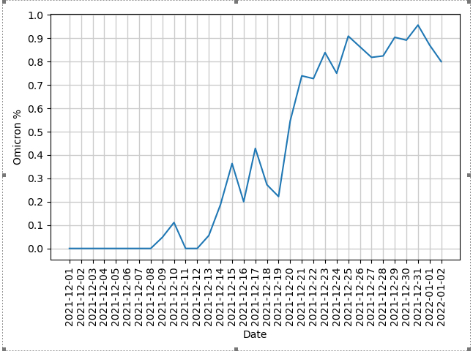
OMICRON, US & UNC-MC
https://covid.cdc.gov/covid-data-tracker/#variant-proportions; https://covariants.org/per-country

Slide 11
OMICRON IMPACT
NY Times

Slide 12
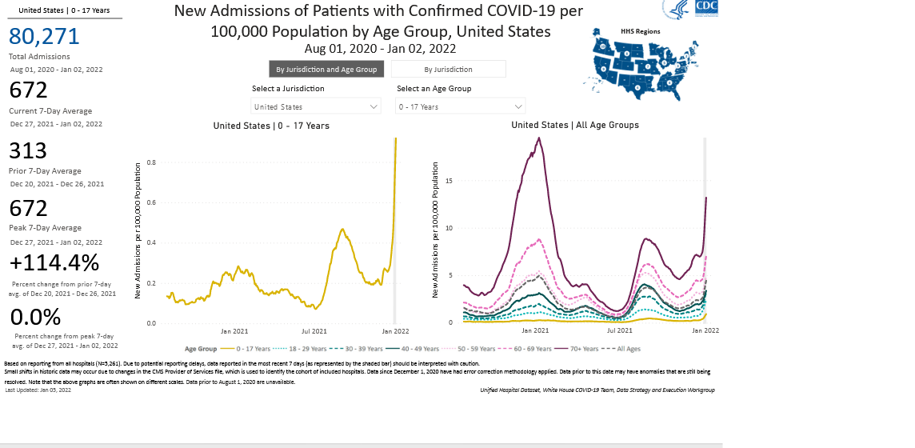
HOSPITALIZATIONS BY AGE (numbers & percent), CDC
https://gis.cdc.gov/grasp/COVIDNet/COVID19_5.html

Slide 13
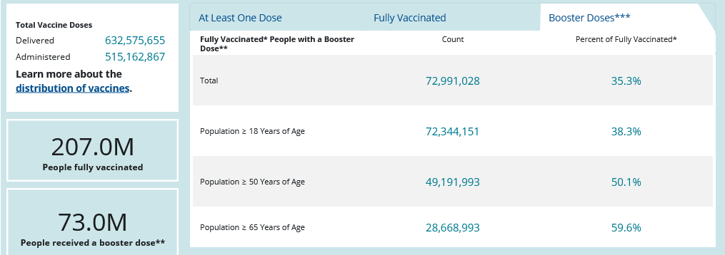
COVID-19 VACCINE COVERAGE BY “UP TO DATE” AND AGE, US, CDC

Slide 14
Risk of Myocarditis Post-COVID-19 Infection or mRNA Vaccination
Young (20 years of age) competitive athletes across 42 colleges and universities in the US were prospectively followed and tested over a 4-month time period¹
Retrospective analysis of healthcare records of 2.5 million vaccinated individuals (>16 years) in Israel²
Kaplan–Meier Estimates of Myocarditis at 42 Days²
3018 athletes tested positive for SARS-CoV-2
19,378 tested positive for SARS-CoV-2
21 of those were positive for cardiac involvement (0.7%)
Overall estimated IR: 2.13 cases per 100,000 (95% CI: 1.56–2.70)²
Highest incidence rate: 10.69 cases per 100,000 (95% CI: 6.93–14.46) among males aged 16–29 yrs²
Cases of myocarditis after COVID-19 or vaccine both were relatively rare and tended to be mild or moderate in severity^{1,2}
CI, confidence interval.
1. Moulson N, et al. Circulation. 2021;144:256-266. 2. Witberg G, et al. N Engl J Med. 2021. Oct 6. DOI: 10.1056/NEJMoa2110737
Notes:
Moulson 2021/p257/col 2/para 3/L9-12; p258/col 2/para 4
Moulson 2021/p258/col 2/para 4; p259/col 1/para 2/L1-3
Witberg 2021/p2/col 2/para 3/L1-5; p3/col 1/para 3/L1-5
Witberg 2021/p4/Fig 1
Witberg 2021/p4/col 1/para 3/L1-4; col 2/para 1/L1-5
Moulson 2021/p260/col 2/para 2;
Witberg 2021/p8/col 2/para 1/L3-4

Slide 15
IMPACT OF COVID-19 VACCINES ON DEATHS, US
https://covid.cdc.gov/covid-data-tracker/#rates-by-vaccine-status
https://www.healthsystemtracker.org/brief/covid19-and-other-leading-causes-of-death-in-the-us/

Slide 16
FORCASTING OMICRON IMPACT ON UNC-MC

Slide 17
OMICRON: IMPACT ON DIAGNOSTIC TESTS, FDA, 12/28/21
Tests Expected to Fail to Detect the SARS-CoV-2 Omicron Variant (As of 12/27/2021)
Meridian Biosciences, Inc. Revogene SARS-CoV-2
Applied DNA Science Linea COVID0-19 Assay Kit
Tests with N-Gene Drop Out - SARS-CoV-2 Detection Should Not Be Significantly Impacted”
DxTerity Diagnostics, Inc.
Vela Diagnostics USA, Inc.
Tests with S-Gene Drop Out - SARS-CoV-2 Detection Should Not Be Significantly Impacted*
See FDA webpage
Other tests may impacted by variants other than Omicron
See FDA webpage
*Presumptive evidence of Omicron: not specific for Omicron and may occur with Omicron
https://www.fda.gov/medical-devices/coronavirus-covid-19-and-medical-devices/sars-cov-2-viral-mutations-impact-covid-19-tests#omicronvariantimpact

Slide 18
SARS-CoV-2 Variants: Reported in vitro Therapeutic Activity
Omicron = B.1.1.529
Available monoclonal antibodies with Omicron activity
Sotrovimab
Evusheld
Available COVID-19 vaccines have reduced effectiveness against Omicron
mRNA boosted persons have good effectiveness to prevent and/or ameliorate COVID-19
https://opendata.ncats.nih.gov/variant/activity

Slide 19
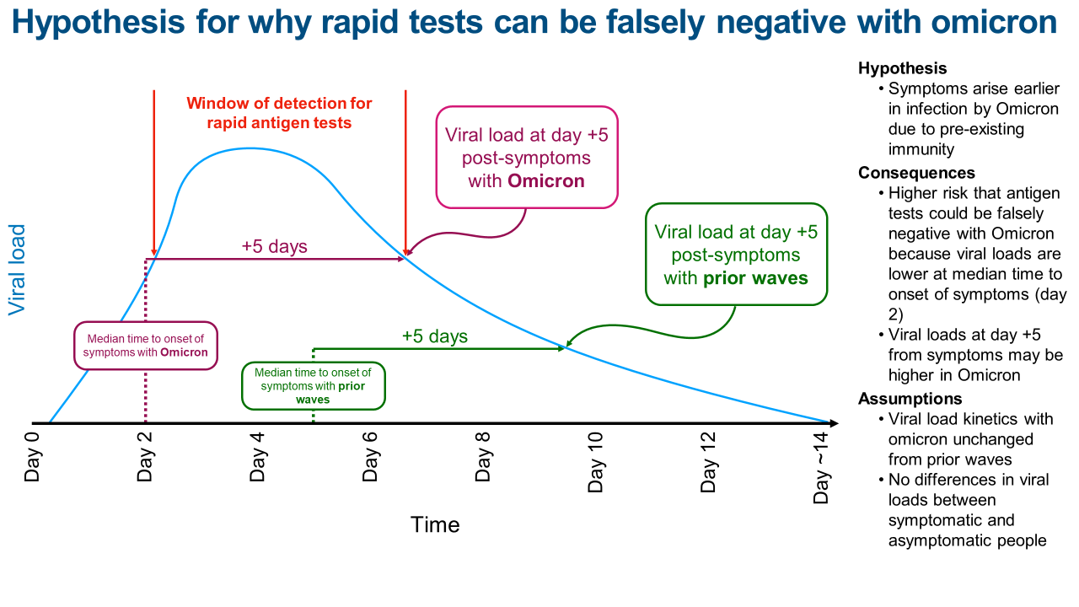
Is my rapid antigen test a false negative?
Courtesy: Sanjat Kanjilal, MD, MPH

Slide 20
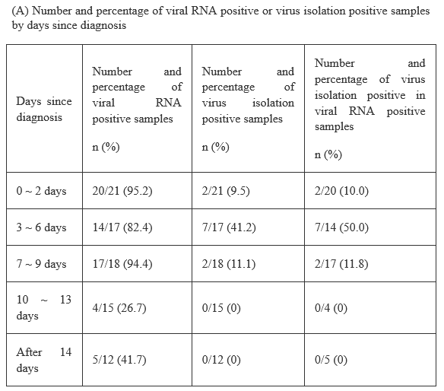
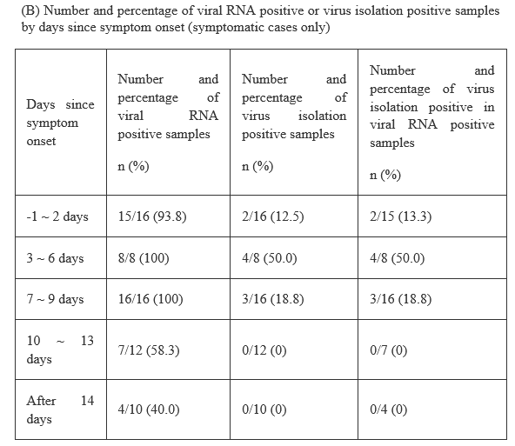
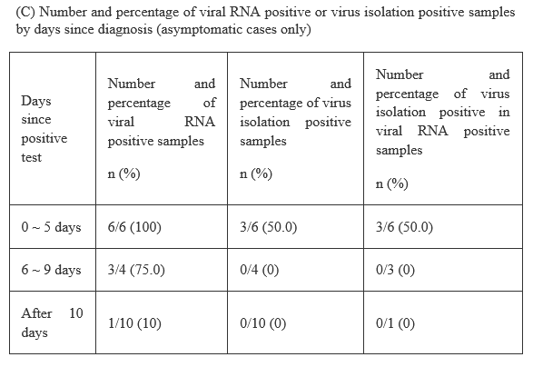
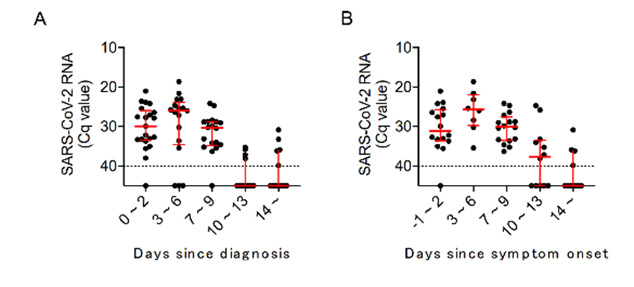
Active epidemiological investigation on SARS-CoV-2 infection caused by Omicron variant (Pango lineage B.1.1.529) in Japan: preliminary report on infectious period
Figure. Kinetics of viral RNA amount in respiratory samples obtained from Omicron variant infected cases
https://www.niid.go.jp/niid/en/2019-ncov-e/10884-covid19-66-en.html

Slide 21
Investigation of a SARS-CoV-2 B.1.1.529 (Omicron) Variant Cluster, Nebraska, Nov.–Dec. 2021
Goal: Outbreak evaluation
Index case had symptomatic COVID-19 in 11/20, unmasked contact with coughing person during conference in Nigeria. Pre-travel test 11/21/21 negative. On 11/23/21 while still asymptomatic, had unmasked contact with 5 household members (1, fully vaccinated plus COVID-19 in 8/21; 3, unvaccinated plus previous COVID-19; 1, unvaccinated with mild URI but negative COVID-19 test. No household members immunocompromised.
On 11/24/21 index case developed symptoms; positive COVID-19 test on 11/26/21. All 6 household members developed symptoms 11/24-11/26 (incubation period, median = 73hr (range, 33-75hr). None hospitalized.
Median incubation period SARS-CoV-2, >5d; Delta, 4d; Omicron, 3d
Conclusions: 1) Omicron highly infectious; 2) Shortened incubation period; 3) Reinfection common; 4) Reduced effectiveness of vaccines; 5) Less virulent
Jansen L, et al. MMWR 2021;28 Dec.

Slide 22
Outbreak caused by the SARS-CoV-2 Omicron variant in Norway, November to December 2021
In late November 2021, an outbreak of Omicron SARS-CoV-2 following a Christmas party with 117 attendees was detected in Oslo, Norway. The observed Omicron attack rate was 74% and most cases developed symptoms.
As of 13 December, none have been hospitalized. Most participants were 30–50 years old. 96% were fully vaccinated (none boosted). All were to be test negative prior to event.
Assuming exposure at the event, the incubation period for symptomatic cases had a median of 3 days (IQ range, 3-4).
Party was a closed event held in a separate room of a restaurant.
These findings corroborate reports that the Omicron variant may be more transmissible, and that vaccination may be less effective in preventing infection compared with Delta.
Brandal LT, et al. Euro Surveillance 2021;26(50):pii=2101147. https://doi.org/10.2807/1560--917.ES.2021.26.50.2101147

Slide 23
Omicron Evades Neutralization by Sera from Vaccinated and Convalescent Individuals
In vitro study of sera from infected or vaccinated persons
Results: Figure 1 shows that sera from vaccinated individuals neutralized the B.1.1.529 variant to a much lesser extent than any other variant analyzed (B.1.1.7, B.1.351, B.1.617.2). We found some B.1.1.529 cross-neutralization in individuals vaccinated with either the homologous BNT162b2 or the heterologous ChAdOx1 prime/BNT162b2 boost regimen but not after homologous ChAdOx1 vaccination. Furthermore, the sera from convalescent individuals largely failed to neutralize B.1.1.529 although cross-neutralization was observed against other variants. All sera from super immune individuals that had been infected and vaccinated once or twice with BNT162b2 or that had been vaccinated and subsequently were infected were able to neutralize B.1.1.529, although to a lesser degree than B.1.617.2.
Rossler A, et al. https://doi.org/10.1101/2021.12.08.21267491

Slide 24
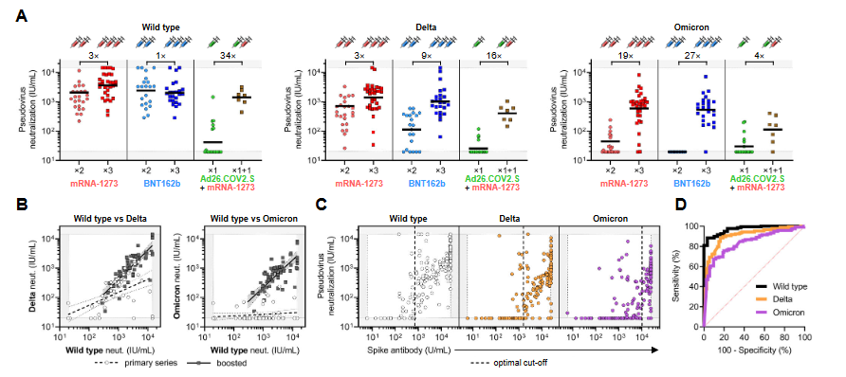
mRNA-based COVID-19 Vaccine Boosters Induce Neutralizing Immunity Against SARS-CoV-2 Omicron Variant
Methods: We measured neutralization potency of sera from 88 mRNA-1273, 111 BNT162b, and 40 Ad26.COV2.S vaccine recipients against wild type, Delta, and Omicron SARS-CoV-2 pseudoviruses. We included individuals that were vaccinated recently (<3 mo), distantly (6-12 mo), or recently boosted, and accounted for prior SARS-CoV-2 infection. Remarkably, neutralization of Omicron was undetectable in most vaccinated individuals.
Results: Individuals boosted with mRNA vaccines exhibited potent neutralization of Omicron only 4-6-fold lower than wild type, suggesting that boosters enhance the cross-reactivity of neutralizing antibody responses. We find Omicron pseudovirus is more infectious than any other variant tested.
Garcia-Beltran WF, et al
https://doi.org/10.1101/2021.12.14.21267755

Slide 25
Plasma Neutralization of the SARS-CoV-2 Omicron Variant
In plasma specimens obtained at ~1 month and 6 months after infection from persons who had recovered from Covid-19, the 50% neutralization titer (NT 50) values were a mean of 60±47 and 37±27 times lower for PMS20 than for Wuhan-hu-1, respectively, and 58±51 and 32±23 times lower for omicron than for Wuhan-hu-1.
Similarly, plasma specimens obtained from different persons in the same cohort 1 year after infection had NT50 values that were 34±24 times lower for PMS20 and 43±23 times lower for omicron than for Wuhan-hu-1.
In plasma specimens from persons who had received two doses of an mRNA vaccine (BNT162b2 [Pfizer–BioNTech] or mRNA-1273 [Moderna]) 1.3 mo before sampling, the NT50 values were 187±24 times lower for PMS20 and 127±66 times lower for omicron than for Wuhan-hu-1. At 5 mo after vaccination, the neutralization potency was 58±23 times lower for PMS20 and 27±17 times lower for omicron.
Many plasma specimens from recipients of the single-dose Ad26.COV2.S vaccine (J&j), obtained 1 or 5 mo after vaccination, lacked detectable neutralizing activity against PMS20 or omicron.
Vaccination of persons who had recovered from Covid-19 or administration of a 3rd dose of an mRNA vaccine to vaccinated persons at least 6 months after the second dose of an mRNA vaccine led to a substantial gain in neutralizing activity against PMS20 and omicron. Person who had received two doses of an mRNA vaccine `6 months earlier and then received a third dose of an mRNA vaccine approximately 1 month before sampling, the NT 50 values after the booster dose were 26 times greater for Wuhan-hu-1, 35 times greater for PMS20, and 38 times greater for omicron.
Schmidt F, et al. NEJM 2022;7 Jan.

Slide 26
Effectiveness of COVID-19 Vaccines Against the Omicron (B.1.1.529) Variant of Concern
Methods: Test-negative case-control design to estimate vaccine effectiveness (VE) against symptomatic disease caused by the Omicron and Delta variants in England. VE was calculated after primary immunization with two BNT162b2 or ChAdOx1 doses, and at 2+ weeks following a BNT162b2 booster
Results: Data from 11/27-12/6; 581 Omicron and 56,439 Delta cases. here was no effect against Omicron from 15 weeks after two ChAdOx1 doses, while VE after two BNT162b2 doses was 88.0% (95%CI: 65.9 to 95.8%) 2-9 weeks after dose 2, dropping to between 34 and 37% from 15 weeks post dose 2. From two weeks after a BNT162b2 booster, VE increased to 71.4% (95%CI: 41.8 to 86.0%) for ChAdOx1 primary course recipients and 75.5% (95%CI: 56.1 to 86.3%) for BNT162b2 primary course recipients.
Conclusion: Boosting with BNT162b2 following either primary course significantly increased protection.
Andrews N, et al. https://doi.org/10.1101/2021.12.14.21267615

Slide 27
DISCOVERY HEALTH: OMICRON REPORT
Real-world analysis of Omicron outbreak based on 211,000 COVID-19-positive test results in South Africa, 14 Dec.
Pfizer vaccine effectiveness: Two-dose Pfizer-BioNTech vaccination provides 70% protection against severe complications of COVID-19 requiring hospitalization, and 33% protection against COVID-19 infection, during the current Omicron wave (test-negative design) - represents a significant drop from the 80% protection against infection afforded during the earlier period, probably on the basis of lower antibody susceptibility, following the extensive spike protein mutations in the Omicron variant.
Reinfection risk: For individuals who have had COVID-19 previously, the risk of reinfection with Omicron is significantly higher, relative to prior variants. People who were infected with COVID-19 in South Africa’s third (Delta) wave face a 40% relative risk of reinfection with Omicron; people who were infected with COVID-19 in South Africa’s second (Beta) wave face a 60% relative risk of reinfection with Omicron.
Severity: The risk of hospital admission among adults diagnosed with COVID-19 is 29% lower for the Omicron variant infection compared to infections involving the D614G mutation in South Africa’s first wave in mid-2020, after adjusting for vaccination status
Children: Despite very low absolute incidence, preliminary data suggests that children have a 20% higher risk of hospital admission in Omicron-led fourth wave in South Africa, relative to the D614G-led first wave.
Limitations on data: 1) limited to first 3 weeks of Omicron-driven wave in SA; 2) data confounded by various factors, including high seroprevalence of COVID-19 antibodies in the South African population as a whole
14 Dec.2021; https://www.discovery.co.za/corporate/news-room

Slide 28
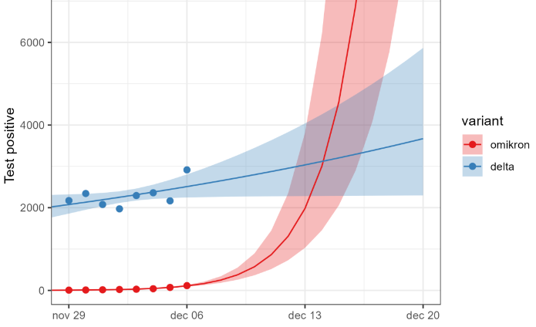
OMICRON IN DENMARK, FIRST 785 CASES
By 9 December 2021, 785 SARS-CoV-2 Omicron variant cases have been identified in Denmark. Most cases were fully (76%) or booster-vaccinated (7.1%); 34 (4.3%) had a previous SARS-CoV-2 infection. The majority of cases with available information reported symptoms (509/666; 76%) and most were infected in Denmark (588/644; 91%). One in five cases cannot be linked to previous cases, indicating widespread community transmission. Nine cases have been hospitalized, one required intensive care and no deaths have been registered.
December 7: Quarantine requirement for close contacts of close contacts of Omicron cases is abolished
Growth rate in the capital
Espenhain L, et al. https://www.eurosurveillance.org/docserver/fulltext/eurosurveillance/26/50/eurosurv-26-50-3.pdf?expires=1639934672&id=id&accname=guest&checksum=8B1B0A274F85DEC7EF02293BB7DFE5B3
Statens Serum Insitut, 12 Dec

Slide 29
Characteristics and Outcomes of Hospitalized Patients in South Africa During the COVID-19 Omicron Wave Compared With Previous Waves
On November 24, 2021, a SARS-CoV-2 variant of concern, Omicron (B.1.1.529), was identified in South Africa as responsible for a fourth wave of COVID-19
Data from Netcare, a private health care group consisting of 49 acute care hospitals (>10 000 beds) across South Africa
The number of patients treated in the hospitals during the same early period of each wave differed; however, 68% to 69% of patients presenting to the emergency department with a positive COVID-19 result were admitted to the hospital in the first 3 waves vs 41.3% in wave 4.
The proportion of patients requiring oxygen therapy significantly decreased (17.6% in wave 4 vs 74% in wave 3, P<0.001) as did the percentage receiving mechanical ventilation. Admission to intensive care was 18.5% in wave 4 vs 29.9% in wave 3 (P<0.001). The median LOS (between 7 and 8 days in previous waves) decreased to 3 days in wave 4. The death rate was between 19.7% in wave 1 and 29.1% in wave 3 and decreased to 2.7% in wave 4.
Paper discussed several limitations of the study.
Maslo C, et al. JAMA 2021;30 Dec.

Slide 30
OMICRON INFECTIVITY FOR BRONCHIAL AND LUNG TISSUES
A study led by researchers from the LKS Faculty of Medicine at The University of Hong Kong (HKUMed) provides the first information on how the novel Variant of Concern (VOC) of SARS-CoV-2, the Omicron SARS-CoV-2 infect human respiratory tract. The researchers found that Omicron SARS-CoV-2 infects and multiplies 70 times faster than the Delta variant and original SARS-CoV-2 in human bronchus, which may explain why Omicron may transmit faster between humans than previous variants. Their study also showed that the Omicron infection in the lung is significantly lower than the original SARS-CoV-2, which may be an indicator of lower disease severity. This research is currently under peer review for publication.
https://www.med.hku.hk/en/news/press/20211215-omicron-sars-cov-2-infection?utm_medium=social&utm_source=twitter&utm_campaign=press_release

Slide 31
Interim Guidance for Managing Healthcare Personnel with SARS-CoV-2 Infection or Exposure to SARS-CoV-2, CDC, 23 DEC. 2021
https://www.cdc.gov/coronavirus/2019-ncov/hcp/guidance-risk-assesment-hcp.html

Slide 32
RTW TESTING OF INFECTED HCP AT DAY 5, UNC-MC
All HCP positive by PCR at day 5. The orange line represents where one would expect the antigen test results to differ. ~80% would also still be positive by antigen on day 5. Also note the very significant viral load of employees at day 5. We also had several people who had MORE virus at day 5 than initial test.

Slide 33
ISOLATION AND QUARANTINE, CDC, 4 JAN. 2022
Who does not need to quarantine: If you came into close contact with someone with COVID-19 and you are in one of the following groups, you do not need to quarantine.
You are ages 18 or older and have received all recommended vaccine doses, including boosters and additional primary shots for some immunocompromised people.
You are ages 5-17 years and completed the primary series of COVID-19 vaccines.
You had confirmed COVID-19 within the last 90 days (you tested positive using a viral test).
Who should quarantine? If you come into close contact with someone with COVID-19, you should quarantine if you are in one of the following groups:
You are ages 18 or older and completed the primary series of recommended vaccine, but have not received a recommended booster shot when eligible.
You received the single-dose Johnson & Johnson vaccine (completing the primary series) over 2 months ago and have not received a recommended booster shot.\
You are not vaccinated or have not completed a primary vaccine series.
Ending isolation for people who had COVID-19 and had symptoms
You can end isolation after 5 full days if you are fever-free for 24 hours without the use of fever-reducing medication and your other symptoms have improved (Loss of taste and smell may persist for weeks or months after recovery and need not delay the end of isolation​).
You should continue to wear a well-fitting mask around others at home and in public for 5 additional days (day 6 through day 10) after the end of your 5-day isolation period.
https://www.cdc.gov/coronavirus/2019-ncov/your-health/quarantine-isolation.html#closecontact

Slide 34
COVID Therapeutics Overview
Before Infection
After Infection
PrEP
PEP
Treatment
Tixagevimab/
Cilgavimab
(Evusheld)
Casirivimab/
Imdevimab
(Regen-CoV)
Bamlanivimab/Etesevimab
Casirivimab/
Imdevimab
(Regen-CoV)
Bamlanivimab/Etesevimab
Nirmatrelvir/Ritonavir
(Paxlovid)
Sotrovimab
(Xevudy)
Remdesivir
(Veklury)
Molnupiravir
(Lagevrio)

Slide 35
