Slide 1
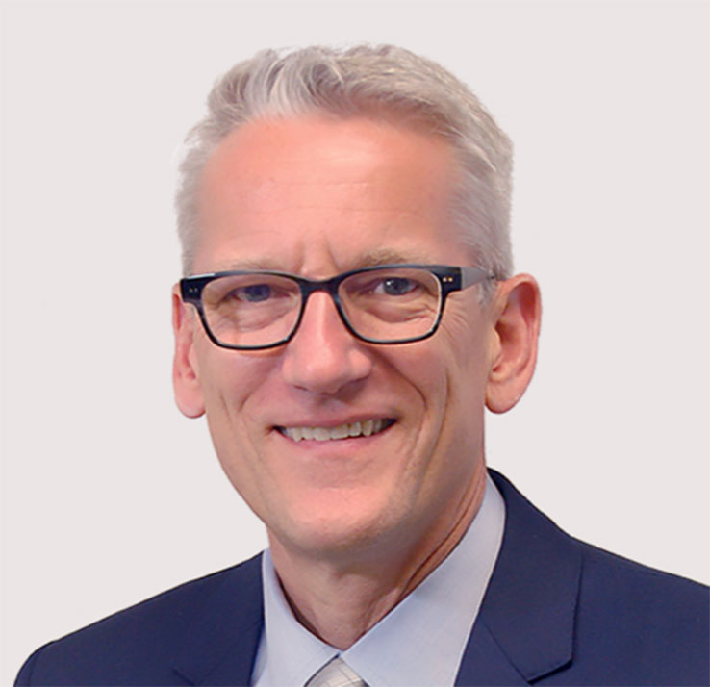
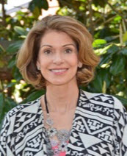
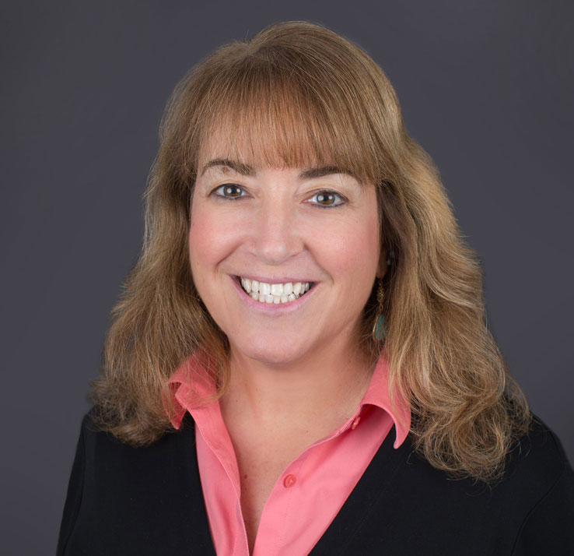
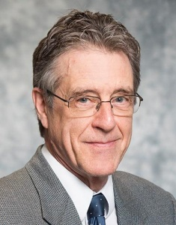
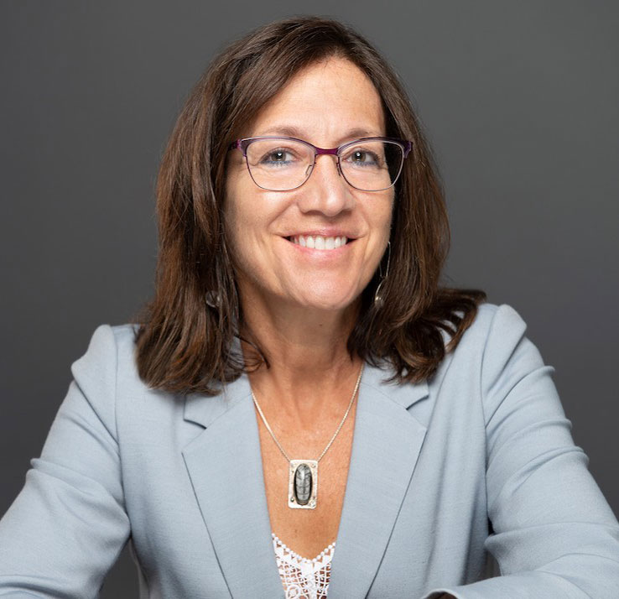
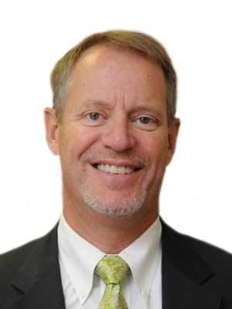
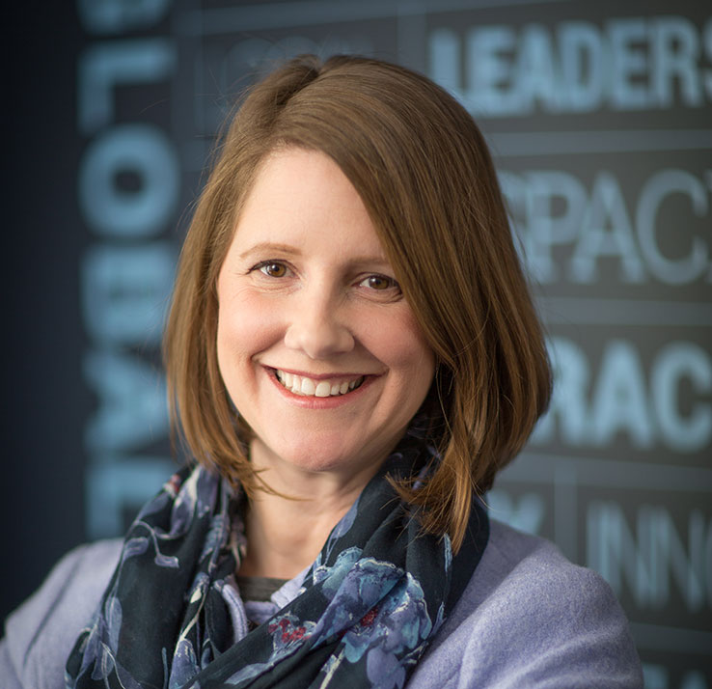
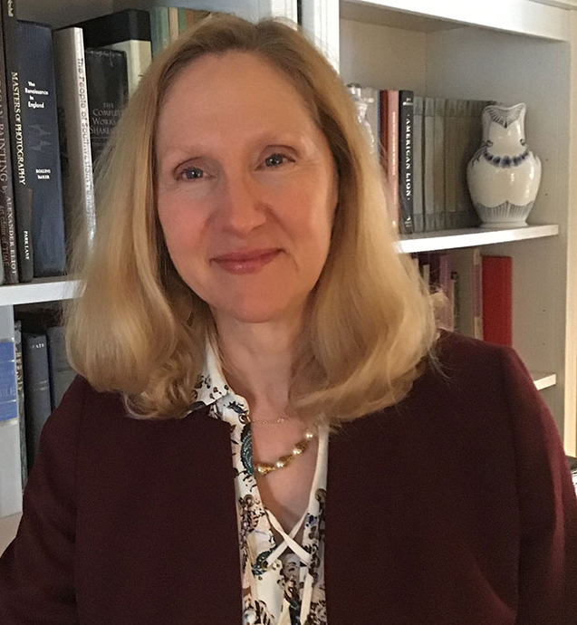
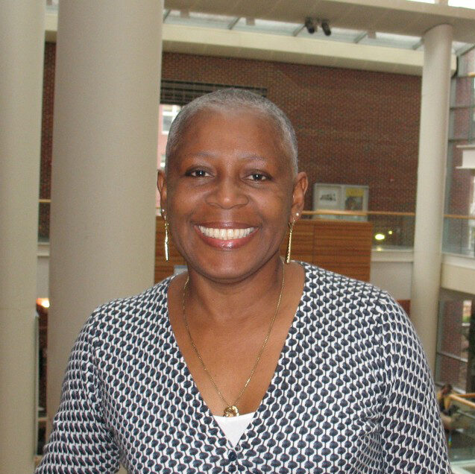
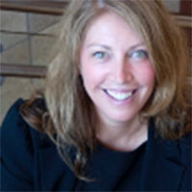
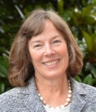
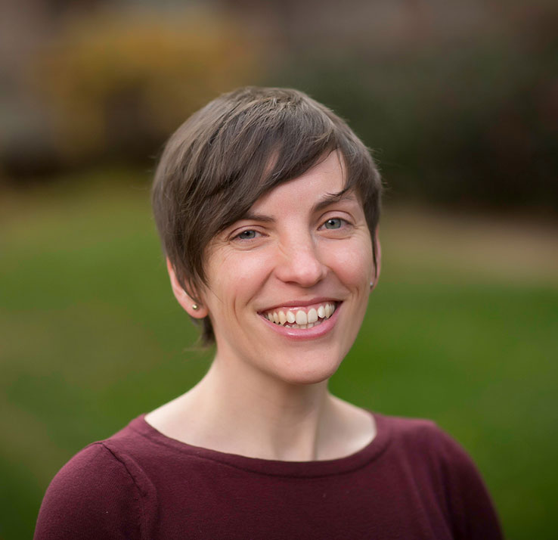
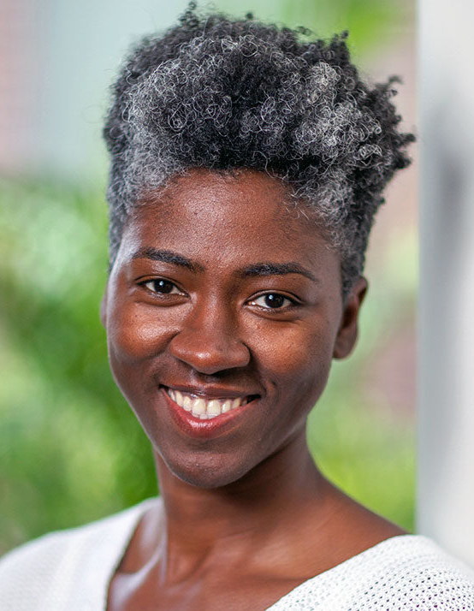
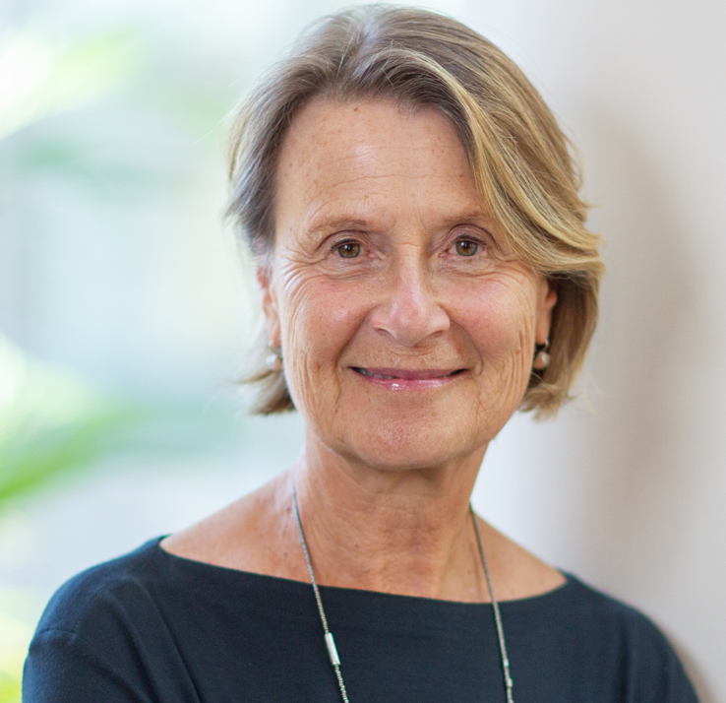
UNC Gillings School Practice Task Force
Practice Task Force Roster
John Wiesman, DrPH, MPH (Co-Chair)
Professor of the Practice; Director, Executive Doctoral Program in Health Leadership
Health Policy and Management
919-445-0774 | john.wiesman@unc.edu
Leah Devlin, DDS, MPH (Co-Chair)
Professor of the Practice
Health Policy and Management
919-696-7095 | leah_devlin@unc.edu
Dorothy Cilenti, DrPH
Associate Professor, Maternal and Child Health; Director, National Maternal and
Child Health Workforce Development Center
919-843-5427 | cilenti@email.unc.edu
Lloyd Michener, MD
Professor Emeritus, Family and Community Medicine
Duke University School of Medicine
919-681-3178 | lloyd.michener@duke.edu
Jeliyah Clark
Doctoral student, Environmental Sciences and Engineering
919-266-1171 | clarkjs@live.unc.edu
Beth Moracco, PhD
Associate Professor, Health Behavior; Adjunct Associate Professor, Maternal and Child Health
919-966-5542 | moracco@email.unc.edu
J. Steven Cline, DDS, MPH
Interim Director, NCIPH
Adjunct Associate Professor
Health and Policy Management
919-926-3963 | stecline@unc.edu
Catherine Sullivan, MPH, RDN, LDN
Assistant Professor, Maternal and Child Health; Director, Carolina Global Breastfeeding Institute
919-843-4118 | catherine_sullivan@unc.edu
Elizabeth French, MA
Associate Dean for Strategic Initiatives;
PAC member/organizer
919-962-2372 | eafrench@unc.edu
Carmen Samuel-Hodge, RD, PhD
Associate Professor
Nutrition
919-966-0360 | cdsamuel@email.unc.edu
Katie Kaney, DrPH, MBA, FACHE
Public Health Foundation Board
ktkaney@aol.com
Anna Schenck, PhD
Associate Dean for Practice; Director and Professor of the Practice, PHLP
919-843-8580 | anna.schenck@unc.edu
Assistant: donaghy@email.unc.edu
Meg Landfried, MPH
Assistant Professor, Health Behavior;
MPH Practicum Director
919-966-0057 | landfried@unc.edu
Courtney Woods, PhD
Assistant Professor/MPH Concentration Director, Environmental Sciences and Engineering
919-962-4660 | cgwoods@email.unc.edu
Sheila Leatherman, CBE, Hon FRCP
Professor of Global Health Policy, Health and Policy Management; Gillings Global Advisor
sleathe@email.unc.edu

Slide 2
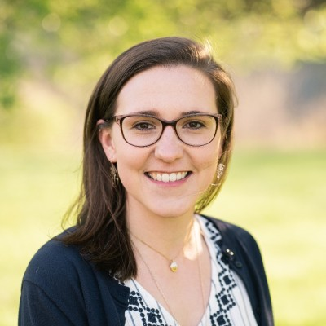
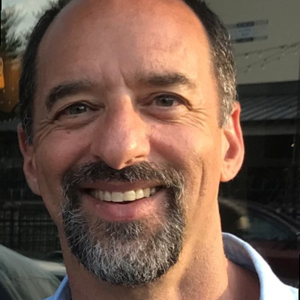
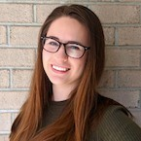
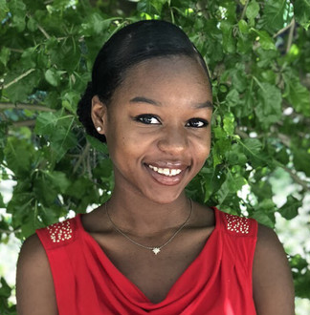
UNC Gillings School Practice Task Force
Key Support
Grace Croitoru
Administrative Support Specialist
Gillings School Dean’s Office
Administrative support to Task Force
919-966-3215 | gracenc@unc.edu
David Napp, MPH
Consultant
Practical Applications of Public Health dnapp@aol.com
Laurel Booth
MPH student
Public Health Leadership Program
GRA to the Practice Dean; RA Support
919-965-9043 | lcbooth@email.unc.edu
Ayanna Smith
MPH student
Maternal, Child and Family Health
RA and Communications Support
919-966-5981 | azsmith@email.unc.edu
Elizabeth French, MA
Associate Dean for Strategic Initiatives
Strategic Plan Staff Lead
Liaison to Practice Task Force
919-962-2372 | eafrench@unc.edu

