Slide 1



Drug Safety in Pregnancy:
Challenges and Solutions
Sonia Hernández-Díaz, MD, DrPH
13th Annual Harry Guess Memorial Lecture

Slide 2
Disclosure
The following personal or financial relationships existed during the past 12 months:
  SHD consulted for Roche and UCB
  SHD participated as investigator in projects funded by Takeda
  SHD was the epidemiologist for the North American Antiepileptic Drugs pregnancy registry and advisor for the Antipsychotics Pregnancy Registry, which are funded my multiple companies
  The Pharmacoepidemiology Program at the Harvard T.H. Chan School of Public Health is partially supported by training grants from Pfizer, UCB, Bayer and Asisa

Slide 3
Outline
Introduction to Drug Safety in Pregnancy
Tools Overview
Challenges & Solutions
Example
Future

Slide 4
Outline
Introduction to Drug Safety in Pregnancy

Slide 5
Background
Once upon a time there was a drug…

Slide 6
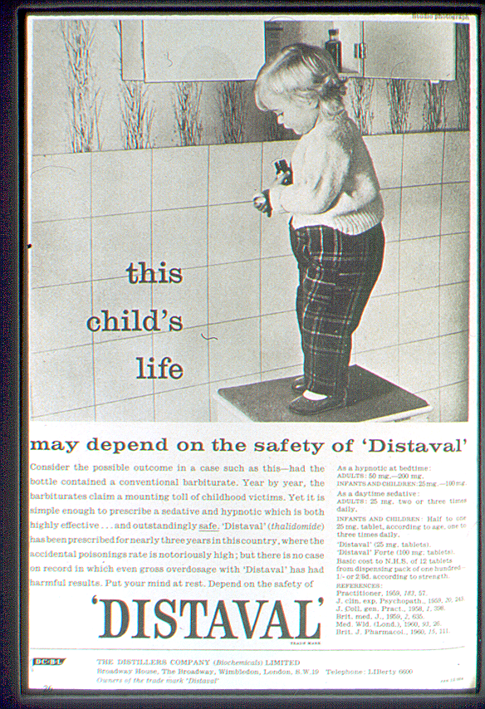
…that entered German market in 1957 as a non-addictive, non-barbiturate sedative
Quickly discovered to also be an effective anti‐emetic and used to treat morning sickness in pregnant women
  Marketing (46 countries; Distaval, Softenon, Contergan):
      “…drug of choice to help pregnant women”
      “completely safe for pregnant women”
  However:
      No studies in pregnant women (or animals) had been conducted.
      “Practically nothing was known about the drug at the time of its marketing"

Slide 7
…that entered German market in 1957 as a non-addictive, non-barbiturate sedative
Quickly discovered to also be an effective anti‐emetic and used to treat morning sickness in pregnant women
  Marketing (46 countries; Distaval, Softenon, Contergan):
      “…drug of choice to help pregnant women”
      “completely safe for pregnant women”
  However:
      No studies in pregnant women (or animals) had been conducted.
      Practically nothing was known about the drug at the time of its marketing

Slide 8
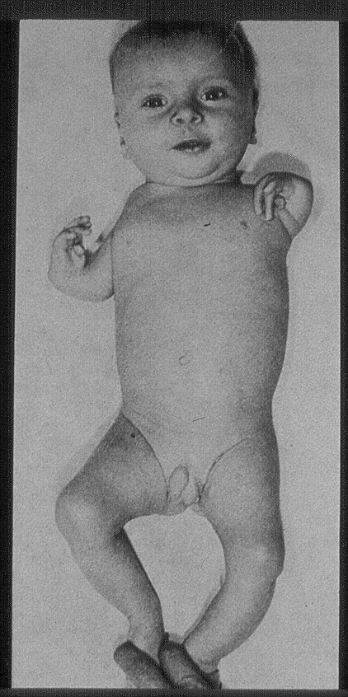
Thalidomide
First afflicted child
  Girl born December 25, 1956
  Daughter of employee of Grünenthal
Thalidomide embryopathy
  Limb deformities (phocomelia)
  Absence of ears

Slide 9
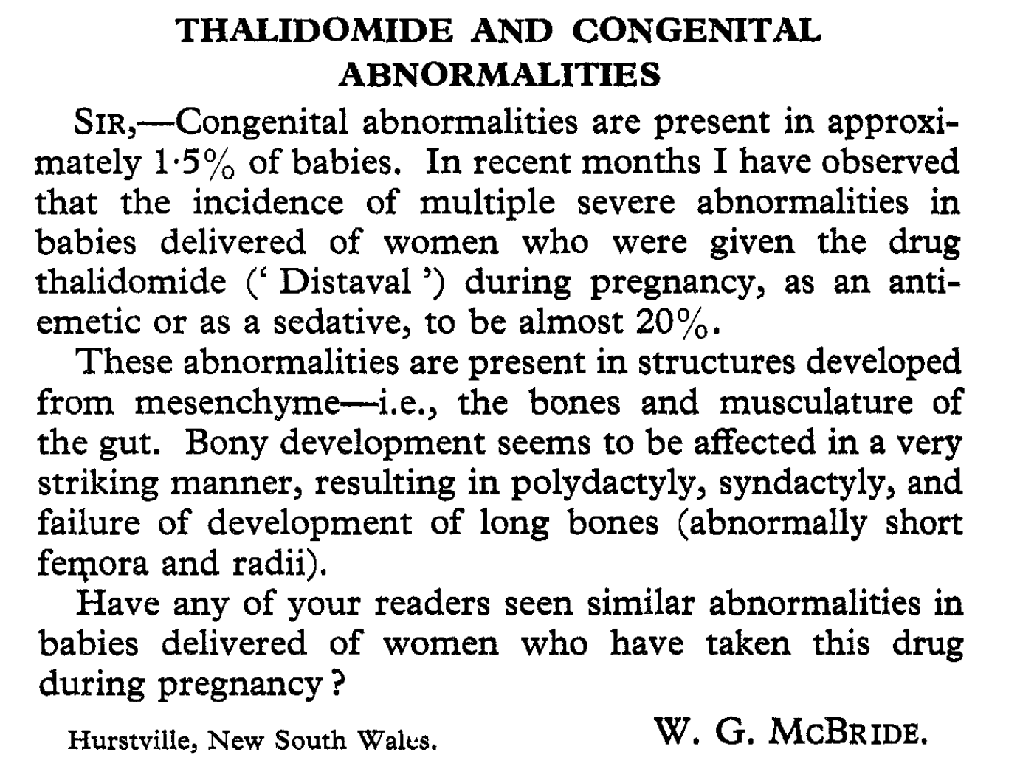
Thalidomide
December 1961, McBride letter in The Lancet:
    Prevalence after exposure: 20% to 50%, around half of the cases included limb defects
    Baseline prevalence of congenital malformations: 3%
No formal epidemiologic studies were necessary to demonstrate causality
However, the lack of a formal surveillance system had a cost….

Slide 10

Lessons learned
Need active surveillance
  Recognition of epidemic of rare defects took almost 4 more years
  Around 10,000 infants were born with deformities worldwide; only about 5,000 survived beyond childhood
  FDA inspector Frances Kelsey, prevented the drug’s approval within the US
1962: Kefauver-Harris Amendments (pre-clinical testing, investigational new drug application, 3 phases of clinical testing)

Slide 11

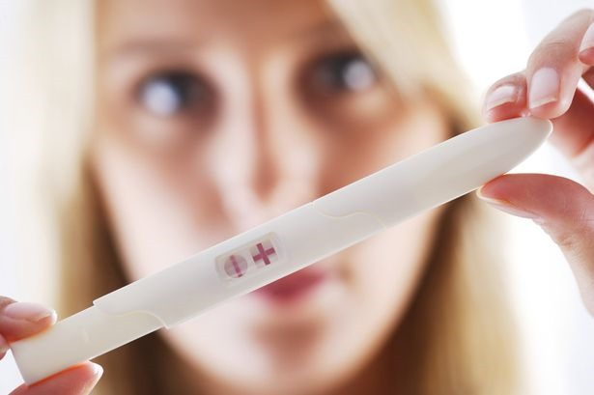
Lessons learned
Need active surveillance
Need to focus on etiologically relevant period
  Critical period 6th and 7th week of pregnancy (35-50 days after LMP)
  Implications for public health

Slide 12
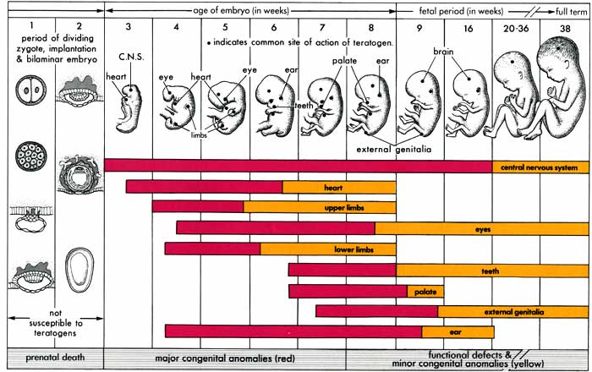
12

Slide 13
Lessons learned
Need active surveillance
Need to focus on etiologically relevant period
  Critical period 6th and 7th week of pregnancy (35-50 days after LMP)
  Implications for public health
  …& for research
Trimethoprim & NTDs by month
Hernández-Díaz S et al. Folic Acid Antagonists During Pregnancy and the Risk of Birth Defects. New England Journal of Medicine 2000;343:1608-1614.

Slide 14
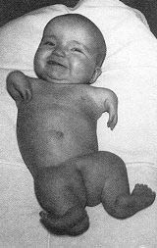
Lessons learned
Need active surveillance
Need to focus on etiologically relevant period
Need to consider specific birth defects
    Major Malformations, 3-4 per 100
    Specific Major Malformations, 1 per 1,000
  Correct phenotype

Slide 15
Lessons learned
Need active surveillance
Need to focus on etiologically relevant period
Need to consider specific birth defects
Post-T-Lesson: Not everything is thalidomide
  1956: Bendectin (doxylamine + pyridoxine) approved
  Concerns arose in late 1970s; series of lawsuits
    “1 of every five malformed infants delivered has been exposed to Bendectin“
    Used by 10 to 25% of pregnant women in the US

Slide 16
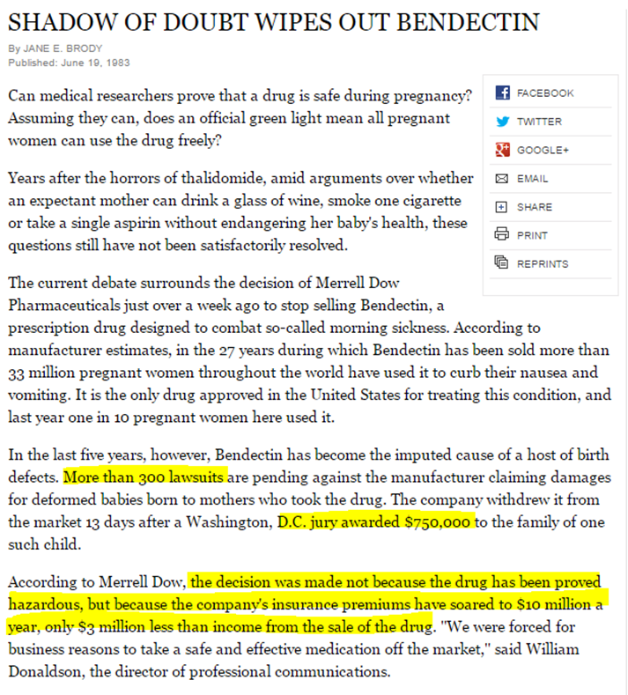
Was there enough evidence to withdraw bendectin?
In 1983, production was discontinued because of litigation.
FDA: “Bendectin was withdrawn by its maker, and not for reasons of safety and efficacy.”

Slide 17

Drug Safety During Pregnancy

Slide 18

Drug Safety During Pregnancy

Slide 19
Outline
Introduction to Drug Safety in Pregnancy
Tools Overview

Slide 20
Is this still a problem today?
Do pregnant women use drugs?
Most women take medications during their pregnancy

Slide 21
What do we need to know for a given drug?
Clinician and patient:
  Is this drug another thalidomide or isotretinoin?
  Are there other, less frequent teratogenic risks?
Regulatory agencies and public:
  What is the teratogenic impact on the public health?
Mitchell AA. Systematic Identification of Drugs That Cause Birth Defects-- A New Opportunity. New England Journal of Medicine 2003;349:2556-2559.

Slide 22
Most commonly used drugs
Apart from vitamins and minerals, the most used drugs during pregnancy are:
  Analgesics
  Cough/cold medications
  Allergy /asthma
  Antibiotics/anti-infectives
Most commonly used drugs are non-prescription
Most commonly used drugs change over time (exposure to opioids, psychotropics and vaccines has increased)

Slide 23
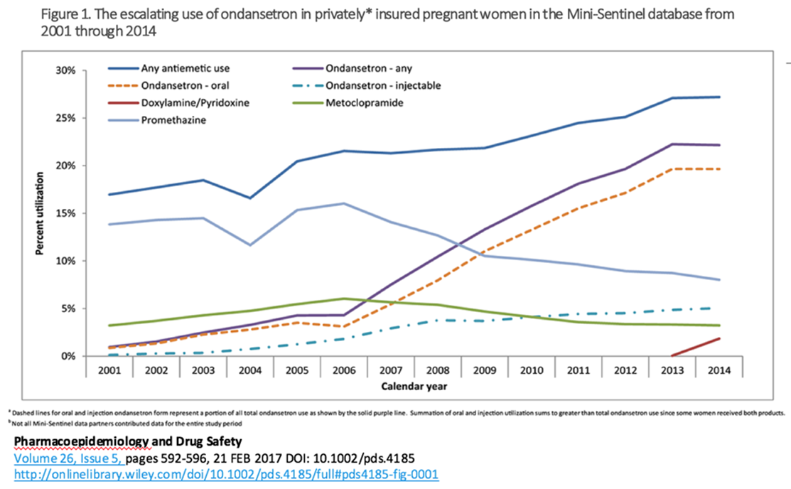
Secular patterns of selected anti-nausea medications during the first trimester

Slide 24
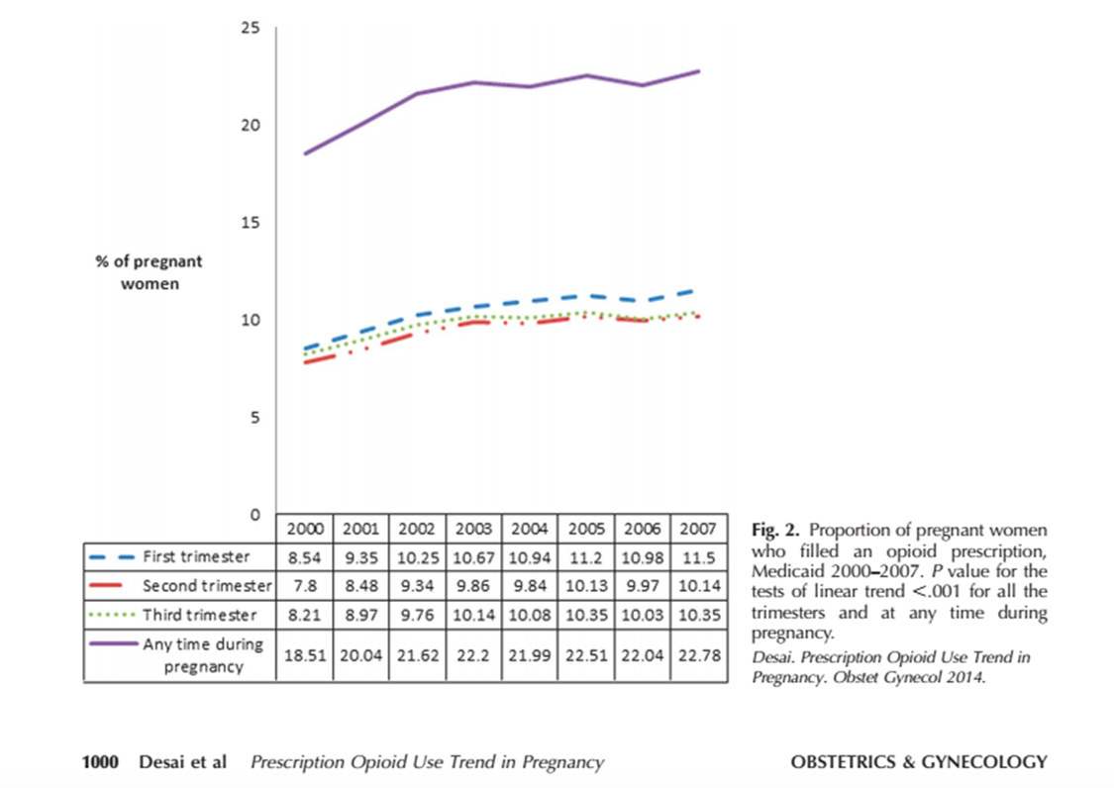
Opioids epidemic also affecting pregnancy…
Desai R, Hernández-Díaz S, Bateman BT, Huybrechts K. Increase in prescription opioid use during pregnancy among Medicaid-enrolled women. Obstet Gynecol. 2014;123(5):997-1002
24

Slide 25

Where can we identify teratogens?
Premarketing Approaches:
  Pharmacologic or toxicologic studies - poor predictors
  Animal studies - poor predictors
  Clinical trials - exclude pregnant women

Slide 26
Where can we identify teratogens?
Post-marketing Approaches:
  Case reports - clues; false alarms
  Ecological studies - clues; false alarms
  Experimental studies - too small
  Non-experimental (epidemiologic) studies
    Cohort
    Case-Control

Slide 27
Where can we identify teratogens?
Designed for Birth Defects Research
  Cohorts, wide range of exposures - Collaborative Perinatal Project, MoBa
  Cohorts, specific exposures – Exposure Pregnancy Registries
  Case control studies – Case Control Surveillance (Slone, BDSTEPS)
Designed for Other Purposes
  Automated claims databases - Medicaid Analytic eXtract, Optum, IBM MarketScan
  Computerized medical records – UK Clinical Practice Research Datalink (CPRD)
  Provincial registries - Régie de l'assurance maladie du Québec, Health Services Saskatchewan
  National Registers - Nordic linked databases

Slide 28
Surveillance strategy
Exposure pregnancy registries
  To identify drugs with dramatic fetal risks (e.g., thalidomide)
  New drugs
Health care databases
  To identify drugs with moderate fetal risk
  Commonly used prescription drugs and/or relatively common outcomes
Case control surveillance
  To identify drugs with moderate fetal risk
  Suspected specific malformation (or other outcome) & relatively common use

Slide 29
Outline
Introduction to Drug Safety in Pregnancy
Tools Overview
Challenges & Solutions

Slide 30
Source Population
Mother
Pregnancy
Fetus (1 or more)
  Need information on outcome for each fetus or newborn

Slide 31

Role of multifetal gestations
Exposure of interest, e.g. what is the effect of multiple gestation on the risk of adverse perinatal outcomes?
Outcome of interest, e.g. what is the effect of infertility treatment on the risk of multiple gestation?
Confounder, e.g. what is the effect of delivery via cesarean section on perinatal outcomes?
Causal Mediator
Source of clustered data structure (Generalized estimating equations)
Oberg AS, VanderWeele TJ, Almqvist C, Hernandez-Diaz S. Pregnancy complications following fertility treatment—disentangling the role of multiple gestation. International journal of epidemiology 2018;47(4):1333-134

Slide 32
Information Bias - Exposure
Misclassification
  False positives (adherence / compliance, stop after conception)
    More than a quarter of new prescriptions are unfilled, especially when the drugs are for symptomless conditions
  False negatives (OTC, sharing, missing data, recall)
Differential misclassification
  Recall bias (retrospective interviews)
Etiologically relevant period → need timing of pregnancy too

Slide 33
Information Bias - Solutions
Exposure: Filling ≥ 1 prescription during the first trimester
Reference: No prescription for index drug in months or filling ≥ 1 prescription for reference drug with same indication
Prospective records of drugs
Comparable sources of information
  Other defects as controls
Improve algorithms to identify last menstrual period (LMP)

Slide 34
Information Bias - Outcome
Misclassification (e.g. ICD9 codes, maternal report)
  Suspected diagnoses may be coded to justify the performance of diagnostic tests (rule-out diagnoses)
Differential misclassification
  Diagnostic bias (ultrasounds and minor defects)
  Comparable “major malformation” definition (CAUTION with external reference)
    Period of diagnosis (prenatal, birth, life)
    Inclusion / exclusion criteria

Slide 35
Information Bias - Solutions
Measure outcome in study with accuracy (accurate internal data)
Use algorithms with high specificity
Validate all potential cases with external data (e.g., medical records) and use “definite cases”
Validate a subsample of potential cases, quantify misclassification and evaluate impact on relative risk estimates

Slide 36
Use algorithms that prioritize Specificity
1 code
Prevalence of major congenital malformations defined on the basis of
a single diagnostic claim (blue bars) or
an algorithm requiring multiple codes or a single code plus a corrective procedure and/or infant death
2 codes or 1+procedure/death
Huybrechts KF, Bateman BT, Hernandez-Diaz S. Use of real-world evidence from healthcare utilization data to evaluate drug safety during pregnancy. Pharmacoepidemiology and drug safety 2019.

Slide 37
 | MALFORMATION GROUP
1 | Central Nervous System
2 | Eye Anomalies
3 | Ear Anomalies
4 | Cardiovascular Anomalies
5 | Other vascular (non-cardiac)
6 | Respiratory malformations
7 | Oral cleft
8 | Gastrointestinal
9 | Genital (male and female)
10 | Urinary
11 | Musculoskeletal (no limbs, includes omphalocele and gastroschisis)
12 | Limb defects
13 | Other
Specific malformations:
  >1 date with code
  1 date + surgery/procedure
  1 date + infant death within 90 days
  For selected malformations: at least one code documented at >= 6 weeks after DoB
Malformations overall:
  Any of the 13 specific malformations present

Slide 38


Validation studies
Medicaid claims data
ID | Date | Type of Code | Code | Description
12345 | 11/15/2005 | ICD-9 diagnosis | V3001 | Single live born in-hospital with CS
12345 | 11/15/2005 | ICD-9 diagnosis | 769 | Respiratory distress syndrome
12345 | 11/15/2005 | CPT procedure | 71010 | Radiologic examination, chest
12345 | 11/15/2005 | ICD-9 diagnosis | 7454 | Ventricular septal defect
12345 | 11/16/2005 | ICD-9 diagnosis | 7454 | Ventricular septal defect
Validate
Hospital medical records
Palmsten K, Huybrechts KF, Kowal MK, Mogun H, Hernández-Díaz S. Validity of maternal and infant outcomes within nationwide Medicaid data. Pharmacoepidemiol Drug Saf. 2014; 23:646-55.

Slide 39
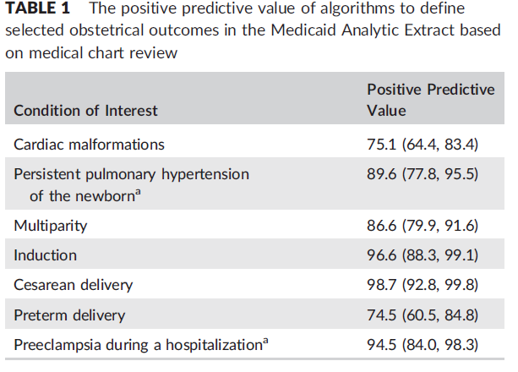
Validation studies
Not all cases validated → Use plausible misclassification in probabilistic bias analyses
Palmsten K, Huybrechts KF, Kowal MK, Mogun H, Hernandez-Diaz S. Validity of maternal and infant outcomes within nationwide Medicaid data. Pharmacoepidemiology and drug safety 2014;23:646-55.

Slide 40
Sensitivity analyses
For misspecification
  Assess robustness of definition, try modifications of phenotype
    Example: For preeclampsia, estimate the relative risk separately for early-onset (diagnosis between day 141-237) and late-onset (diagnosis after 237 days)
2. For misclassification
  Assess impact of excluding outcomes designated as “probably occurred” or “likely did not occur” based on review of claims profiles or medical records
  Correct relative risks for outcome misclassification using sensitivity and specificity derived from PPV estimated in validation studies
Fox MP, Lash TL, Greenland S. A method to automate probabilistic sensitivity analyses of misclassified binary variables. International journal of epidemiology 2005;34:1370-6.
Lash TF, Fox MP, Fink AK. Missclassification. Applying Quantitative Bias Analysis to Epidemiologic Data. New York: Springer; 2009:79-108.

Slide 41
Selection Bias
Start of follow up (left-censoring)
  What would you expect to find if exposed subjects are enrolled during first trimester and unexposed are enrolled later in pregnancy?

Slide 42
Timing of first interview

Slide 43
Differential Timing of Enrollment
Pregnancies
43
Notes:
9/7/2020
Sonia Hernández-Díaz
43

Slide 44
Impact on Spontaneous Abortions
All enrollees
cases/N in AED users: 353/7,029
Non-users: 6/581
 | RR
Unconditional logistic regression | 5.1 (2.3;14.1)
Conditional on:
Trimester of enrollment | 2.7 (1.2; 7.6)
Week | 2.0 (0.9; 5.6)
Average IRR | 2.1 (0.9; 4.6)
Margulis AV, Mittleman MA, Glynn RJ, Holmes LB, Hernández-Díaz S. Effects of gestational age at enrollment in pregnancy exposure registries. Pharmacoepidemiology and Drug Safety. 2015; 24(4):343-52.

Slide 45
Selection Bias
Start of follow up (left-censoring)
  What would you expect to find if subjects are enrolled late in pregnancy, after prenatal screening tests?
    If diagnoses are included: potential overestimation if preferential enrollment or underestimation if lower participation of cases.
    If diagnoses are excluded: underestimation

Slide 46
Impact on Birth Defects
Pregnancies
Enrollment
46
Notes:
9/7/2020
Sonia Hernández-Díaz
46

Slide 47
Impact on Birth Defects
Pregnancies
47
Notes:
9/7/2020
Sonia Hernández-Díaz
47

Slide 48
Impact on Birth Defects
Pregnancies
48
Notes:
9/7/2020
Sonia Hernández-Díaz
48

Slide 49
Impact on Birth Defects
All enrollees
Pre-screening enrollees
M/N in AED users: 210/6,676
nonusers: 6/575
AED users: 117/3,955
nonusers: 3/206
 | RR |  | RR
Unconditional logistic regression | 3.1 (1.4; 8.5) |  | 2.1 (0.7; 10.2)
Conditional on:
Trimester of enrollment | 3.2 (1.4; 9.0) |  | 2.1 (0.7; 10.4)
Week | 3.2 (1.4; 9.0) |  | 2.0 (0.7; 10.1)
Notes:
Here, comparing the results in the first row, restricting to pre-screening enrollees (that is, those who did not get the results from their prenatal screening) brings the relative risks down.
Comparing within each column, we see that conditioning on gestational age at enrollment does not make much of an impact.
Why? Is it possible that AED users, when they know that they carry a fetus with a MCM, decide to enroll (after prenatal screening), while non-users do the opposite?

Slide 50
Selection Bias - Solutions
Minimize left truncation (enroll early or detect early pregnancies)
When the incidence rate of events changes over pregnancy (e.g., SAB), ensure that the distribution of time at risk for the outcome is comparable between exposure groups
When an event may influence enrollment decisions (e.g., prenatal screening), primary analyses must include only subjects who enrolled before this event

Slide 51
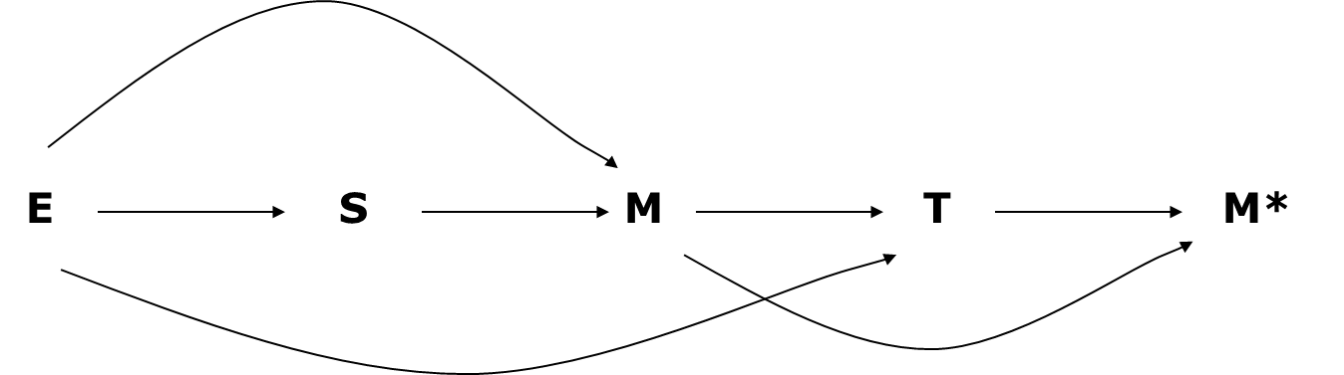
Selection Bias
End of follow up (right-censoring & Competing events)
  Abortion, Preterm delivery → Reduced opportunity for exposure & outcomes
  Intrauterine survival (Incidence versus prevalence at birth)
Exposure (E) may affect the risk of early miscarriages or social terminations during 1st trimester (S), and/or the risk of Malformations (M); Malformation (M) early in pregnancy affect terminations in second trimester (T), when diagnosed prenatally and family decides to induced abortion, and M affects fetal loss if incompatible with fetal survival; which affect observation of malformations at birth (M*).

Slide 52
Selection Bias
What would you expect to find in an analysis of teratogenicity if
  exposure to drug XX causes early pregnancy losses?
  a large proportion of malformations (e.g., NTDs) are terminated ?
  only livebirth have information on malformations?

Slide 53
Impact on Birth Defects
Pregnancies
Window of observation at birth
53
Notes:
9/7/2020
Sonia Hernández-Díaz
53

Slide 54
Impact on Birth Defects
Pregnancies
54
Notes:
9/7/2020
Sonia Hernández-Díaz
54

Slide 55
Intrauterine survival
Right truncation
    Non-differential
      How common is it ? What is the impact?
    Differential
      How likely is it ? What is the impact ?
Elisabeth Svensson et al. Estimating the Proportion of all Observed Birth Defects Occurring in Pregnancies Terminated by a Second-trimester Abortion. Epidemiology 2014.
Levy A et al. Bias toward the null hypothesis in pregnancy drug studies that do not include data on medical terminations of pregnancy: the folic acid antagonists. J Clin Pharmacol. 2012;52:78–83.

Slide 56
Confounding
Smoking, illegal drugs, BMI, etc.
Indication (e.g., depression, asthma)

Slide 57
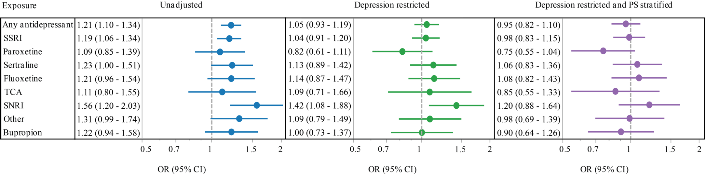
Effect of antidepressants on the risk of cardiac defects
In 2005, the FDA warned against a potential increase in the risk of congenital cardiac malformations associated with paroxetine
Adjustment (for smoking, BMI, SES, etc) did not change OR in case-control studies
We created the Medicaid Analytic eXtract (MAX) mother-infant cohort (>3M)
Huybrechts K, Palmsten K, Avorn J, Cohen LJ, Holmes LB, Franklin JM, Mogun H, Levin R, Kowal M, Setoguchi S, Hernández-Díaz S. Antidepressant Use in Pregnancy and the Risk of Cardiac Defects. New England Journal of Medicine. 2014;370:2397-407).
Notes:
In 2005, FDA warned against a potential increase in the risk of cardiac malformations associated with maternal use of antidepressants,
Many (NON EXPERIMENTAL) studies looked at it. Most small and none had taken into account depression
We created a cohort of over 3 million pregnancies linked to the infants using Medicaid data
These are the crude results… antidepressants were associated with a 20% increased risk.
However, users are not comparable to non users. Among other things, users have depression or anxiety. When we restricted to women with depression and further adjusted for other comorbidities such as diabetes… the relative risk moved to the null.

Slide 58
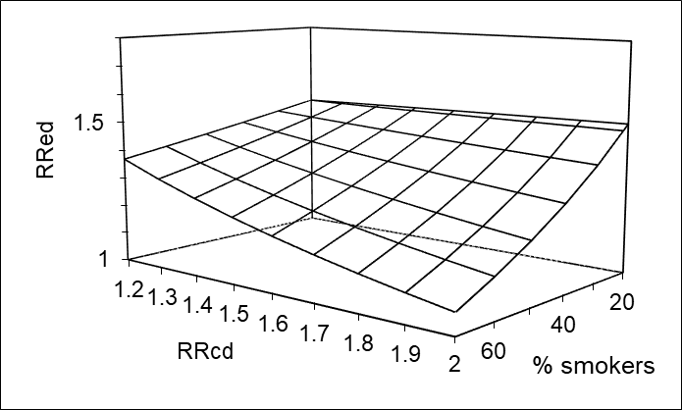
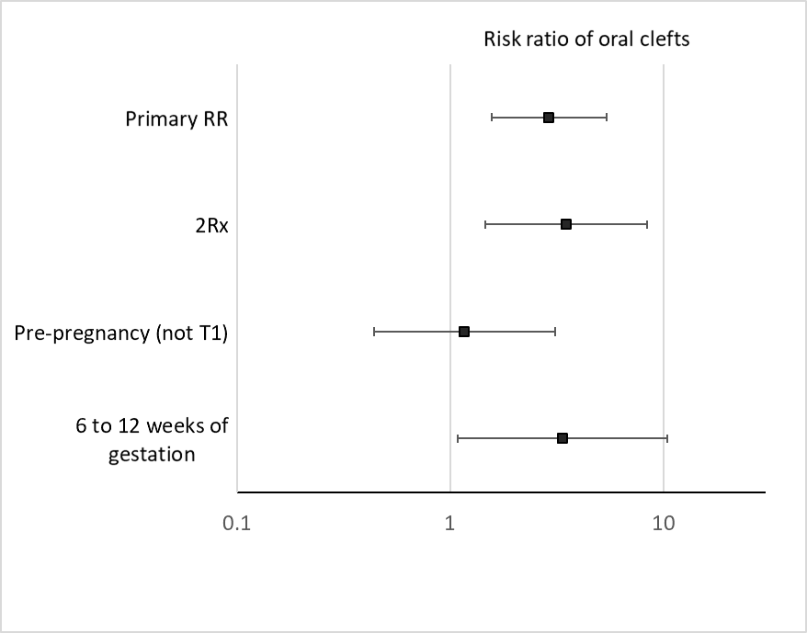
Confounding
Mitigate through design → Target trial (e.g., inclusion criteria, active comparator)
Adjust for measured confounders
External adjustment (e.g., National Health and Nutrition Examination Survey)
Negative controls (e.g., Evaluate the effect of exposure during a window other than the suspected etiologically relevant window)
Probabilistic bias analyses (Fox et al. Int J Epidemiol 2005)
External adjustment of the observed crude relative risk (RR_{ED}) using NHANES data.
Hernandez-Diaz S, Huybrechts KF, Desai RJ, et al. Topiramate use early in pregnancy and the risk of oral clefts. Neurology. 2018; 90(4):e342-e351

Slide 59
Alternative explanations
Association
Chance
Bias
Selection
Causal
Information
Confounding

Slide 60
Pregnancy Registries
First line of evidence to identify teratogens because they are able to enroll women soon after drug approval.
However, they often fail to produce robust safety data, particularly for newly introduced drugs for relatively rare conditions.
Targeted enrollment usually ranges between 100 and 500 pregnancies
  only 14% of registries achieve target enrolment
  Is this sample size sufficient to detect meaningful risks?
Sahin L. Pregnancy exposure registries and other post-approval studies: current status and observations. Data on file. Center for Drug Evaluation and Research, Office of New Drugs, FDA; 2014. Available at: http://www.fda.gov/downloads/Drugs/NewsEvents/UCM399660.pdf.

Slide 61
Deciding the minimal sample size: Under null
Assuming a baseline risk of 3% for major malformations, a cohort with a ratio of exposed to unexposed 1:3, and about 100 exposed pregnancies would have 80% power to “exclude” relative risks (RRs) of 6.5 based on 95% confidence intervals, if the true RRs equal 1.
Upper limit of 95% CI for RR will be less than | Study size required to have 80% probability that the UL of the 95% CIs will be below selected thresholds
 | Exposed | Unexposed
350 | 10 | 30
13.5 | 50 | 150
6.5 | 100 | 300
2.3 | 500 | 1500
Alpha=0.05 ; Beta=0.20; Reference group = 3x Exposed
Rothman KJ. Available at: http://www.krothman.org/episheet.xls.

Slide 62
Deciding the minimal sample size: Under alternative
If there is an effect, a sample size of 100 exposed would provide power to detect RRs over 3.1.
Larger numbers would be needed to study specific defects
To identify a relative risk of at least | Need to follow
 | Exposed | Unexposed
10 | 10 | 30
4.5 | 50 | 150
3.1 | 100 | 300
1.9 | 500 | 1500
Alpha=0.05 ; Beta=0.20; Reference group = 3x Exposed

Slide 63
For a relatively common defect such as oral cleft
(baseline 1 per 1,000 births):
To identify a relative risk of at least | Need to follow
 | Exposed | Unexposed | Total
20 | 150 | 300 | 450
12 | 300 | 600 | 900
5 | 1,500 | 3,000 | 4,500
Alpha=0.05 ; Beta=0.20; Reference group = 2x Exposed
63
Notes:
63
63
rely on volunteer participation and, consequently, minorities and underserved populations are often under-represented (e.g. HIV positive women)

Slide 64
Conclusion
The typical pregnancy registry would detect strong teratogenicity, but low- risk teratogens will not be identifiable
Most registries are inadequately powered to study associations for specific major malformations
Complementary approaches should be considered before concluding that “there is no increased risk in birth defects,” or that “drug A causes specific defect X”
Gelperin K, Hammad H, Leishear K, Bird ST, Taylor L, Hampp C, et al. A systematic review of pregnancy exposure registries: examination of protocol-specified pregnancy outcomes, target sample size, and comparator selection. Pharmacoepidemiol Drug Saf. 2017 Feb;26(2):208-14.

Slide 65
Consequences of small numbers
False Negatives:
  Most studies lump together all major malformations even when teratogens tend to cause specific defects → dilution of effect
  Wrong interpretation of evidence when non statistical significance is used as evidence of no effect → DO NOT USE p-values for safety
    It is not a yes/no question, it is about establishing the level of risk and discussing whether it is acceptable given the benefits, risks and costs

Slide 66
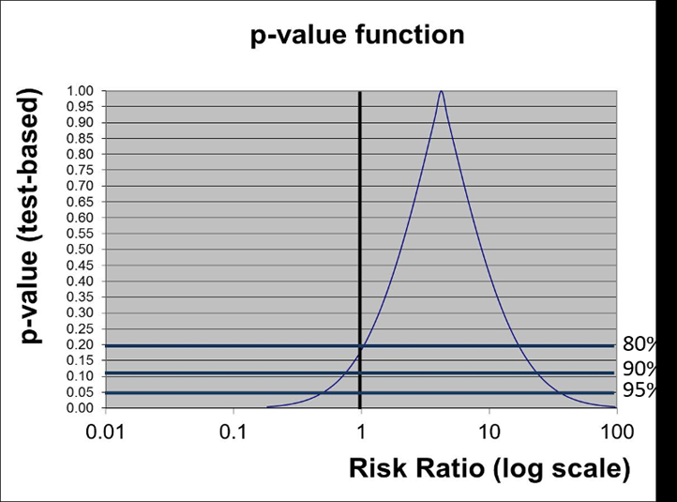
Incorrect use of p-values and confidence intervals
  Example: “… we found an adjusted hazard ratio [HR] of 1.59 [95% CI, 1.17-2.17]). After adjustment the association was not significant (HR, 1.61 [95% CI, 0.997-2.59]). In conclusions, in utero XXXXX exposure was not associated with YYYYY
  Just wrong

Slide 67
Consequences of small numbers + multiple comparisons
False Positives
  when the estimated prevalence for the first specific malformation identified in enrollees (e.g., an oral cleft) is compared with the expected prevalence in the population (e.g., 0.1%) → no cherry picking
  or when results are selectively reported only if the number of exposed cases is >5 → publication bias

Slide 68
Selective reporting renders false the meanings of statistical significance, P values, and confidence intervals
.5
1
2
3
null

Slide 69
Solution
Careful Interpretation
Replication
Strategies to increase the power
  Healthcare Databases
  International collaborations

Slide 70
Outline
Introduction to Drug Safety in Pregnancy
Tools Overview
Challenges & Solutions
Example

Slide 71
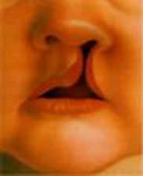
Example: Topiramate
Background: One report had suggested an increased risk of oral clefts after in utero exposure to topiramate
Aim: To estimate the risk of oral clefts in infants whose mothers had taken topiramate as monotherapy during the first trimester of pregnancy
Hunt S et al. Topiramate in pregnancy: Preliminary experience from the UK Epilepsy and Pregnancy Register. Neurology 2008;71;272-276

Slide 72
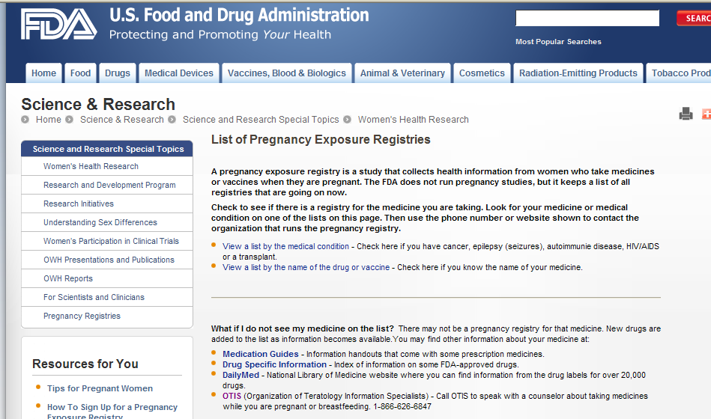
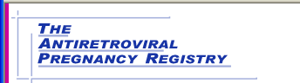
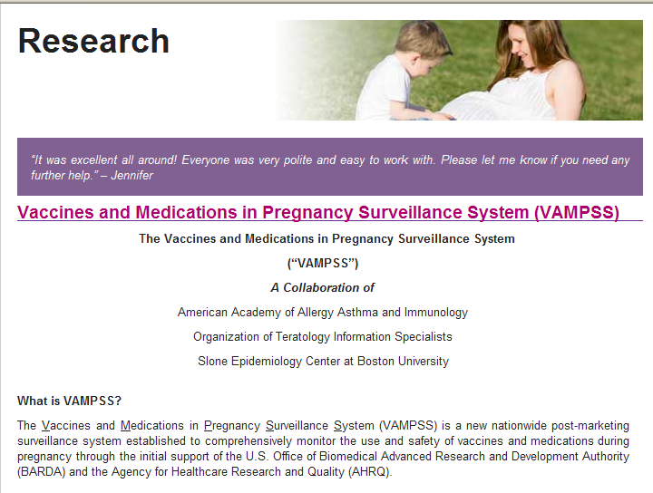
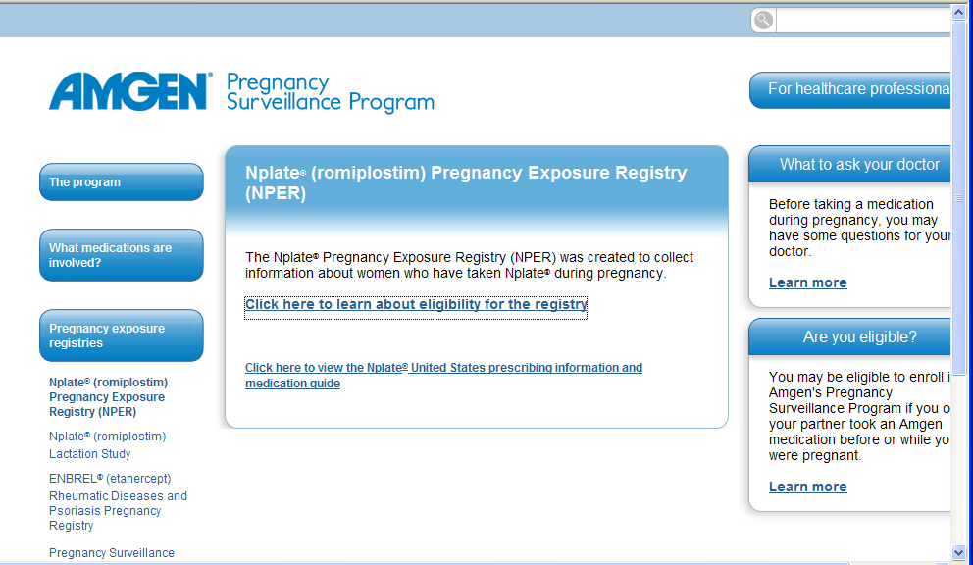
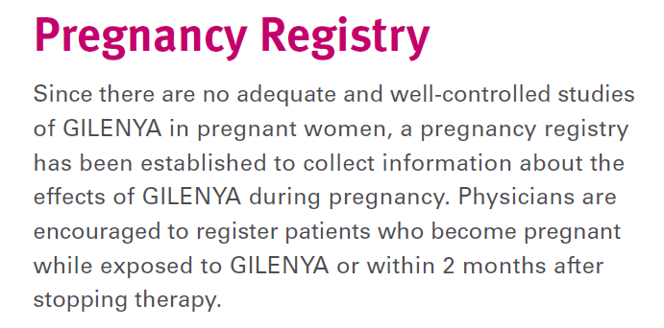
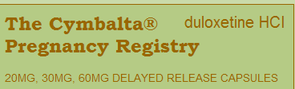
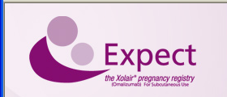
http://www.fda.gov/ScienceResearch/SpecialTopics/WomensHealthResearch/ucm134848.htm

Slide 73
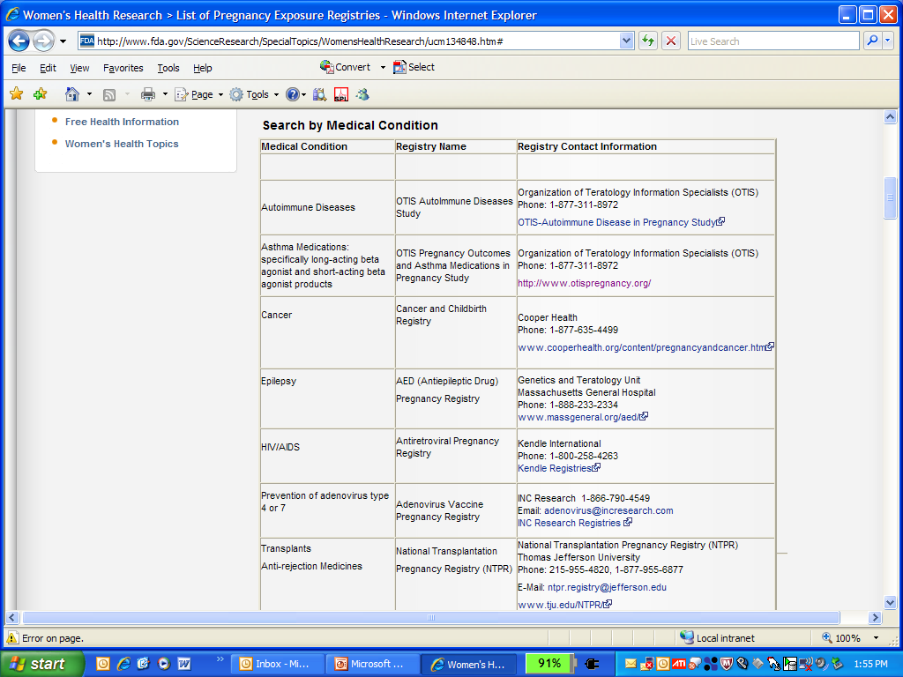
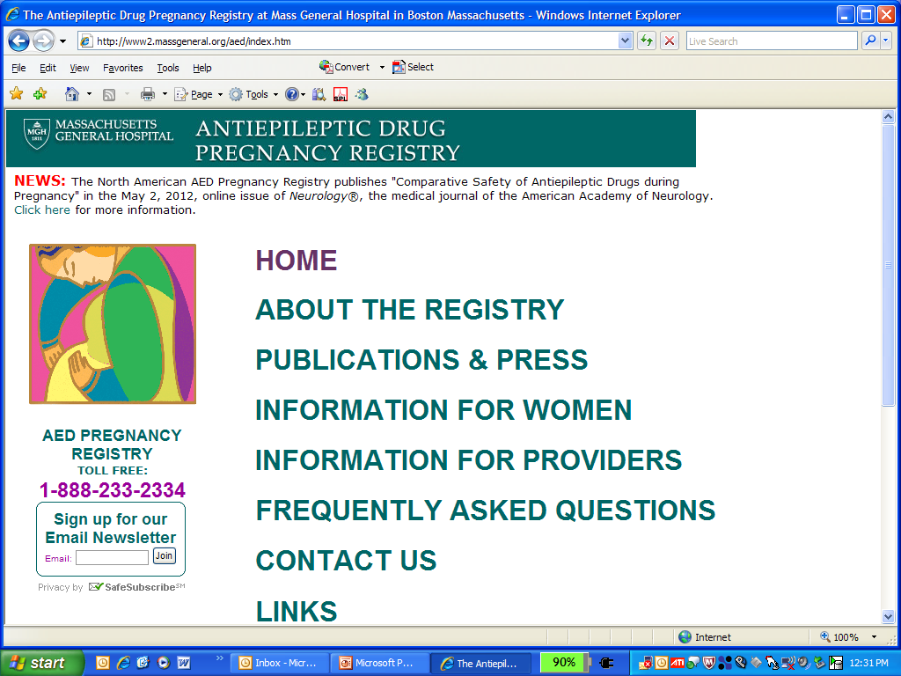
http://www.fda.gov/ScienceResearch/SpecialTopics/WomensHealthResearch/ucm134848.htm

Slide 74
North American AED Pregnancy Registry
Established in 1997 at Mass. General Hospital, Boston
Enrolls pregnant women taking AEDs, and a reference group of friends and family members not taking AED
Women call
Consent is obtained verbally for interview. Written consent obtained for maternal and infant’s medical records

Slide 75
North American AED Pregnancy Registry
Three telephone interviews:
  Enrollment (10-15 min.)
  7 Months GA (5 min.)
  2 Months postpartum (5 min.)
Ask about
  AED use, demographic characteristics, epilepsy, vitamin use and the presence of malformations
  For any AED data is collected on indication, dose, and start and stop dates
Presence of malformations confirmed by medical records
  Findings in infant reviewed by teratologist blinded to exposure status

Slide 76
Reference groups
Exposed (to other AED) internal reference group
  Lamotrigine, the most commonly reported AED
Unexposed internal reference group
  Friends and family members not taking AED enrolled in the Registry
External reference group
  Active Malformations Surveillance Program, BWH, 1972 – 2000
  206,244 livebirths, stillbirths and elective terminations
  Malformations identified before 5 days of age

Slide 77
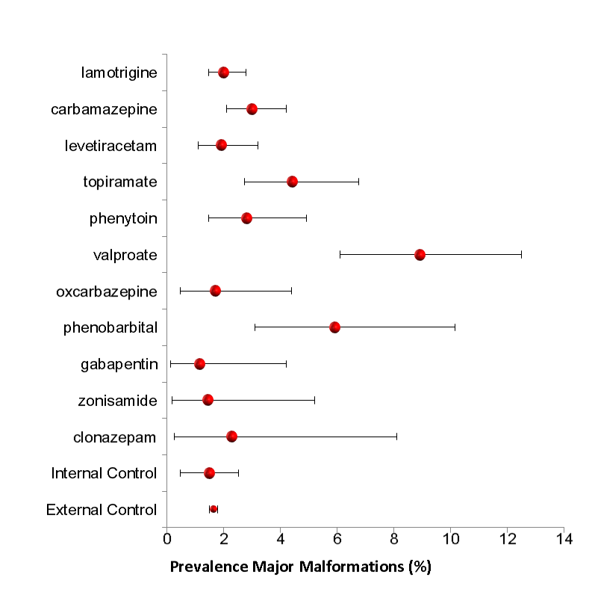
Topiramate

Slide 78
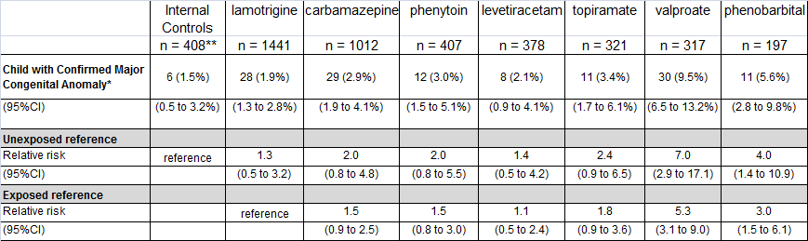
Risk of major malformations among infants exposed to specific AED in monotherapy during the first trimester
Hernández-Díaz S, Smith CR, Shen A, Mittendorf R, Hauser WA, Yerby M, Holmes BH. Comparative Safety of Antiepileptic Drugs during Pregnancy. Neurology 2012;78:1692-1699.

Slide 79
Topiramate
4 of these 11 were oral clefts (13.5/1,000)
Frequency in the external control group: 0.7/1,000
Conclusion: Need to replicate

Slide 80


Topamax (topiramate): Label Change - Risk For Development of Cleft Lip and/or Cleft Palate in Newborns
Available as generic topiramate
AUDIENCE: Neurology, OB/GYN
ISSUE: FDA notified healthcare professionals and patients of an increased risk of development of cleft lip and/or cleft palate (oral clefts) in infants born to women treated with Topamax (topiramate) during pregnancy. Because of new human data that show an increased risk for oral clefts, topiramate is being placed in Pregnancy Category D. Pregnancy Category D means there is positive evidence of human fetal risk based on human data but the potential benefits from use of the drug in pregnant women may be acceptable in certain situations despite its risks. The patient medication guide and prescribing information for Topamax and generic topiramate will be updated with the new information.
BACKGROUND: Topiramate is an anticonvulsant medication approved for use alone or with other medications to treat patients with epilepsy who have certain types of seizures. Topiramate is also approved for use to prevent migraine headaches. The new data was from the North American Antiepileptic Drug (NAAED) Pregnancy Registry.
RECOMMENDATION: Before starting topiramate, pregnant women and women of childbearing potential should discuss other treatment options with their health care professional. Women taking topiramate should tell their health care professional immediately if they are planning to or become pregnant. Patients taking topiramate should not stop taking it unless told to do so by their health care professional. Women who become pregnant while taking topiramate should talk to their health care professional about registering with the North American Antiepileptic Drug Pregnancy Registry, a group that collects information about outcomes in infants born to women treated with antiepileptic drugs during pregnancy.
Notes:
The FDA has recently recategorized the anticonvulsant drug topiramate (Topamax®) as pregnancy class D from its previous class C status in response to data released from the North American Antiepileptic Drug Registry showing an association between topiramate use in pregnancy and oral clefts in the newborn
This potential teratogenic effect is of particular relevance given current consideration of FDA approval for a topiramate-containing weight loss product.

Slide 81
Replication: Topiramate
Two North American birth defects case control studies
  Slone Epidemiology Center Birth Defects Study (BDS)
  Centers for Disease Control and Prevention National Birth Defects Prevention Study (NBDPS)
The two studies have many similarities:
  Study design
  Data collection methods (e.g. identification of cases and controls; a computer-assisted telephone interview)
  Case classification (i.e. by expert clinical reviewers)
  Controls are live born infants without birth defects

Slide 82
Slone Epidemiology Center Birth Defects Study
Centers for Disease Control and Prevention National Birth Defects Prevention Study
Results from pooled data
 | No AED | Topiramate | Adjusted* OR (95% CI)
Controls | 15,367 | 6 | Reference
CL/P | 3,034 | 7 | 5.36 (1.49 – 20.07)
AED, antiepileptic drug; CI, confidence interval; CL/P, cleft lip with or without cleft palate; MCM, major congenital malformations; OR, odds ratio
* Conditional on year and region of birth, and study
Margulis AV, Mitchell AA, Gilboa SM, Werler MM, Mittleman MA, Glynn RJ, Hernández-Díaz S, and the National Birth Defects Prevention Study. Use of topiramate in pregnancy and the risk of oral clefts. Am J Obstet Gynecol 2012;207:405.e1-7.

Slide 83

Medicaid Analytic eXtract (MAX)
Joint state and federal health insurance program for low-income families
      Covers ~50% of births in the U.S
Medicaid enrollment & health care utilization data
      Demographics, insurance enrollment information
      Diagnostic and therapeutic procedures (ICD-9/10; CPT)
      Diagnoses (ICD-9/10)
      Dispensed outpatient prescription medications (drug, dose, days supply)
Cohort
  Woman-infant linkage
  1.3 M pregnancies ending in live birth in which women were enrolled in Medicaid from 3 months before the LMP through 1 month post delivery, and infants were enrolled for ≥3 months
Continuously updated as new information released by CMS: 2000-2014, ~1.9 M linked pregnancies
Palmsten K, Huybrechts KF, Mogun H, Kowal MK, Williams PL, Michels KB, Setoguchi S, Hernández-Díaz S. Harnessing the Medicaid Analytic eXtract (MAX) to Evaluate Medications in Pregnancy: Design Considerations. PLoS One 2013;8(6):e67405

Slide 84
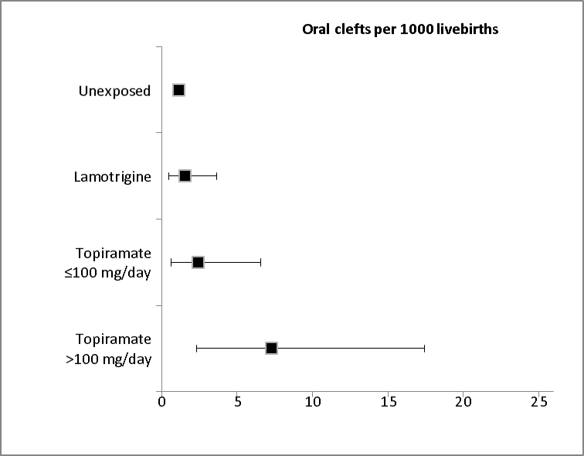
Replication: Topiramate
 | Unexposed | Lamotrigine | Topiramate
 | n = 1,322,955 | n = 2796 | n = 2425
Oral clefts
Prevalence (per 1,000) | 1.1 | 1.5 | 4.1
Unadjusted RR (95%CI) | Reference | N/A | 3.63 (1.95-6.76)
PS-Adjusted RR (95%CI) |  |  | 2.90 (1.56-5.40)
Unadjusted RR (95%CI) | N/A | Reference | 2.30 (0.69-7.64)
PS-Adjusted RR (95%CI) |  |  | 2.38 (0.71-7.96)
Hernandez-Diaz S, Huybrechts KF, Desai RJ, Cohen JM, Mogun H, Pennell PB, Bateman BT, Patorno E. Topiramate use early in pregnancy and the risk of oral clefts. A pregnancy cohort study. Neurology. 2017; 90(4):e342-e351.

Slide 85
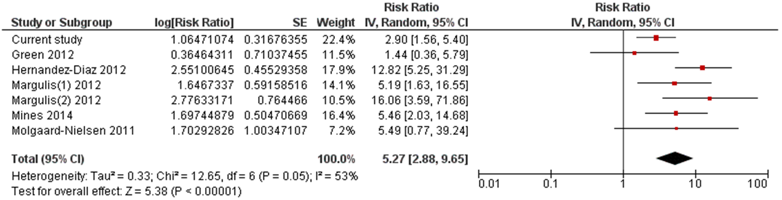
Replication: Topiramate
If pooled results represent the “truth”, the absolute risk of CL/P would increase from approximately 1 per 1,000 births to 5 per 1,000 births

Slide 86
Outline
Introduction to Drug Safety in Pregnancy
Tools Overview
Challenges & Solutions
Example
Future

Slide 87
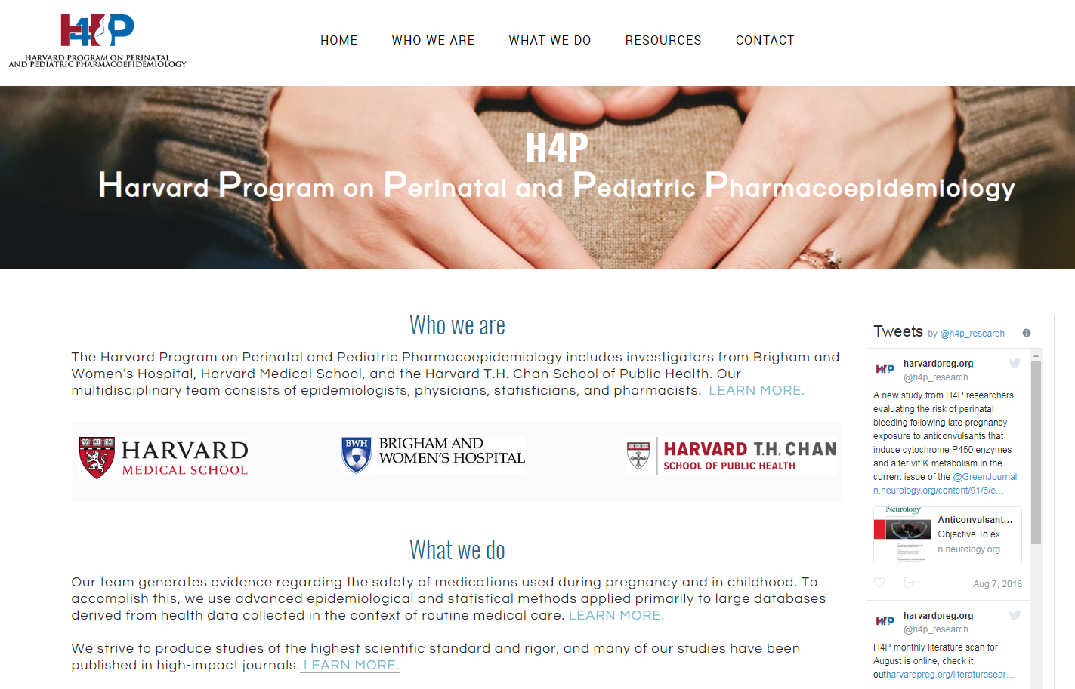
Harvard Program on Perinatal and Pediatric Pharmacoepidemiology
www.harvardpreg.org

Slide 88

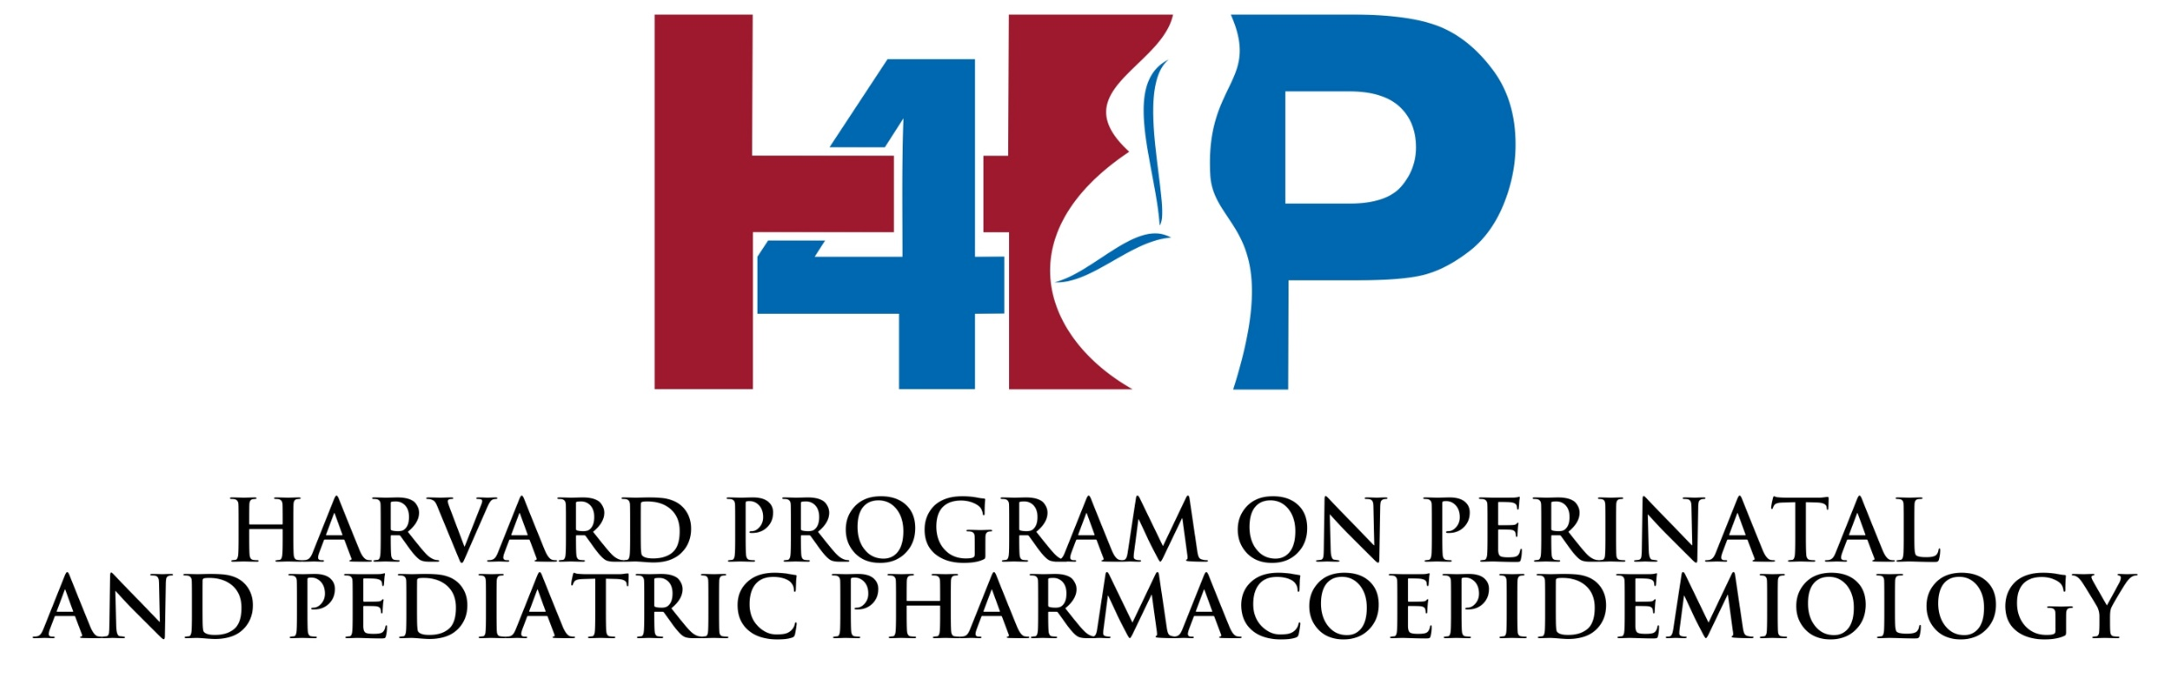




Sonia Hernandez-Diaz, MD, DrPH
Krista F. Huybrechts, PhD
Brian T. Bateman, MD, MSc
Professor, Dept. of Epidemiology,
Harvard Chan School of Public Health
Associate Professor of Medicine,
Brigham and Women's Hospital and Harvard Medical School
Associate Professor of Anesthesia,
Brigham and Women's Hospital and Harvard Medical School

Slide 89
Funding:
NIMH, NICHD, NIDA
AHRQ
FDA
Eli Lilly, GlaxoSmithKline,
Pfizer,
Shire (Takeda)
Research Activity:
>50 Publications
Book Chapters
Courses
Presentations
Students/Fellows/Trainees
http://www.harvardpreg.org/
Areas of interest
Pain (opioids)
Psychiatry / Neurology
Cardiovascular/Metabolic
Auto-immune disorders (MS, RA, IBD)
Diabetes
HIV
Asthma
Vaccines
Pediatrics
Methods

Slide 90
Funding:
NIMH, NICHD, NIDA
AHRQ
FDA
Eli Lilly, GlaxoSmithKline,
Pfizer,
Shire (Takeda)
Research Activity:
>50 Publications
Book Chapters
Courses
Presentations
Students/Fellows/Trainees
http://www.harvardpreg.org/
Outcomes
NAS
Fetal death
Preeclampsia
Maternal mortality
Gestational diabetes
Birth defects
Prematurity
Infections
Neurodevelopment
Validations

Slide 91
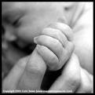
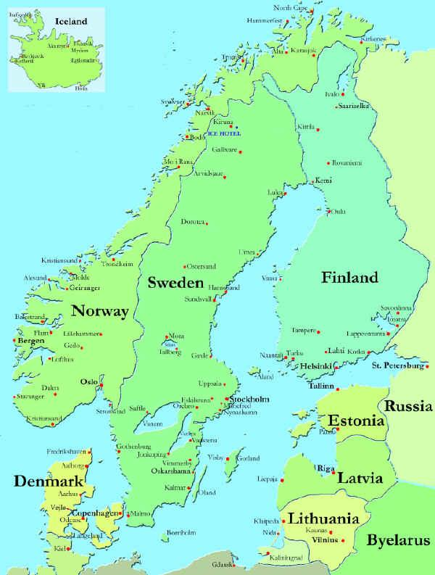
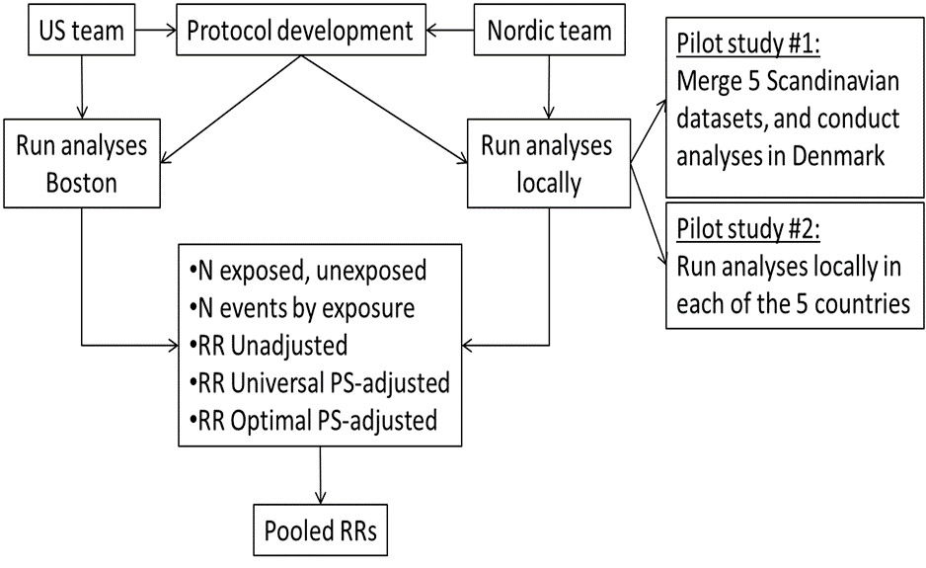
Future
Next level for less commonly used drugs: Big Data Pooling
We had a dream…
Identify Exposed Pregnancy Cohorts Nested in a multi-national collaboration of health care databases with demonstrated ability to study the safety of medications in pregnancy

Slide 92
Electronic health records | Claims database | Pregnancy Registry | Case-control
Prospective data recording |  | Prospective data if enrolled before outcome | Retrospective exposure information
Data exist (economy of cost and time) |  | Ad hoc collection takes time and $$ | Cheaper than a registry
Real world experience, stable population | Real world experience, dynamic population | Selected group of volunteers, limited follow up | Selected group of volunteers, limited follow up
Information on multiple drugs |  | Information on one, or few, drugs | Information on multiple drugs
Outpatient prescriptions | Usually outpatient filling of prescription | Real use, outpatient and inpatient, Rx and OTC | Real use, outpatient and inpatient, Rx and OTC
Information on multiple outcomes if recorded | Information on multiple outcomes if reimbursed | Information on outcomes of interest | Information on outcome of interest (e.g., birth defects)
Incomplete ascertainment of pregnancy losses |  | Incomplete ascertainment of pregnancy losses | Can ascertain pregnancy losses, mainly for cases
May have access to validation |  | Validation usually part of the design | Detailed outcome information
Comprehensive clinical information |  | Few key clinical factors collected in detail | Few key clinical factors collected in detail
Some information on socio-demographics | Little information on socio-demographics | Can collect information on socio-demographics | Can collect information on socio-demographics
May have laboratory data | May have laboratory data in subsample | May have laboratory data if collected | Can collect samples and laboratory data
Key characteristics may be missing, e.g., LMP (not always recorded), use algorithm. |  | Can collect key factors (e.g., gestational age, family history) | Can collect key factors (e.g., gestational age, family history)
Internal control groups allow CER |  | Some use external reference, few allow CER | Few allow for active comparators within indication
Large source population | Huge source population | Small populations | Efficient sample from large populations
No information on new drugs |  | Can target new drugs (need to recruit users) | New users have to deliver and be ascertained

Slide 93
Registries
Advantages
Prospective drug exposure information. No recall bias.
Concentrating on selected drugs can increase efficiency, particularly to study uncommon drugs in relation to common events.
Longitudinal. Can estimate risk and risk differences.
Assess real use through maternal interview.
Can study multiple exposures and multiple outcomes
Notes:
Self-referral bias generated by the small and potentially non-representative proportion of exposed women who volunteer the information.
Reference group. Most registries enroll only exposed women and compare the incidence of adverse events with estimates from surveillance systems or hospital-based samples, which has raised concerns about the comparability of the control group in terms of population characteristics and ascertainment methods
Under-ascertainment of adverse perinatal outcomes and losses to follow-up

Slide 94
Registries
Limitations
Non-representative (self-referral bias, volunteers).
Often lack control group (non-comparable external comparison groups).
Inefficient (cost and time).
Limited power.
Short follow up (cannot assess late development).
Left truncation. Enrollment late in pregnancy
Right truncation. Losses to follow-up (selective under-ascertainment)
Notes:
Self-referral bias generated by the small and potentially non-representative proportion of exposed women who volunteer the information.
Reference group. Most registries enroll only exposed women and compare the incidence of adverse events with estimates from surveillance systems or hospital-based samples, which has raised concerns about the comparability of the control group in terms of population characteristics and ascertainment methods
Under-ascertainment of adverse perinatal outcomes and losses to follow-up

Slide 95
Case-Control Studies
Advantages
Information on non-prescription drugs.
Assess real use.
Information on wide range of covariates.
Statistical power to study the risk of specific (uncommon) birth defects in relation to relatively common medications.
Notes:
Self-referral bias generated by the small and potentially non-representative proportion of exposed women who volunteer the information.
Reference group. Most registries enroll only exposed women and compare the incidence of adverse events with estimates from surveillance systems or hospital-based samples, which has raised concerns about the comparability of the control group in terms of population characteristics and ascertainment methods
Under-ascertainment of adverse perinatal outcomes and losses to follow-up

Slide 96
Case-Control Studies
Limitations
May be relatively slow to complete. Cost and time.
Rely on volunteer participation (under-represent minorities).
Need to identify a valid control group (e.g. malformed controls).
Need to obtain complete and unbiased drug exposure information
Notes:
Self-referral bias generated by the small and potentially non-representative proportion of exposed women who volunteer the information.
Reference group. Most registries enroll only exposed women and compare the incidence of adverse events with estimates from surveillance systems or hospital-based samples, which has raised concerns about the comparability of the control group in terms of population characteristics and ascertainment methods
Under-ascertainment of adverse perinatal outcomes and losses to follow-up

Slide 97
Healthcare Databases
Advantages
Population based. No control selection bias
Prospective drug exposure information. No recall bias
Information on a wide range of confounders
Efficient (cost and time)
Real clinical practice, not limited to volunteers
Longitudinal. Can estimate risk and risk differences
Can study multiple exposures and multiple outcomes
May have large sample size
Notes:
Self-referral bias generated by the small and potentially non-representative proportion of exposed women who volunteer the information.
Reference group. Most registries enroll only exposed women and compare the incidence of adverse events with estimates from surveillance systems or hospital-based samples, which has raised concerns about the comparability of the control group in terms of population characteristics and ascertainment methods
Under-ascertainment of adverse perinatal outcomes and losses to follow-up

Slide 98
Healthcare Databases
Limitations
Limited to prescription drugs
Assess prescription or dispensing ≠ real use (need sensitivity analyses)
Incomplete ascertainment of terminations (need sensitivity analyses)
Limited information on specific potential confounders, e.g. BMI (need sensitivity analyses)
Limited power when exposure & outcome are infrequent (need collaborations)
Relatively short follow up (explore feasibility of studying long-term consequences)
Notes:
Self-referral bias generated by the small and potentially non-representative proportion of exposed women who volunteer the information.
Reference group. Most registries enroll only exposed women and compare the incidence of adverse events with estimates from surveillance systems or hospital-based samples, which has raised concerns about the comparability of the control group in terms of population characteristics and ascertainment methods
Under-ascertainment of adverse perinatal outcomes and losses to follow-up

