Slide 1
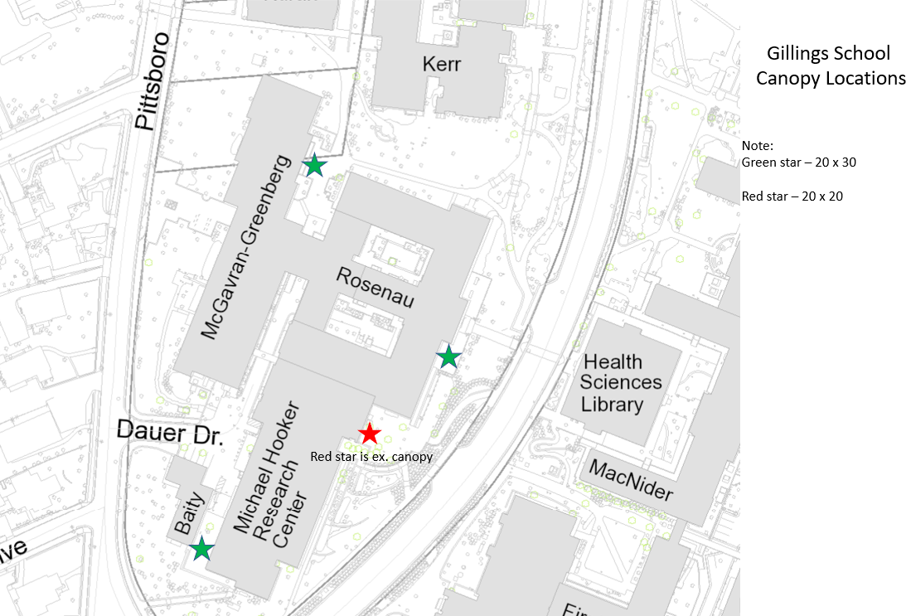
Canopies installed at every building

Slide 2
How to reserve outside spaces
New locations
SPH – Rosenau Hall – Patio North (ESOP side)
SPH – Rosenau Hall – Patio South (end closer to MHRC)
SPH – MHRC – Upper Patio (main entrance at tent)
SPH – MHRC – Lower Patio (outside of 0001 MHRC)
SPH – McGavran-Greenberg Hall – Court yard
Health Affairs Outdoor Theater (area with stone wall seats between Rosenau/MG and Kerr Hall)
Reservation instructions at https://sph.unc.edu/rooms/

Slide 3
Good things to know
Gillings Facilities Team
Contact us anytime
Sph_Facilities@UNC.EDU
https://sph.unc.edu/sph-facilities/

