Slide 1
Observational data, effectiveness,
and real-world evidence:
How do we get there from here?
David J. Graham, MD, MPH
Harry Guess Memorial Lecture
Gillings School of Global Public Health
University of North Carolina at Chapel Hill
April 24, 2019

Slide 2
Disclaimer
The opinions expressed are my own and are not necessarily
those of the US Food and Drug Administration or the
Department of Health and Human Services
No conflicts of interest to disclose

Slide 3
Pub Med citations with “real-world evidence” in title or abstract, by year

Slide 4
How did we get here?
  2006: IOM report – The Future of Drug Safety
    Identify ways to access health-related databases
    Create a public-private partnership to support safety/efficacy
  2007: Food and Drug Administration Amendments Act
    Section 905 – Establish a post-market risk identification and analysis system; link and analyze healthcare data from multiple sources (Sentinel Initiative)
  2010: Affordable Care Act
    Creation of PCORI, charged with promoting comparative effectiveness research, to improve patient outcomes
  2016: 21st Century Cures Act
    Section 3022 amends FD&C Act on use of RWE

Slide 5
The 21st Century Cures Act’s RWE provision
  Defines RWE: data regarding the usage, or the potential benefits or risks, of a drug derived from sources other than traditional clinical trials
  Requires FDA to establish a program to evaluate RWE
    1) To help support approval of new indications for approved drugs
    2) To help support or satisfy post-approval study requirements
  Imposes timeline for FDA implementation
    By Dec 2018, establish and implement an RWE framework
    By Dec 2021, issue draft guidance describing
      1) Circumstances under which sponsors of drugs may rely on RWE
      2) Acceptable standards and methods for collecting and analyzing RWE
  Section 3022 does not limit FDA’s use of RWE for other purposes or change the standards of evidence required under 505(c) and (d) of FD&C Act or 351(b) of the Public Health Service Act

Slide 6
For drug and biological products
Outlines FDA’s plan to implement its RWE program
Multifaceted program
  Internal processes
  Guidance development
  Stakeholder engagement
  Demonstration projects
https://www.fda.gov/downloads/ScienceResearch/SpecialTopics/RealWorldEvidence/UCM627769.pdf

Slide 7
Definitions from FDA’s RWE Framework
  Real-world data (RWD)
    Data relating to patient health status and/or the delivery of health care routinely collected from a variety of sources
  Real-world evidence (RWE)
    Clinical evidence about the usage and potential benefits or risks of a medical product derived from analysis of RWD

Slide 8
Potential Sources of RWD
  Medical claims
  Electronic health records
  International health care databases
  Product or disease registries
  Personal devices and health applications

Slide 9
Potential uses of RWD in clinical studies
  Randomized, interventional
  Non-randomized, interventional
  Non-randomized, non-interventional (observational)
    Prospective data collection
      Registry studies
      Prospective cohort studies
    Retrospective (existing data)
      Cohort studies
      Case-control studies

Slide 10
Traditional RCTs not considered RWE
  Research infrastructure is usually separate from routine clinical practice
  More likely to have restrictive eligibility criteria designed to maximize detection of a drug effect
  In addition to randomization, usually also double-blind
  Use separate procedures and/or personnel to collect specified data using standardized procedures
  Detailed case report forms that are separate from routine medical records
  Protocol-driven scheduled monitoring
  Efforts to ensure strict adherence to study procedures

Slide 11
Scope of FDA’s RWE Program
  Evaluates the potential use of RWE to support changes to labeling about drug product effectiveness, including:
    Adding or modifying an indication, such as a change in dose, dose regimen, or route of administration
    Adding a new population
    Adding comparative effectiveness or safety information

Slide 12
Criteria for evaluating the potential use of RWD/RWE in regulatory decision making
  Are the RWD fit for use?
  Can the study design used to generate RWE provide adequate scientific evidence to answer or help answer the regulatory question?
  Does the study conduct meet FDA regulatory requirements?

Slide 13
Fitness for use (1)
  Assessing data reliability
    Data accrual and structure
    Missingness
    Consistency over time (includes coding)
    Coded data adequately represent intended underlying medical concepts
    Quality control
  Assessing data relevance
    Captures clinical effectiveness outcomes that address specific regulatory questions
      “Hard” outcomes vs. disease exacerbations/progression
    Captures relevant data on exposure and covariates
    Coding accuracy
    International data?

Slide 14
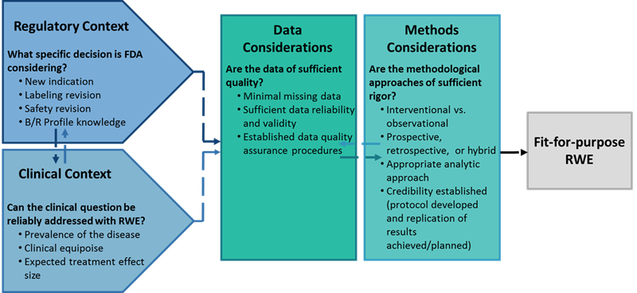
Fitness for use (2)
Source: Duke-Margolis Center for Health Policy white paper,
“A framework for regulatory use of real-world evidence,” 2017

Slide 15
Adequacy of study design to answer regulatory question (1)
  Randomized designs in routine clinical settings
    Quality of data captured
    Number of patients available
    Variations in clinical practice
    Bias control if blinding infeasible
  Non-randomized, single arm with external RWD control
    Is control population comparable
    Lack of standardized or equivalent outcome measures
    Variability in follow-up procedures

Slide 16
Adequacy of study design to answer regulatory question (2)
  Observational studies
    FDA’s Pharmacoepidemiology Guidance (for safety)
    Focus is on ability to draw reliable causal inference
      Characteristics of data
      Characteristics of study design and analysis
        Active comparator
        Unmeasured confounders
        Measurement variability
      Prespecified sensitivity analyses and statistical diagnostics
    Transparency
      Concern that studies can be conducted multiple times and in multiple databases, until desired result obtained

Slide 17
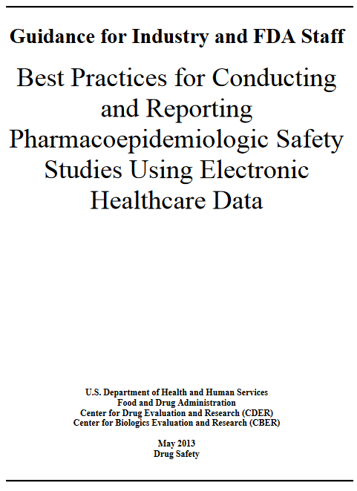
FDA’s Pharmacoepidemiology Guidance
Appropriateness of data source
Pre-specified study protocol and statistical analysis plan
Selection of study population – explicit inclusion and exclusion criteria
Exposure ascertainment
Outcome ascertainment – validation, linkage
Confounding adjustment
Sensitivity analysis - robustness
https://www.fda.gov/downloads/drugs/guidances/ucm243537.pdf.

Slide 18
Does study conduct meet FDA regulatory requirements
  Informed consent
  Oversight and monitoring
  Guidance on use of electronic source data
    Recommendations on capture, review, and retention of data
  Guidance on use of EHRs in clinical studies
    To ensure integrity of EHR data
  Draft guidance on procedures to ensure that electronic records are trustworthy, reliable
  Other potential future guidance documents

Slide 19
Potential FDA draft guidance documents on RWD/RWE
  How to assess whether RWD are fit for use to generate RWE in support of product effectiveness
  Considerations for using RWD in RCTs for regulatory purposes. Including pragmatic design elements
  Use of RWD to generate external control arms for single-arm trials
  Observational study designs and how they might provide RWE to support effectiveness in regulatory decision making
  Regulatory considerations raised by different study designs to generate RWE that are submitted to support product effectiveness

Slide 20
A recent example of RWE
Source: https://doi.org/10.1016/j.amjmed.2018.12.023

Slide 21
Methods (1)
Medicare fee-for-service claims data, 2010-2015
Inception cohort design
  New users of warfarin or a NOAC
  Standard NOAC doses only (73%-84%)
Age ≥ 65
≥ 6 months Medicare Parts A, B, D
Nonvalvular AF
No prior anticoagulant use
No diagnoses indicating valvular heart disease, VTE, or joint replacement in prior 6 months
Edoxaban use too low for study inclusion

Slide 22
Methods (2)
PS matched warfarin to pooled NOAC users
Adjusted using stabilized IPTW generated from multinomial logistic regression model
Variables included in PS model (n=112)
  Demographics
  Cardiovascular risk factors
  Bleeding risk factors
  Chronic medical conditions
  Rx medications
  Metabolic inhibitors
  Health care utilization & frailty
  Prescriber characteristics
  CHA₂DS₂-VASc and HAS-BLED scores

Slide 23
Dabigatran
n=86,198
Rivaroxaban
n=106,382
Apixaban
n=73,039
Pooled NOACs
n=265,626
Warfarin
n=523,264
PS matching
with replacement
Warfarin Dabigatran Rivaroxaban Apixaban
n=183,318 n=86,198 n=106,382 n=73,039
Unweighted
Multinomial logistic regression
Stabilized IPTW
Warfarin Dabigatran Rivaroxaban Apixaban
n=183,003 n=86,293 n=106,369 n=72,921
Weighted

Slide 24
Cohort follow-up
On-therapy; 3-day gap allowance
Censoring for:
  Disenrollment
  Any outcome event
  > 3-day gap in days supply
  Switch to another oral anticoagulant
  Dialysis or kidney transplant
  Admission to NH, SNF, or hospice care
  End of study period

Slide 25
Outcomes
  Thromboembolic stroke (PPV 88%-95%)
  Intracranial hemorrhage (89%-97%)
  Major extracranial bleeding* (87%)
  Death (linked to Social Security) (95%)
    1st event or within 30 days of a 1° outcome
* Hospitalized + requiring transfusion, resulting in death, or involving a critical extracranial site (modified ISTH definition)

Slide 26
Analysis
Cox PH regression
For each outcome, a single regression model
  Included independent variables for exposure to each of 4 study drugs
  Generated HR (95% CI) for each pairwise comparison of interest (n=6)
    NOAC vs. warfarin
    NOAC vs. NOAC
  All cohorts were simultaneously adjusted to the same standard and all subjects included in analysis
Sensitivity analyses: 14-day gap, study period post-apixaban approval, subset with 2+ Rxs, unweighted multivariable Cox, crude (unadjusted)

Slide 27
Study design: inception cohort, time-to-event
Medical covariates, medication use
Not in hospital, NH, SNF, hospice
Age ≥ 65
-183 d t₀ Up to 5 years
No oral anticoagulants
No valvular heart disease
No VTE, joint replacement
Censor: Switch, therapy gap, NH, hospice, SNF, dialysis/transplant, outcome, study end
Outcomes: Ischemic stroke, intracranial hemorrhage, major extracranial bleeding, death

Slide 28
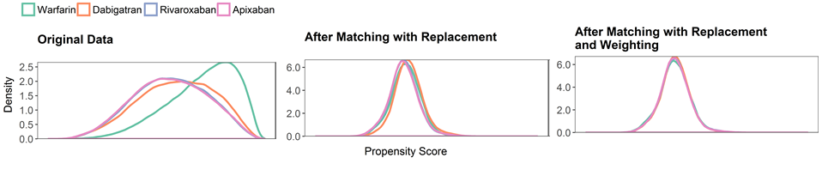
Propensity score distributions
(warfarin propensity scores only)

Slide 29
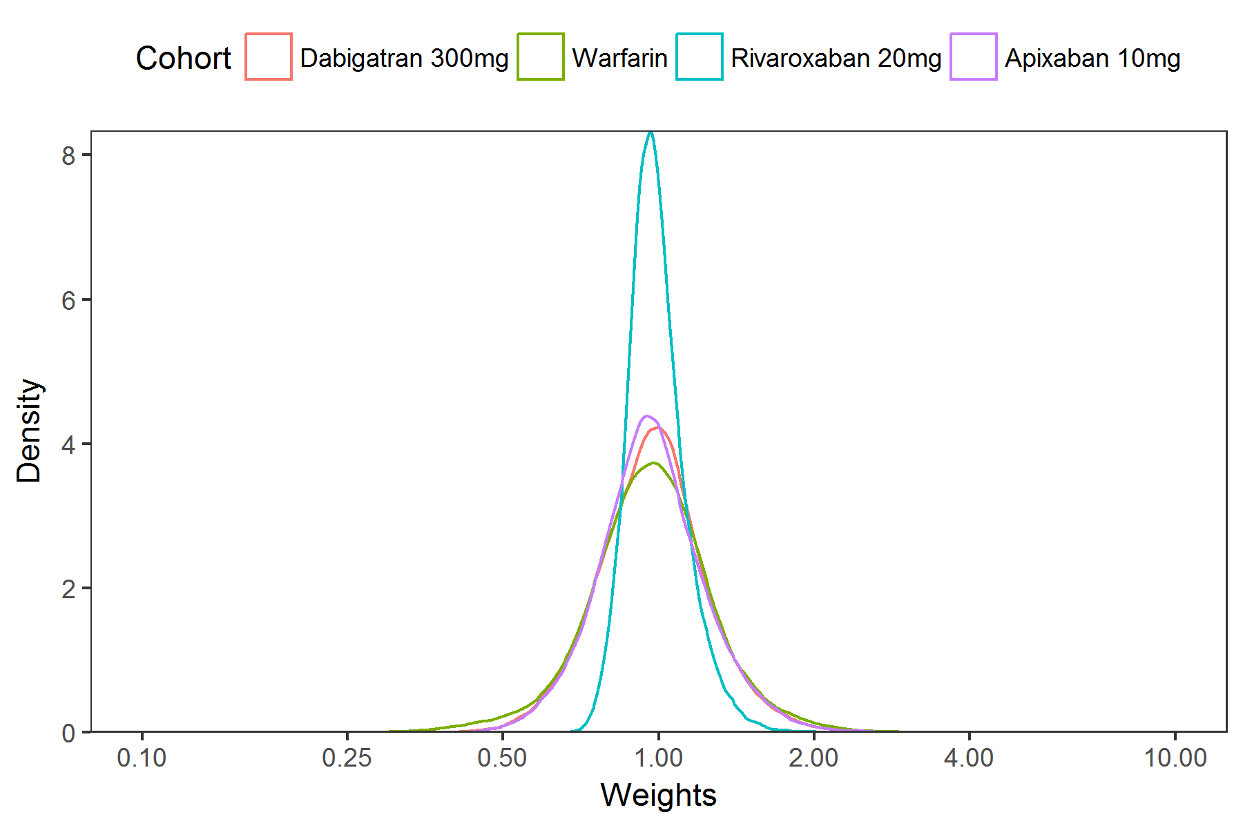
Distribution of AT-NOAC IPTWs
Cohort | Mean | Percentiles
 |  | Min | 50% | 99% | Max
Dabigatran 300mg | 1.00 | 0.41 | 0.97 | 1.81 | 4.25
Warfarin | 1.00 | 0.23 | 0.96 | 1.93 | 4.10
Rivaroxaban 20mg | 1.00 | 0.66 | 0.98 | 1.45 | 2.49
Apixaban 10mg | 1.00 | 0.41 | 0.96 | 1.80 | 3.19

Slide 30
Covariate balance across study cohorts: distribution of maximum standardized mean differences for each study covariate across six pairwise comparisons*
SMD range | Unweighted Unmatched | Matched Weighted
0.00 – 0.01 | 1 | 109
0.02 – 0.04 | 18 | 3
0.05 – 0.09 | 44 | 0
0.10 – 0.19 | 38 | 0
≥ 0.20 | 11 | 0
*D vs. W R vs. D
R vs. W R vs. A
A vs. W D vs. A

Slide 31
Cohort sizes and event counts
Warfarin n=183,318 | Dabigatran n=86,198 | Rivaroxaban n=106,389 | Apixaban n=73,039
 | Events (n)
Thromboembolic stroke | 1,595
Intracranial hemorrhage | 1,018
Major extracranial bleed | 4,379
All-cause mortality | 4,271

Slide 32
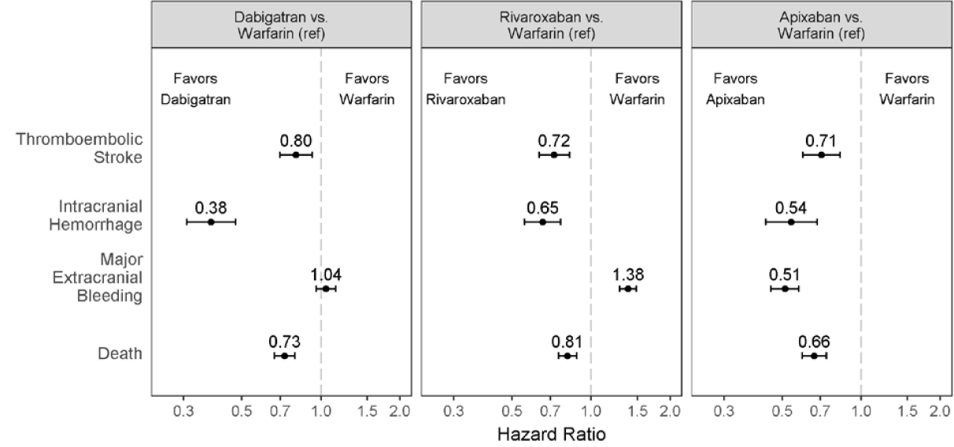
Adjusted hazard ratios (95% CI) for
NOAC vs. warfarin comparisons

Slide 33
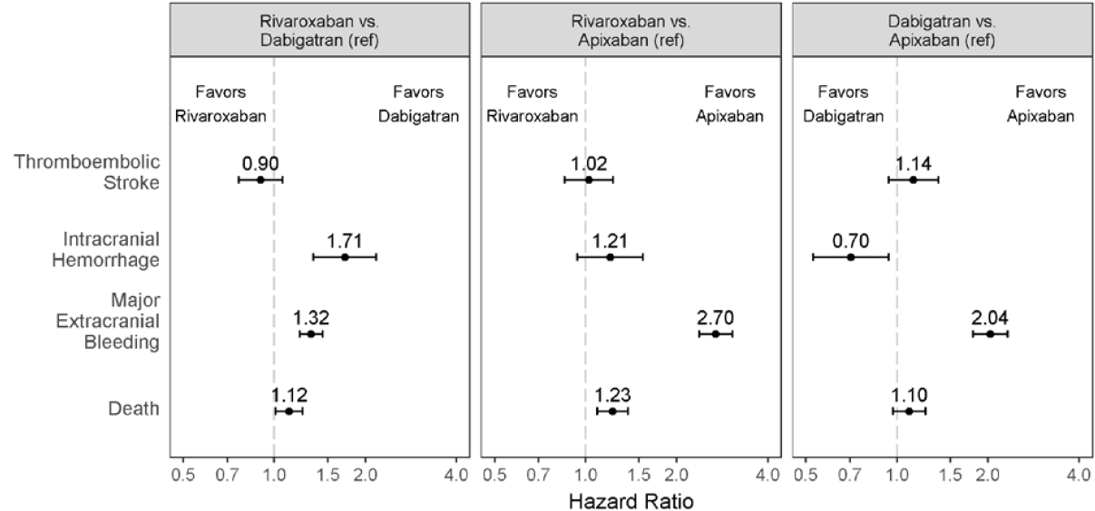
Adjusted hazard ratios (95% CI) for
NOAC vs. NOAC comparisons

Slide 34
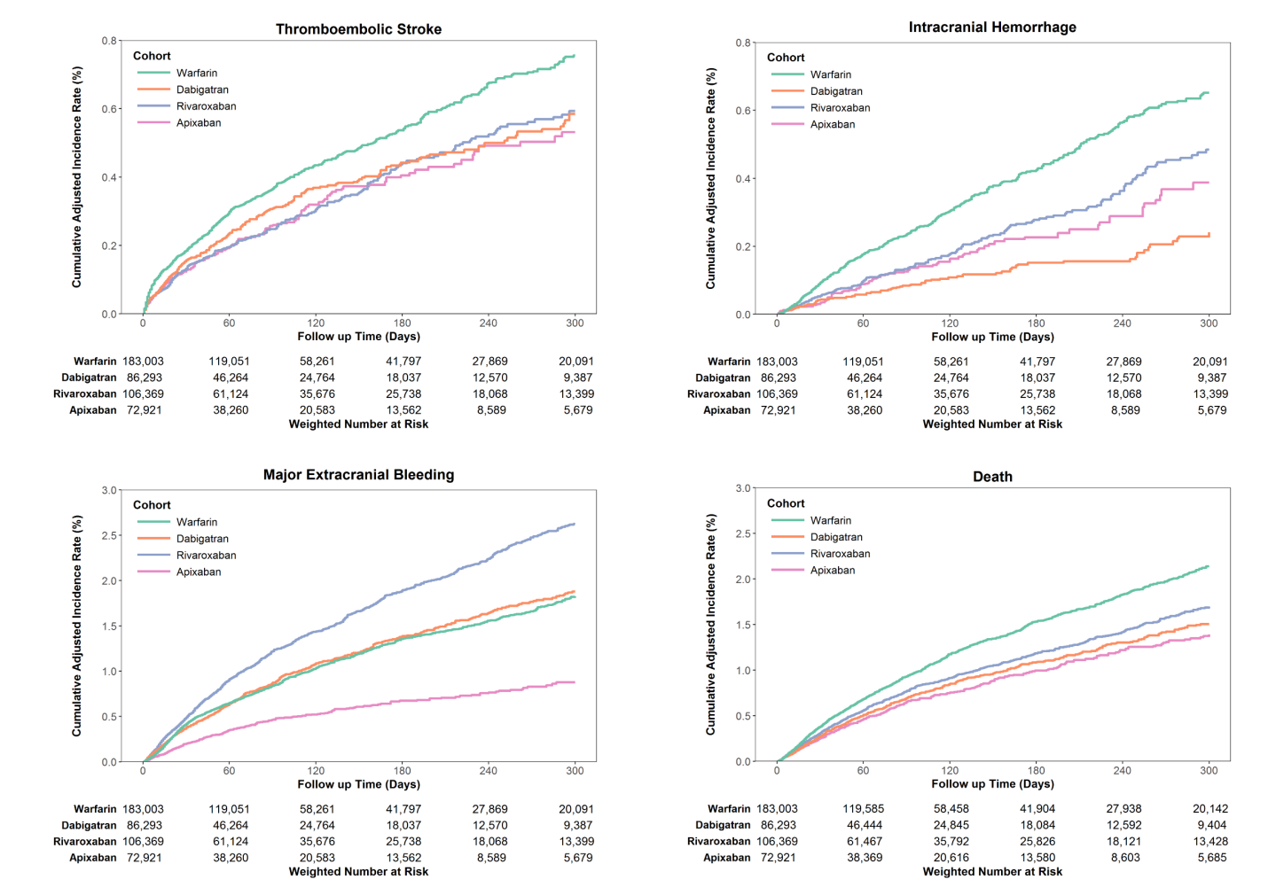
Kaplan-Meier plots

Slide 35
Sensitivity analyses
14 day gap allowance
Restricted to ≥ 2 dispensings
Restricted to post-apixaban approval
Multivariable regression
  Crude
  Adjusted
Post hoc (including most or all warfarin users)
  Multivariable adjustment
  Trimmed analyses
  Interacted splines analyses

Slide 36
Conclusions
NOACs have a more favorable benefit-harm balance than warfarin
Among NOACs, rivaroxaban has a less favorable benefit-harm balance than dabigatran or apixaban

Slide 37
Does this study constitute RWE upon which regulatory decisions can be made for effectiveness and safety?
More generally, could a claims-based observational study be used to support changes to labeling about a drug product’s effectiveness:
New indication
New population
Comparative safety or effectiveness

Slide 38
Substantial evidence (FD&C Act §505(d))
Substantial evidence of effectiveness required for FDA approval
“Evidence consisting of adequate and well-controlled investigations…by experts qualified by scientific training and experience to evaluate the effectiveness of the drug involved, on the basis of which it could…be concluded…that the drug will have the effect it purports”
In certain situations, data from one adequate and well-controlled clinical investigation and confirmatory evidence may be sufficient to establish effectiveness, and may be considered to constitute substantial evidence

Slide 39
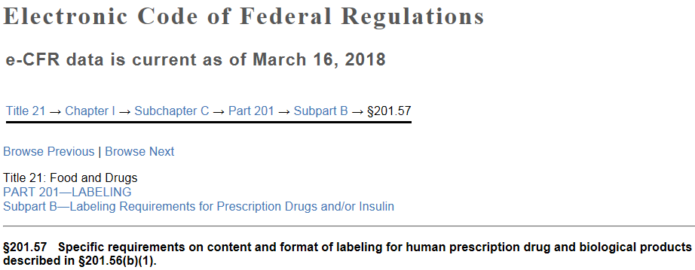
Comparative Claims §201.57 (c)F(iii)
(iii) Any statements comparing the safety or effectiveness of the drug with other agents for the same indication must, except for biological products, be supported by substantial evidence derived from adequate and well-controlled studies as defined in §314.126(b) of this chapter unless this requirement is waived under §201.58 or §314.126(c) of this chapter. For biological products, such statements must be supported by substantial evidence.

Slide 40
“Adequate and well-controlled” studies (21CFR 314.126)
Prespecified protocol with description of objectives, study design, method of treatment assignment, methods to minimize bias, and methods of analysis
Design permits valid comparison with a control
Subjects have the disease or condition being studied
Method of assigning patients to treatment and control groups minimizes bias and is intended to assure comparability of groups for pertinent variables (e.g., severity/duration of disease, other drugs)
Adequate measures to minimize bias of subjects, observers, analysts
Methods of assessment of subjects’ response well-defined, reliable
Analysis is adequate to assess effects of drug

Slide 41
Reality check
FDA just released its RWE framework—much work to be done, many questions to be resolved
  Can observational studies qualify as “substantial evidence”?
  Assuming the answer is “yes,” what are the necessary characteristics of an “adequate and well controlled” observational study?
  How many AWC observational studies are needed to support an effectiveness claim?
    Can multiple studies (some AWC others not), together, constitute substantial evidence?
  Which product labels would be affected?
    Where in label to place safety claims, effectiveness claims?
    How should claims be phrased?

Slide 42
Let’s play “devil’s advocate” (1)
(Why might FDA question this study?)
Some results differed from those of pivotal RCTs
  Protective effect for all-cause mortality
  Protective effect for thromboembolic stroke
  Differences in INR management between RCTs and community-based care
Matching warfarin with NOAC users excluded 65% of warfarin users
  Impact on generalizability
Potential unmeasured confounding
  Warfarin vs. NOAC
  NOAC vs. NOAC?
Reliance on validated outcome algorithms
  Should sample or all outcomes be confirmed? How?
Treatment persistence--bias and informative censoring

Slide 43
On-treatment persistency
Notes:
AC_2010_2015_Persistency_Matched_16Feb2017

Slide 44
Let’s play “devil’s advocate” (2)
(Why else might FDA distrust observational studies?)
Unmeasured confounding (can’t be repeated enough)
Bias
Study integrity (planning, conduct, analysis)
Outcome ascertainment (how defined, sensitivity, PPV)
Concern that studies can be conducted multiple times and in multiple databases, until desired result obtained
Heterogeneity of results across different studies
False positives and false negatives

Slide 45
Heterogeneity of treatment effects across databases
(PS-stratified new user cohort studies)
43% with I² ≥ 75%
21% with “significant”
positive and negative
results
Source: Madigan et al. Am J Epidemiol 2013; 178(4):645-651

Slide 46
Heterogeneity within the same database
3rd generation oral contraceptives and VTE risk (GPRD)
Oral bisphosphonates and esophageal cancer (GPRD)
Lower extremity amputation risk with SGLT2 inhibitors vs. DPP4 inhibitors or sulfonylureas (MarketScan)
 | SGLT2 inhibitors vs.
 | DPP4 inhibitors | Sulfonylureas
Dawwas et al. | 0.88 (0.65-1.15) | 0.74 (0.57-0.90
Yang et al. | 1.69 (1.20-2.33) | 1.02 (0.69-1.55)
Source:
Dawwas et al. Diab Obes Metab 2018. doi: 10.1111/dom.13477
Yang et al. Diab Obes Metab 2019. doi: 10.1111/dom.13647

Slide 47

Rumpelstiltskin
Source: Anne Anderson (illustrator), Grimm’s Fairy Tales (1922)

Slide 48
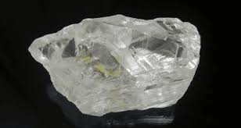

Diamond in the rough
Hope diamond

Slide 49
