Slide 1
Chartfield Foundations- Unit #5 -Additional Chartfields
This is the fifth of a 5-unit module that explores the new ConnectCarolina chartfield structure.
Note: this presentation is designed for ConnectCarolina users in SPH only as it is customized for SPH-specific chartfields.
This presentation is best viewed on a device with a screen resolution of at least 1280x960.

Slide 2
#5. Additional Chartfields
After completing this unit, learners will:
Understand when the Additional Chartfields are required on a transaction and what information is captured.
Understand that missing Additional Chartfields will result in an error.
Understand how Optional Chartfields might be used.

Slide 3
Core Chartfields-Recap
We have covered the five core chartfields over the past 4 units:
These Core Chartfields are required on each and every transaction and answer many questions about each transaction:
Business Unit: Which legal entity is spending the money? UNCCH for all departmental transactions.
Department: Which department is spending the money?
Fund: Which major fund group is being used and for what purpose?
Source: What specific source of funding is being used?
Account: What is the accounting classification of items in the transaction?
Business Unit
Department
Fund
Source
Account

Slide 4
Additional and Optional Chartfields
For certain transactions pertaining to grants and contracts, three Additional Chartfields are required.
Finally, four Optional Chartfields may be used on any transaction.
We will go over both of these groups of chartfields.
PC Bus Unit
Project ID
Activity
Program
Cost Code 1
Cost Code 2
Cost Code 3

Slide 5
Additional Chartfields
Below are three Additional Chartfields required for each transaction line involving a grant or contract.
Source for grants and contracts ranges from 49000 to 49999 and represents the type of funding agency giving the grant.
Unlike other types of funding, the Source for grants and contract don’t act as a unique identifier.
Unique grant or contract information is instead captured in the Additional Chartfields.
PC Bus Unit
Project ID
Activity

Slide 6
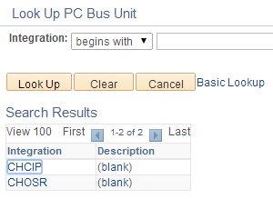
Additional Chartfields
For every transaction involving a grant, Additional Chartfields are required as follows:
PC Bus Unit
The PC Business Unit will be CHOSR for each grant-related transaction. This chartfield indicates the transaction falls into the activities of the Office of Sponsored Research (OSR).
Searching for the appropriate PC Business Unit is easy. The results list only has two items:
CHCIP (capital improvement projects)
CHOSR.
In all cases, select CHOSR.

Slide 7
Additional Chartfields
For every transaction involving a grant, Additional Chartfields are required as follows:
Project ID
Project ID is the unique grant identifier. It is a 7-digit code that begins with a 5. The Project IDs will look familiar to the old grant accounts in FRS. For example:
Old FRS Grant
5-32267
New Project ID
5032267
Old FRS Grant
5-46890
New Project ID
5046890
All old FRS grants will retain their similar number. New grant numbers will then be assigned incrementally.

Slide 8
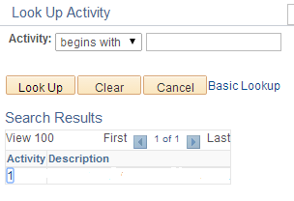
Additional Chartfields
For every transaction line involving a grant, the Additional Chartfields are required as follows:
Activity
Activity is the last required additional chartfield when working with contracts and grants.
In all cases, the Activity will be the number 1.
Even if you forget what this chartfield should be, the lookup will only have one result: 1.

Slide 9
Additional Chartfields
Since the Core Chartfields are required on all transactions, and Additional Chartfields are required for all grant transactions, all grant-related transactions will have 8 chartfields. For example:
Business Unit
Department
Fund
Source
Account
UNCCH
460502
25210
49000
511120
PC Bus Unit
Project ID
Activity
CHOSR
5030566
1
This chartfield string indicates the transaction was made within the university by CEHS using grant funds for organized research from a Federal agency, the CEHS Administrative Core, to pay for EPA Non-Teach salaries.

Slide 10
Additional Chartfields
Here is another example:
Business Unit
Department
Fund
Source
Account
UNCCH
464001
25210
49100
511170
PC Bus Unit
Project ID
Activity
CHOSR
5044806
1
This chartfield string indicates the transaction was made within the university by Health Behavior using grant funds for organized research from an Educational & Research Institution, “Tobacco Control in a Rapidly Changing Media Environment,” to pay for Student monthly salaries.

Slide 11
Additional Chartfields
All existing grants will be listed in the Departmental Quick Reference Card.
When the system detects a fund beginning with 252XX, which indicates that the transaction involves a contract or grant, it will be waiting for the information in the Additional Chartfields.
If you enter a Fund of 252XX but neglect to enter the Additional Chartfields, you will run into a combo-edit error which will need to be fixed before you can move on.
Business Unit
Department
Fund
Source
Account
252XX
PC Bus Unit
Project ID
Activity

Slide 12
Optional Chartfields
There are four Optional Chartfields. These may be used on any transaction but they are truly optional and may be skipped if appropriate.
The Optional Chartfields are available to assist schools and departments to capture financial information in the way it is useful.
Program
Cost Code 1
Cost Code 2
Cost Code 3

Slide 13
Optional Chartfields
The Optional Chartfields are available to assist schools to capture financial information in the way it is useful:
Program
The Program chartfield is used by certain areas such as the College of Arts & Sciences, School of Medicine and in some cases, the Provost’s Office to capture programmatic information.
SPH has decided not to roll out this chartfield at this time. In almost all instances, you can leave this blank.
Since the Program is optional, however, it will always be available for entry – be careful not to accidentally populate it or you may run into errors.
The Program will only be required in rare cases that involve funding from the Provost and should that occur, you will be provided with the code.

Slide 14
Optional Chartfields
The Optional Chartfields are available to assist departments to capture financial information in the way it is useful to each department:
Cost Code 1
The 3 Cost Code chartfields are all similar in nature. These enable you to track costs across funding types and by categories that run across accounts.
For example, you may want to track the total cost of a conference which may involve spending from both F&A and a university trust in various accounts.
By coding all event-related transactions to a cost code you will be able to easily report on the aggregate costs for that event.
This functionality is similar to how Infoporte may be used today.
Cost Code 2
Cost Code 3

Slide 15
Optional Chartfields
The Optional Chartfields are available to assist departments to capture financial information in the way it is useful to each department:
Cost Code 1
Cost codes cannot be created in an ad hoc manner. All cost codes must be uploaded into the system before they can be used.
Cost codes are also set up in a specific cost code field. A cost code that is set up in Cost Code 1 will not be found in the Cost Code 2 or Cost Code 3 lists.
Each department uses Cost Codes differently. Please talk to your business manager to understand how your department has chosen to use them.
Cost Code 2
Cost Code 3

Slide 16
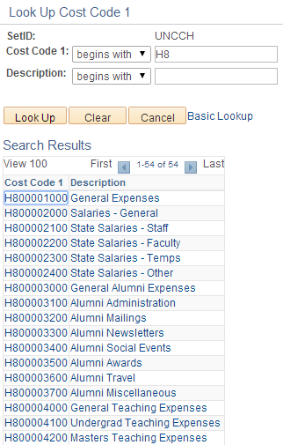
Optional Chartfields
The Optional Chartfields are available to assist departments to capture financial information in the way it is useful to each department:
Cost Code 1
All SPH Cost Codes begin with “H”.
The second digit of the Cost Code will represent your department. If you know this digit, you will be able to search for the cost codes.
Cost Code 2
Cost Code 3
In this example, the search was for all cost codes that begin with “H8”.

Slide 17
Chartfield Foundations
Congratulations! You’ve completed the final unit of Chartfield Foundations.
The new chartfields will require time to digest. Don’t worry about memorizing codes. Resources will be provided to facilitate your work.
Please continue the presentation to take the summary test. Your answers will be kept anonymous and only reviewed in aggregate to see which areas may need additional training.
Business Unit
Department
Fund
Source
Account

